Slide 1

Liability Management
The Borrow Smart Conversation™
What the heck is that?
Notes:
7 Steps Advisor Conversation
Before the conversation: do a lot of prep work to understand who they are. Their interest, kids, college attended, etc. Type of practice and clientele.
Thank them for taking the time to meet.” I have no idea if there is a reason for us to work together. However, if you have time for a few questions I think we can discover quickly if there is value to us getting to know each other.”
What is most important to you when working with outside professionals who may assist you or your clients?
Is there anything else that is important to you that stands out?
What concerns might you have with outside advisors?
Anything else that I should know?
Our firm and planning are focused on Liability Management.
Do you have anyone managing liabilities for your clients currently or do you help them?
How do you handle/involve or consider real estate in your financial planning practice?
Are you familiar with mortgage planning/Liability Management?
Do you advise your clients on repayment strategies for debts they take on?
Depending on where it goes. At this point you have likely worked the fact that we solve the same issues they do but from the liability side of the balance sheet. The eligibility versus suitability conversation can be worked into this dialogue.
What challenges have you heard from your clients recently?
Do you have a client where a mortgage is getting in their way of retiring or causing a problem in their retirement?
Do any of your clients struggle to hit their cash flow or savings goals?
Other positioning questions
How often do you meet with your clients? This question is designed to understand the advisor's client engagement frequency and opens the door to discussing opportunities where you could provide value during these interactions.
What percentage of your clients own a house?
What percentage of your clients have a mortgage?
Would you be open to having me look at some of your client scenarios to see what I might recommend for them?
Could you send me just the liabilities of a client (with no name) so I can show you a sample of what I can do for them?
On the next three clients you meet with, would you be willing to share their mortgage and debt information so I can provide some insights?
Based on the client's mortgage details you provide, I can offer questions you could ask them, to help uncover needs the client may not have articulated yet.
I'll also provide analysis and recommendations based on the information you share, showcasing various mortgage strategies. that can complement your advice.

Slide 2

Financial Planning from the Liability Side of the Balance Sheet

Slide 3
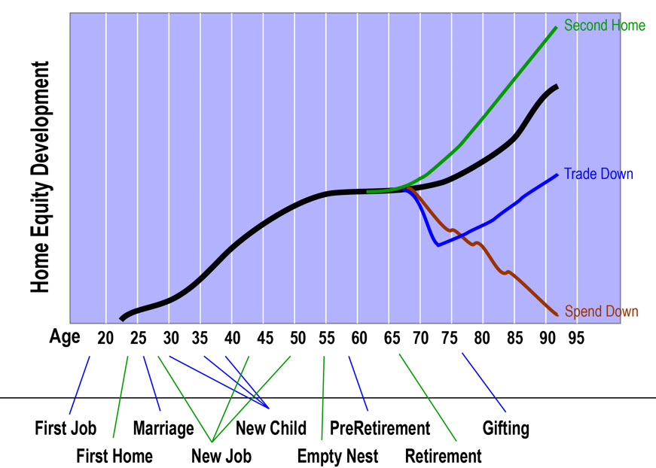

Slide 4
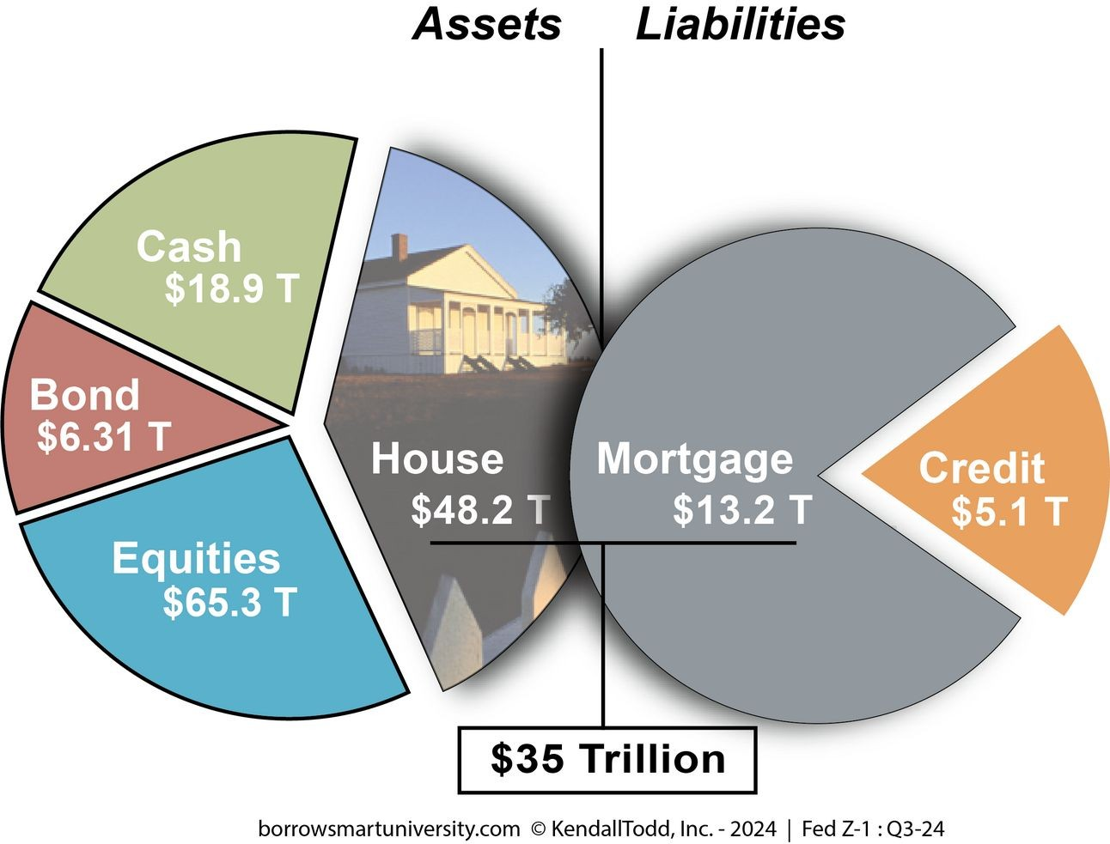

Notes:
7 Steps Advisor Conversation
Before the conversation: do a lot of prep work to understand who they are. Their interest, kids, college attended, etc. Type of practice and clientele.
Thank them for taking the time to meet.” I have no idea if there is a reason for us to work together. However, if you have time for a few questions I think we can discover quickly if there is value to us getting to know each other.”
What is most important to you when working with outside professionals who may assist you or your clients?
Is there anything else that is important to you that stands out?
What concerns might you have with outside advisors?
Anything else that I should know?
Our firm and planning are focused on Liability Management.
Do you have anyone managing liabilities for your clients currently or do you help them?
How do you handle/involve or consider real estate in your financial planning practice?
Are you familiar with mortgage planning/Liability Management?
Do you advise your clients on repayment strategies for debts they take on?
Depending on where it goes. At this point you have likely worked the fact that we solve the same issues they do but from the liability side of the balance sheet. The eligibility versus suitability conversation can be worked into this dialogue.
What challenges have you heard from your clients recently?
Do you have a client where a mortgage is getting in their way of retiring or causing a problem in their retirement?
Do any of your clients struggle to hit their cash flow or savings goals?
Other positioning questions
How often do you meet with your clients? This question is designed to understand the advisor's client engagement frequency and opens the door to discussing opportunities where you could provide value during these interactions.
What percentage of your clients own a house?
What percentage of your clients have a mortgage?
Would you be open to having me look at some of your client scenarios to see what I might recommend for them?
Could you send me just the liabilities of a client (with no name) so I can show you a sample of what I can do for them?
On the next three clients you meet with, would you be willing to share their mortgage and debt information so I can provide some insights?
Based on the client's mortgage details you provide, I can offer questions you could ask them, to help uncover needs the client may not have articulated yet.
I'll also provide analysis and recommendations based on the information you share, showcasing various mortgage strategies. that can complement your advice.

Slide 5
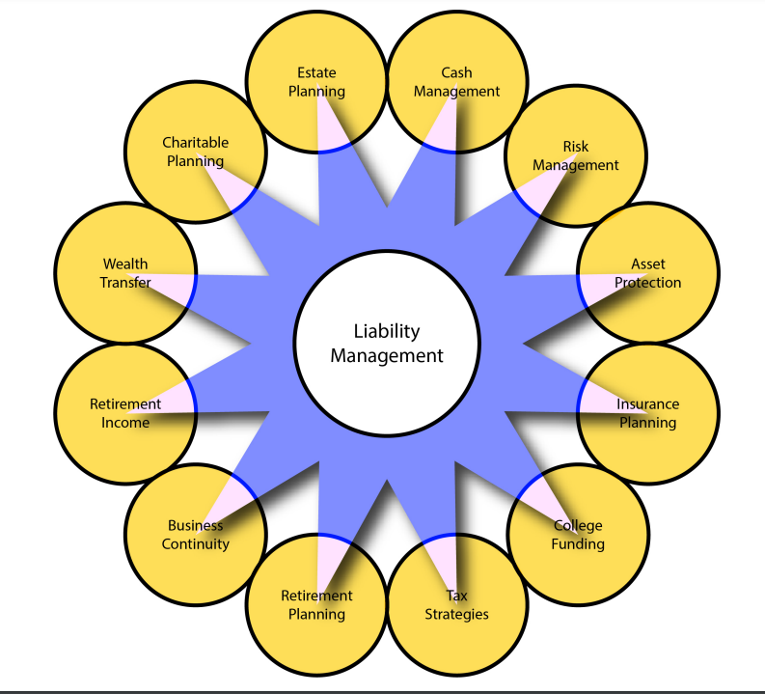
Growing Wealth Problems
Notes:
7 Steps Advisor Conversation
Before the conversation: do a lot of prep work to understand who they are. Their interest, kids, college attended, etc. Type of practice and clientele.
Thank them for taking the time to meet.” I have no idea if there is a reason for us to work together. However, if you have time for a few questions I think we can discover quickly if there is value to us getting to know each other.”
What is most important to you when working with outside professionals who may assist you or your clients?
Is there anything else that is important to you that stands out?
What concerns might you have with outside advisors?
Anything else that I should know?
Our firm and planning are focused on Liability Management.
Do you have anyone managing liabilities for your clients currently or do you help them?
How do you handle/involve or consider real estate in your financial planning practice?
Are you familiar with mortgage planning/Liability Management?
Do you advise your clients on repayment strategies for debts they take on?
Depending on where it goes. At this point you have likely worked the fact that we solve the same issues they do but from the liability side of the balance sheet. The eligibility versus suitability conversation can be worked into this dialogue.
What challenges have you heard from your clients recently?
Do you have a client where a mortgage is getting in their way of retiring or causing a problem in their retirement?
Do any of your clients struggle to hit their cash flow or savings goals?
Other positioning questions
How often do you meet with your clients? This question is designed to understand the advisor's client engagement frequency and opens the door to discussing opportunities where you could provide value during these interactions.
What percentage of your clients own a house?
What percentage of your clients have a mortgage?
Would you be open to having me look at some of your client scenarios to see what I might recommend for them?
Could you send me just the liabilities of a client (with no name) so I can show you a sample of what I can do for them?
On the next three clients you meet with, would you be willing to share their mortgage and debt information so I can provide some insights?
Based on the client's mortgage details you provide, I can offer questions you could ask them, to help uncover needs the client may not have articulated yet.
I'll also provide analysis and recommendations based on the information you share, showcasing various mortgage strategies. that can complement your advice.

Slide 6


Consumer Goals
Paying down debt (58%)
Saving more money (53%)
Avoiding further debt (42%)
Saving for vacation (31%)
Opening a retirement account, or ramping up contributions to an existing one (28%)

Slide 7

The Reality
…75 percent of Americans manage their own finances, with no help from a professional or online service…
Only 17 percent said they use a financial advisor.
…workers are living paycheck to paycheck and not even half of all adults would be able to cover an unexpected $1,000 expense, the majority of Americans are declining any financial help or advice.

Slide 8

The Borrow Smart Solution
“…how you handle the purchase (financing) of your home will have far-reaching implications on virtually every facet of your financial life, including your ability to save, pay for college and plan for retirement.”
– Ric Edelman, Financial Planner

Slide 9
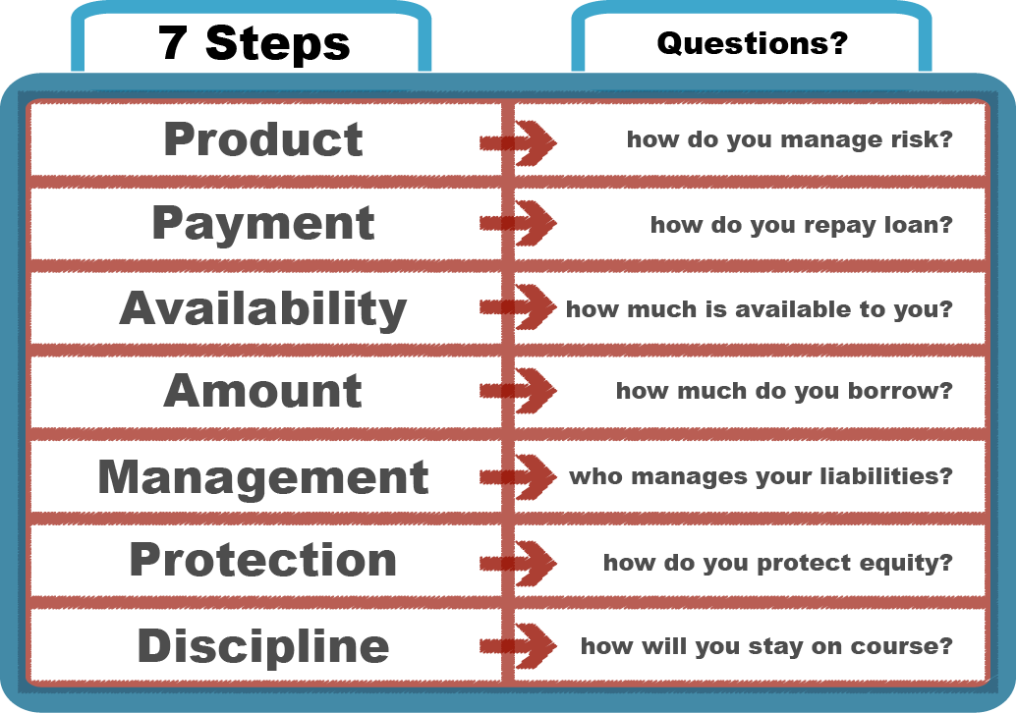
7 Steps to the Right Mortgage
These questions lead to the correct mortgage taking into account both short and long-term financial goals.
Blended with a financial plan will lead to better outcomes.
Notes:
7 Steps Client Conversation
Why are you XXXXX - so that is the most important thing to you – what else is important?
Are there any other goals that are important to you – ask Twice
What’s your biggest concern?
Anything else?
If there is only one thing you want to discover in our time together today, what would that be?
There are seven questions that I would want you to be able to answer. For now, I am going to focus on just four of them. The reason I go through these questions is to make sure that I am the right fit for you and if not then I will get you to the right person.
I assume you have heard of different types of mortgages, right? We want to look at the right product that helps you manage RISK – there are lots of mortgage products, but we want to focus on the ones that fit your RISK profile
What is your strategy for repaying the loan? How you choose to repay the loan over time has everything to do with your financial success. Have you given any thought to this?
How much mortgage is available to you and how much do you have available for this transaction? Lenders focus on eligibility, income, assets, credit to determine how you can borrow. That is an important part of the process. However, the most important part is determining what mortgage amount is most suitable for you. Which leads us to the fourth question.
How much do you Borrow? You see, financial advisors work in the world of suitability and our planning is designed to align to match the suitability of your other financial plans.
Following this planning process, from determining the suitable mortgage amount, while also confirming how much mortgage is available to you, then helping you develop your repayment strategy and getting you into the correct product and structure that will help you manage risk over time.
There are three other questions in our process, but I want to see how all this sounds so far?
Before we get into the numbers, I just want to make sure that this is what you are looking for and that going through our process would be valuable to you.
I've been through some advanced financial training that most lenders in our industry have not invested the time or money into..."

Slide 10
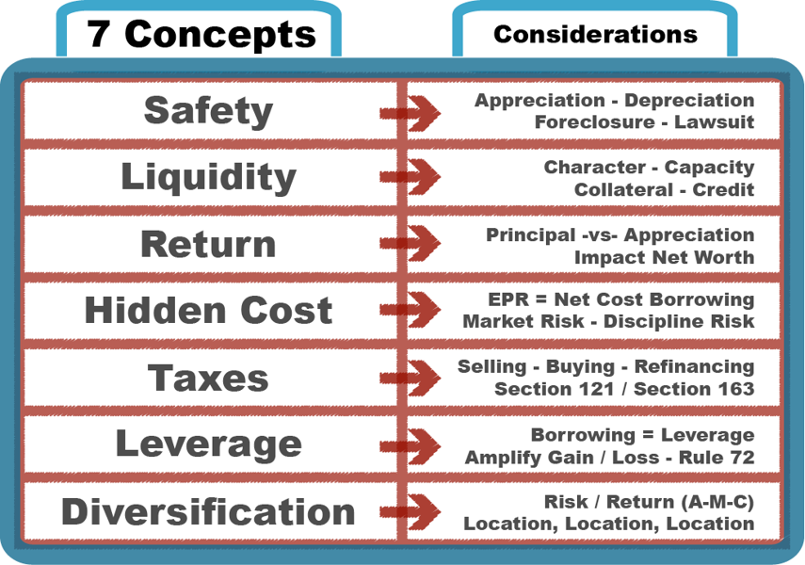
A Unique Process
Understanding how key financial planning concepts can be applied to residential real estate and the management of cash and liabilities.

Slide 11
Let’s Start with a Quiz
A large down payment will save me more money than a small down payment?
True
False
A 15-year mortgage will save me more money over time than a 30-year mortgage?
True
Making an extra principal payment saves me money?
True
The interest rate is the main factor determining the cost of my mortgage?
False
False
True
False

Slide 12

Perspective ‘House –vs– Home’
House –
Appreciation
Tax Benefits
Diversification
Collateral
Place to Work
Leverage
Credit
Mortgage
Home –
Family
Hobbies
Friends
Neighbors
Relaxation
Privacy
Freedom
Security
Rational – the house as
a physical shelter.
Emotional - experience
you have in a house.

Slide 13
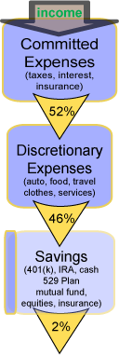



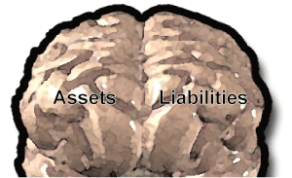

Your Cash Flow (over time)
How might our managing your liabilities help us increase your assets?

Slide 14
Impact Cash Flow
Cash Flow Found | Used to Payoff 30-year Mortgage* | Used for 30 Years of Investing**
$150 mo. | 21.5 years | $182,996
$250 mo. | 18.5 years | $304,993
$350 mo. | 16 years | $426,990
$450 mo. | 14.5 years | $548,987
$550 mo. | 13 years | $670,984
$750 mo. | 11 years | $914,978
$1,000 mo. | 9 years | $1,219,971
* (Assumes 30-year fixed mortgage, 7% interest rate) **(Assumes 7% after-tax rate of return)

Slide 15

Key Question
– how does the house compare
to other investments?
Safety
Liquidity
Return
Notes:
Each couple has the same goal: having their house paid off. They each believe their method is best.
The first couple is the Free-n-clears. They have paid off their mortgage. So, they do not have to make any monthly mortgage payments. Their house is worth $300,000 and they took $300,000 and put the money in the house. Here is your $300,000, I would like for you to put it in the house. Thanks
The second couple is the Pay-Extras. They make extra principal payments every month in hopes of paying their mortgage off as soon as possible. From time to time I am going to give you some money and you are going to put your money in the house until you get it paid off. Got it.
The third couple is the Owe-it-Alls. They could have paid cash for their house like the Free-n-clears—but decided to keep their money and invest it in a “safe account” so they could access it in case they ever needed to. Although they “owe it all” on their mortgage—they have no other debt. So here is your $300,000 and I want you to put the money in your safe.
Who would like to be the Free-n-clears? Who would like to be the Owe-it-alls? These two couples represent both ends of the extreme. Most of us were not able to pay cash for our house like the Free-n-clears but if we had the money we would. Obtaining a 100% mortgage loan like our Owe-it-alls may not be possible in today’s mortgage world but you understand their position. So which of these couples do you think is in the best position? Let’s explore several mortgage aspects to find out how they impact our couples:

Slide 16

Safety
– the risk of loss of your money.
There are four obvious threats to wealth in the house;
Safety
Lawsuit
Foreclosure
Depreciation
Appreciation
and one general threat
to building wealth that may help some borrowers.
Notes:
Text here… on Safety.
If you meet with us individually, we’ll explain a simple strategy we use to better protect you from all 5 of these key threats.

Slide 17

Liquidity
Cash
Bonds
Stocks
Immediate access up to your available balance.*
Insurance
Quick access
– to your available cash balance**
House
Equity
Sell (60 – 240) days
Borrow (30 - 60) days***
– the use and control of your money.
How can money inside the house be accessed?
    Sell
    Borrow***
*Possible marketing timing losses could occur, **Subject to the terms of your insurance contract, ***subject to qualification

Slide 18

Return
– the growth of your money over time.
Money inside a
house can increase
in only two ways:
  Appreciation (market)
  Principal (you)
Return
Opportunity Cost
EPR™
Principal
Appreciation

Slide 19

Return - $80,000 (with appreciation and principal)
$400,000 purchase price
$320,000 mortgage loan
Interest Rate: 4% (30-year fixed amortizing)
Appreciation: 4% (annual)
 | Day 1 | 5 Years | 15 years | 30 years
House Value | $400,000 | $486,661 | $720,377 | $1,297,359
Mortgage Balance | $320,000 | $289,432 | $206,537 | $0
Total Wealth | $80,000 | $185,071 | $482,775 | $1,297,359
Appreciation | $897,359
Principal | $400,000
It appears that $80,000 investment grew to $1,297,359 over 30 years…new wealth is actually $897,359 – of which is 100% Appreciation.

Slide 20

Opportunity Cost ($400,000 cash)
House For Sale: Price = $400,000
$400,000 cash
(no payment)
$2,661 mo. investment
7% interest*
$2,588,778
Cost Difference = $657,820
$400,000 mortgage
7% interest
$2,661 mo. payment
$400,000 investment
7% interest*
$3,246,598

Slide 21
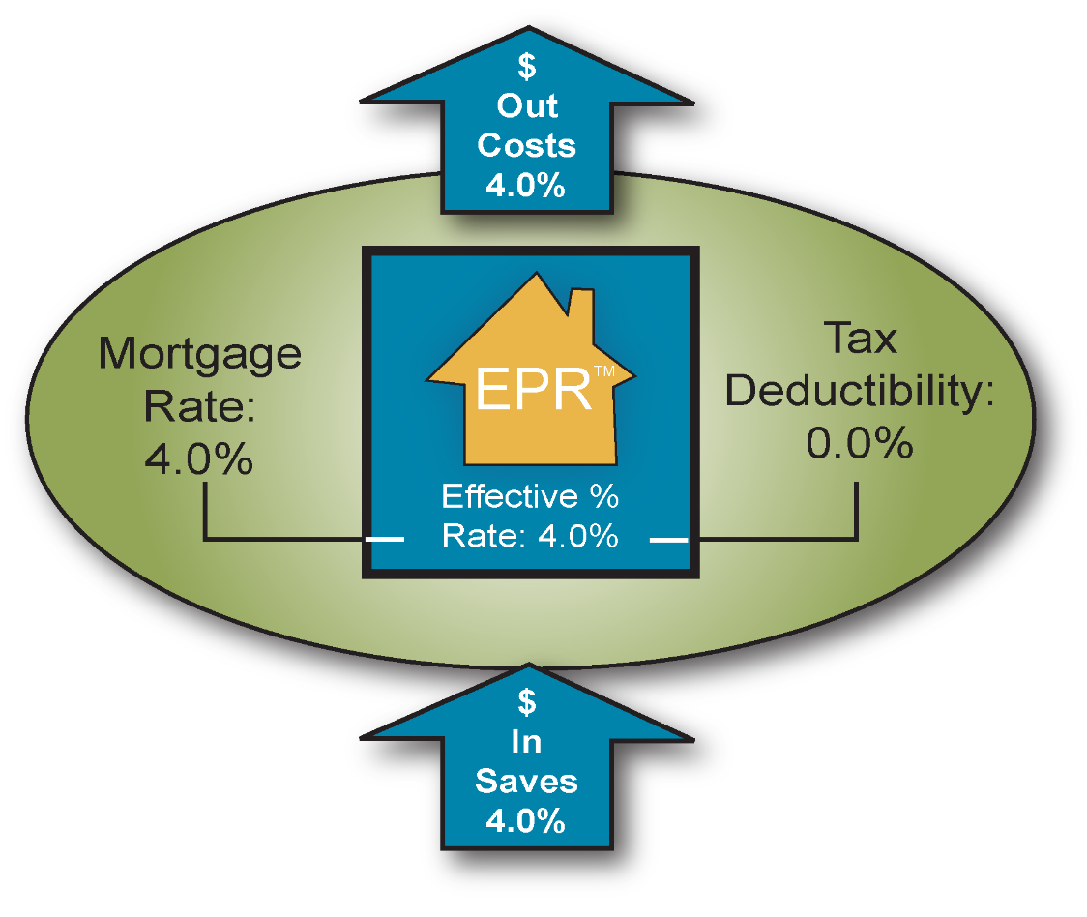
EPR™ - Effective Percentage Rate
EPR™ - Key Location, Location, Location consideration to answer common questions.
Big down payment?
15-year or 30-year mortgage?
Make extra principal payments?
Interest rate is main cost factor?

Slide 22
Let’s Finish with a Quiz
A large down payment will save me more money than a small down payment?
True
False
A 15-year mortgage will save me more money over time than a 30-year mortgage?
True
Making an extra principal payment saves me money?
True
The interest rate is the main factor determining the cost of my mortgage?
False
False
True
False

Slide 23
The Borrow Smart Solution
Asset Management
Liability Management

Slide 24
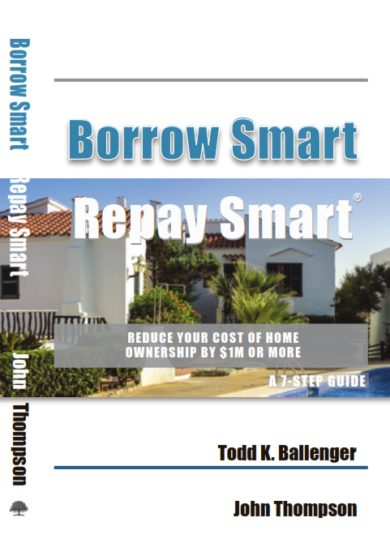
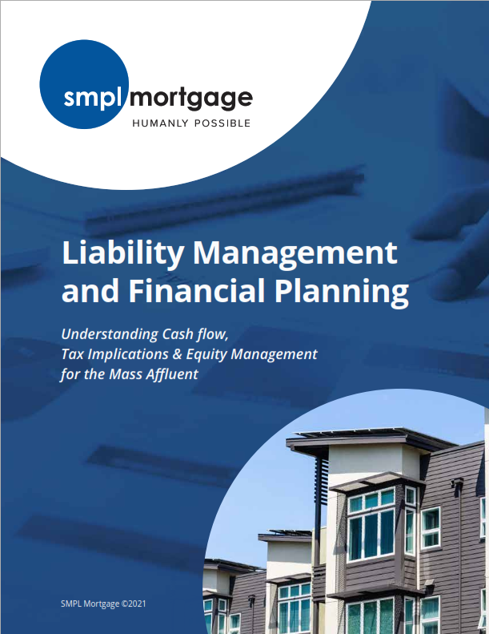
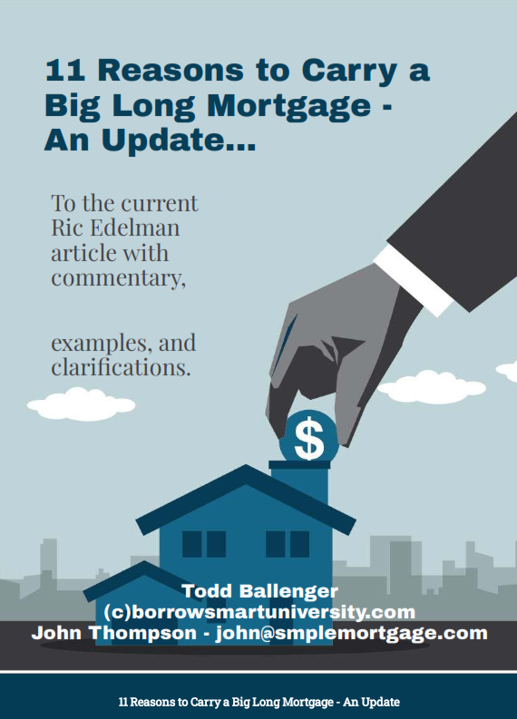
Published Education

Slide 25



SMPL Mortgage and C2 Financial

Slide 26

Next Action?

