Slide 1




Home Equity: A Vital Component of Retirement and Legacy Planning
Notes:
RECORD

Slide 2






The
IRS
1098
25% - 40%
Forced Payments
Check with CPA on what interest is deductible
JOB
15%
INCOME
ASSETS
EQUITY
4%-6%
1099
Income
4%-7%
4%-7%
Taxable
“Tax Free”
  Food
  Gas
  Daily Expenses
Age Funds Become Available
Age “Tax Free” Funds
Become Available
Social Security
Pensions
401k’s
SEP’s
IRA’s
ROTH IRA’s
Brokerage
Savings
62-70
Generally, 60-70
59.5-73
59.5-73
59.5-73
59.5
Interest taxed 1st
Interest taxed 1st
62
“Voluntary Payments”

Slide 3






What Issues do Retiree’s & Pre-Retirees Face?

Slide 4

The Retirement Savings Crisis is Real -FACTS
60% of people going into Retirement have a traditional mortgage.
  The mortgage is 30-50% of the monthly income.
In recent years over 1 Million mortgage applicants over the age of 62 were denied a mortgage due to excessive Debt ratios
Recent data showed, 1.3 Million mortgages were made to borrowers over the age of 62, but only 33,000 were reverse mortgages.
  This was only one year’s worth of data – it happens every year.
55% of seniors do not have a written financial plan
54% said inflation was their biggest concern (36% said Healthcare expenses)
49% wish they had started planning earlier
39% of seniors (65-74) have their marriage end in divorce in retirement
^{[1]} Mayer, Christopher and Moulton, Stephanie, "The Market for Reverse Mortgages Among Older Americans" (2020). Wharton Pension Research Council Working Papers.

Slide 5



What does it Mean
Debt
Extended Pressure
Wellbeing
Debt is going to be a major headwind for a sustainable retirement for millions of American homeowners.
This will place financial pressure on extended families, government and private agencies that provide support services in this space.
Personal Health and wellbeing will be impacted by longer working older adults

Slide 6

Real People – Real Lives – Still Teaching Late in Life!
Widow (67) – still teaching to pay mortgage on Condo. Would love to hang out with her kids and grandkids more. The kids are considering making her mortgage payment so she can stop working!
Paid off mortgage – eliminated $1400/mo
Paid off car - $380 cash flow
Tenure payment – added $1200/mo income
HELOC – safety net
Kids don’t have to start supporting her

Slide 7

Retirement Income Planning
Coordinated approach to an investment portfolio and house equity.
Some traditional financial planning only looks at the house as an exit strategy to access funds on a sale
THE ULTIMATE GOAL OF RETIREMENT INCOME PLANNING IS TO USE ASSETS TO ALLOW FOR MORE INCOME AND/OR A LARGER LEGACY.

Slide 8

Retirement income planning
Goals
  Income
  Contingent expenses
  Legacy Planning
Risks
  Reduced Earning Capacity
  Longevity
  Long Term Care
  Sequence of Returns Risk
  Spending Shocks
  Declining Cognitive Ability
  Public Policy Risk

Slide 9
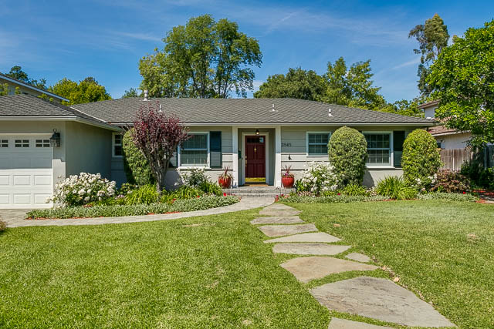

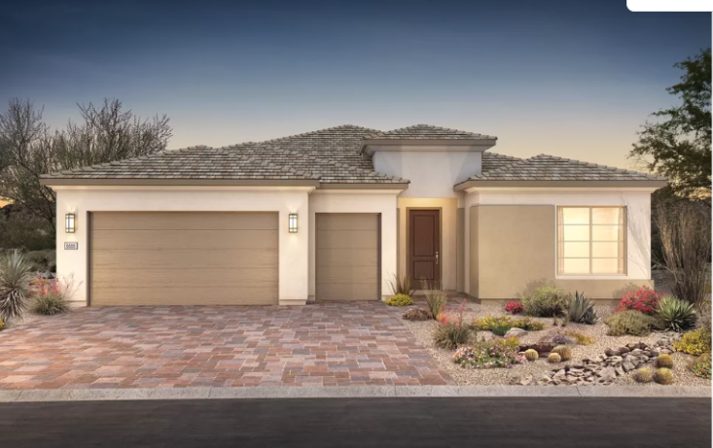

Notes:
We are Blessed and Lucky in CA CA home appreciation has given many an unexpected gift one that may have not been counted on because who knew that CA ranch would sme day be woth over 1M!

Slide 10

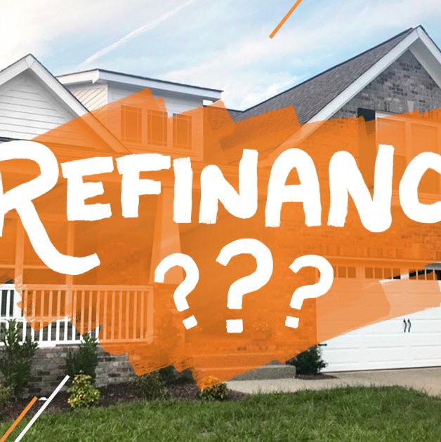




Home Equity Options to Consider
The Coordination of Cash Flow & Finances is Critical – both on the income/Asset side and Debt/Payment side.
Sale
Refinance
Reverse Mortgage
Hybrid Mortgage
Equity Release
Create liquidity – reduce expenses
Are there cash flow or liquidity options that make sense – HELOC - Private Money
HECM or Portfolio Options/2nd Mortgage
Improves Cash flow Now – leading to No Payment in 10 Yrs
Sell a portion of equity now – retain ownership
Government (Local/State/Federal) Programs and Social Support Services
Wellness Care can and should include a Focus on Finances

Slide 11



Sale of Home
Planned Trade Down or Up – To Free up Capital while creating a sustainable housing situation
Costs To Sell
Replacement Home
Taxes
Commissions
Home Improvement
Time and Effort
Community/Family
Access to Services
Medical Care
Capital Gains
Property tax Transfer
Inheritance/Gift

Slide 12

Generational Living is Happening
Adult children in their mid 50’s realize they have a retirement financial gap to fill in a relatively short time OR may be forced to work into their 70’s or 80’s. Widowed parent has a Free and Clear home, Social Security and limited liquid assets – and will need significant care over the rest of her lifetime.
Options:
Sell one or both homes and downsize – consider moving into one of the homes
Buy a new home with a guest house or build an ADU and combine households
Move parent to assisted living after selling home
Concerns:
Access to health care/Community/extended family
Costs of living in LA/CA
Living together or nearby
Tax implications (Capital gains, Prop 19/60/90) – Estate Plan

Slide 13

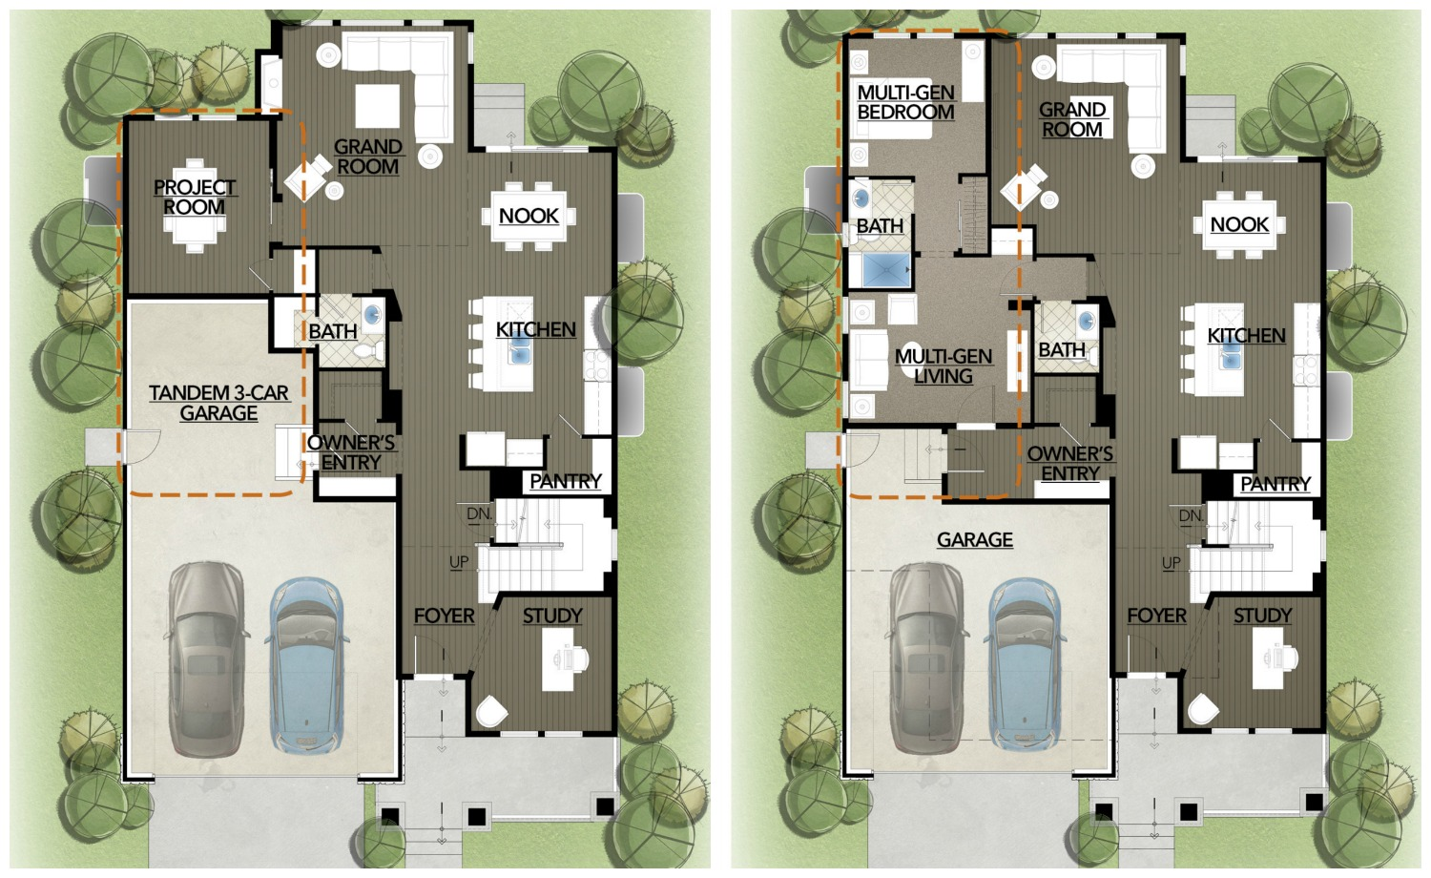
Generational Living is Happening - Outcome
Sold two homes, freeing up $1.3M in cash - Purchase $600k home together in less expensive area
Parent
Adult Kids
Adds $500,000 in liquidity (LTC coverage)
Transfers Property Tax Base to new home
Has kids in home for care and support while aging
Reduction of living expenses
Adds $200,000 to retirement funds
Keep home after Parent passes with low tax base
Can leverage home later for additional liquidity
Reduction of living expenses (needed to get away often….)

Slide 14



Refinance - Conventional
Goals: Cash Flow – Home Improvement – Emergency Liquidity
Manageable Payments
Age In Place
Finances
Align Payments with Income
15 to 30
ARM to Fixed
Interest Only
Pay down Balance
Home Updates
Reduce Maintenance
Plan for In-Home Care
ADU – Generational Living
Co-Living/Housing
Combine Debts
HELOC for Safety
Advance Gifting
**Assets as Income Did you Know
Notes:
As mentioned in the first slide a high % of over 62 borrowers get declined due to DTI – we can now use Assets as Income to qualify AND if they have not started distributions from an IRA they can set that up (the particullars are tricky so we can talk about that offline. BONUS – Did you know ASSETS as INCOME
AND retirement Distribution 3 yrs – Set up and then remove

Slide 15

Real People – Real Lives
Profile
Dual income couple in their mid 50’s
Apx $90,000 Annual employment income
$260,000 in qualified Plans
$50,000 in liquidity
$960,000 home with $250,000 Mtg (paying extra to get it paid off)
Want to try to stay in home
Stated Goal
  Refinance to 15 yr to pay off mtg before full retirement
Borrow Smart Plan – in coordination with CFP^{tm}
  Move to 30 yr loan with lowest possible payment
  Advisor models sustainable income with SS, assets and continuing to add to savings and qualified plans while working (plan to retire in 10 more years)
  Reverse Mortgage option to be determined at 62 but modeled that as well
Profile
Single Woman – 61 Yrs old
Apx $140,000 Annual employment income
$650,000 in qualified Plans
Sold a home in 2020 – replaced it with a 900k home and a 10 Yr ARM mortgage of $500k – wanted low payment
Wants to stay in home
Advisor did not want the unknown impact of the ARM in 9 yrs to affect her retirement income planning – wants certainty
Borrow Smart Plan – in coordination with CFP^{tm}
  Move to 30 yr loan with same rate as 10 Yr ARM
  Advisor is able to give her confidence that she can stay in the home with current assets and income projections
  Discussed Reverse option down the road if she wants to retire earlier – loves her job but getting difficult

Slide 16


HECM – Reverse Mortgage (Portfolio)
Forward Mortgage: You make payments to pay off. Reverse: You receive payments and Mtg is paid on sale.
Significant Changes 2015
Eligibility
Amount
NBS Protection
Financial Assessment
Cash out Limitations
Reduced LTV
Homeowner
Primary
62+ (60 for Portfolio)
SFR – Approved Condo – 2-4 Owner
Age of Youngest
Home Value
Expected Interest Rate
Increases with Age
Assume 35-45% LTV

Slide 17

Real People – Real Lives – Mass Affluent !
Retired Couple (65/64) – Good current income, home worth 1.6M. 1.5M in IRA and assets. Concerned about outliving the money and forced to sell the home.
Paid off mortgage – eliminated $2300/mo
Reverse Line of Credit – Starting at 250k – will grow
Will delay IRA required distributions as long as possible by using HELOC for cash flow
Will also use Line of Credit during down market to avoid liquidating investment portfolio

Slide 18


Slide 19
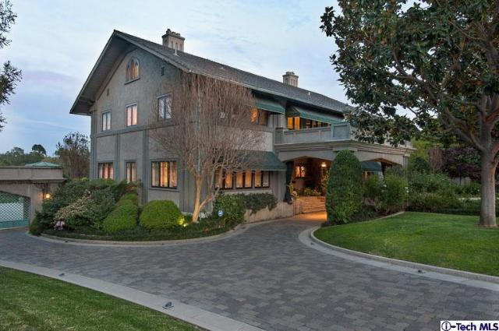
Did you Know? HECM 4 Purchase – Downsize and Add Liquidity
Use a Reverse Mortgage to Downsize while adding Liquidity
Standard Purchase Contract - FHA
Buyer and Seller pay typical costs – nothing extra!
Down Payment just over 50% in most cases
Same timing as conventional financing
Benefits
  Preserve cash
  No payments required
  Overfund to create growing Credit Line
  Increase purchasing power
  Buy two homes
Notes:
Did you KNOW you can use a RM to buy a home?

Slide 20

Downsize
A 70-Year-old Couple sell their home for $950,000 and purchase a new home for $700,000.
They can pay cash but want to retain as many funds as possible from the sale and increase liquidity.

Slide 21
Strategy – Reverse for Purchase (R4P) Downsize
Without R4P
Sales Price $950k
7% Cost to sell 66k
Proceeds $884k
New Home $700k
Funds Rem $184k
With R4P
Sales Price $950k
7% Cost to sell 66k
Proceeds $884k
New Home $700k
R4P $322k
Down Pay $321k
Funds Rem $320k

Slide 22

Upsize
A 70-Year-old Couple sell their home for $950,000 and purchase a new home for $1,200,000.
They do not want any mortgage payments.

Slide 23
Strategy – R4P Upsize
Without R4P
Sales Price $950k
7% Cost to sell 66k
Proceeds $884k
New Home $1.2M
Funds Required $316,000
With R4P
Sales Price $950k
7% Cost to sell 66k
Proceeds $884k
New Home $1.2M
R4P $420k
Down Pay $780k
Funds Rem $104k
Portfolio options to $4,000,000 Reverse loans!

Slide 24

Multi-Family (Co-housing)
A 62-Year-old Couple wishes to purchase a new multi-family home without incurring a monthly mortgage payment.
The goal is to supplement income from the other units (tenants in a co-housing scenario)

Slide 25
Strategy – Multi-family
Conventional
Mortgage
Proceeds $884k
New Duplex $1.2M
Funds Needed $316k
Mortgage $316k
Payment $2,209
Rental Income $2,500
Added cashflow = $291 a month
With Reverse for Purchase
Proceeds $884k
New Duplex $1.2M
R4P $420
Borrower Funds $780k
No Mortgage payment
Rental Income $2,500
Added cash flow = $2500 a month and $104,000 additional liquidity.

Slide 26
A New Retirement Cash Flow Tool
A Retirement Mortgage (for those that don’t want a mortgage in retirement) – No one really wants to go through retirement with a mortgage – and yet millions of 60+ homeowners do. This product is ideal for those looking to:
Free up cash flow without selling their home
Create a more sustainable retirement plan
Get equity out of their home
Refinance but may not qualify for a conventional loan

Slide 27
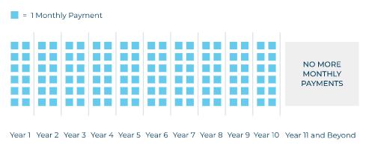
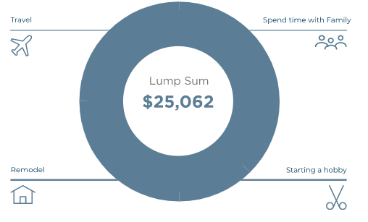
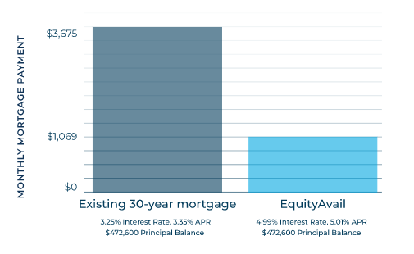
The Retirement Hybrid Mortgage…
… combines the advantages of both traditional mortgages and reverse mortgages. Starts with 10 years of monthly mortgage payments, and then mirrors a reverse mortgage by eliminating the monthly mortgage requirement for the remaining life of the loan. Borrower is responsible for property tax and insurance obligations. Fixed Rate Loan with partial interest Only Payments required - with the option to make any payment above the minimum. Payments are not required after 10 years.
Payments for 10 Yr
Lower Required
payments
Lump Sum Possible
Notes:
600k Purchase 5% Down - or wait 2 yrs and rate rise .5%

Slide 28

Requirements
Occupy as your Primary Home – with a Minimum of 10 Years Remaining on your Current Mortgage.
Continue to pay property taxes and Home insurance, maintain the home and other loan obligations.
At least 60 years old – and unable to qualify for a standard reverse mortgage.
A refinance of at least $100,000, one-time lump sum funding – with possible cash to the homeowner for any use.
Notes:
600k Purchase 5% Down - or wait 2 yrs and rate rise .5%

Slide 29
Equity Release Products
Reversion – Sell home at a discount today and stay as tenant for life – discount based on Age.
Shared Appreciation – Lump sum today in exchange for portion of future Gain.

Slide 30

Notes:
Why is there a increased interest in this subject – to be blunt a subject that for the most part does not have a great historical reputation. The reality is that the Myth of retirement is messed up for a lot of people – for many, working for years and years, saving when they could, raising families etc. has not lead them to the promised land.

Slide 31

What is being asked about Reverse?
“I’m aging and going to need more money.”
“My kids are going to call and want my Retirement Money.”
“I have lots of equity in Real Estate, what should I be thinking about?”
“I’m about to retire and am worried about stocks selling off.”
“I want to have a better lifestyle in retirement, how can I achieve that with what I have?”

Slide 32
Who?
In their 60’s
Have at least one home, maybe a second home and a rental property
Still have a mortgage (could be free and clear)
Have between 250k and 2M in IRA’s or retirement accounts

Slide 33

Today’s HECM – Home Equity Conversion Mortgage
“A reverse mortgage is a special type of loan that lets homeowners convert a portion of the equity in their home to cash, without having to make monthly payments.”

Slide 34
Reverse vs. Forward
In a conventional forward mortgage, you make monthly payments to the lender, which pays off the mortgage over time.
With a reverse mortgage, you receive payments from the lender, and the mortgage is paid off when the home is sold.
Reverse
Forward
Notes:
KAL

Slide 35
Major Changes to HECM
Product Created in 1988
Massive Changes since 2014 – (Reverse Mortgage Stabilization ACT of 2015)
  Protection for Non-Borrowing Spouse
    (Spouse losing house Fear)
  Income and Credit underwriting (4/2015)
    Prevent Tax/insurance Default and Ensure a Positive Benefit
  Limitations on Cash out in year 1
    Slows home equity drawdown – Helps HELOC Growth
Oct 2017 update – reduced borrowing limits & change in UFMIP (higher/lower) + Reduced Monthly MI Premium

Slide 36


Who is eligible
Homeowners
Primary residence
62 years + (55 Option)
Single Family Home
FHA-approved condo
2-4 Unit Owner Occupied
  QUALIFICATIONS
Age of the youngest borrower
Appraised value of the home
Expected interest rate
Financial Assessment and credit
Notes:
KAL

Slide 37
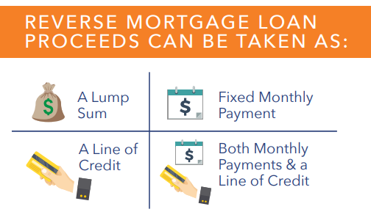
Flexibility

Slide 38

PROTECTION
No matter what happens in the economy or with home values, OR how much money the borrower receives, OR how long they live in the home, they will never be required to make a mortgage payment.
There is always guaranteed access to money.
Financial Assessment –The borrower has to prove they can afford tax/insurance payments
The borrower can never owe more than the home is worth – even if the mortgage is upside down
Counseling is required through a HUD-approved counseling agency.
  In person or over the phone
  Family is encouraged to participate

Slide 39

What happens if the loan exceeds the home value?
What if I’ve used up all the funds?
Who owns the home??

Slide 40

IT’s due – what happens?
When you no longer live in the home (12 Month Period) or when you pass away the reverse mortgage becomes due (unless surviving spouse). Options:
  Pay off the balance (refinance or other funds)
  Sell the home
  Buy it at 95% of value
  6 Months (2x 90 Day Ext.)
Pretty much the same as a
forward mortgage, except
with a forward you could be
upside down and have to
pay the difference!

Slide 41

FACTS
Reverse mortgage funds are non-taxable
Reverse mortgages do not impact SS or Medicare/Medi-Cal
Non-Recourse loan (only the home)
No restrictions on use of money

Slide 42
Who owns the home?
The bank gets the home when the borrower dies – T or F?
The homeowner could get forced out of their home - T or F?
Can I make payments on a HECM (Reverse Mortgage)?

Slide 43
Bonus – what happens if you can’t make your payments on a forward mortgage??
Double Bonus – is a bank more likely to foreclose on a home with lots of equity or little equity?

Slide 44

Top Reasons homeowners use a Reverse Mortgage to access their largest asset!
Remodel or update a home – for new needs
Refinance to no Payments
Buy a home with no payments
Travel
Pay for assisted, in-home care
Remove the stress of trying to make ends meet
Age in place – keep your home
Debt Consolidation
Defer Social Security
Avoid selling stocks/financial portfolio in a down market
Emergency fund
Grandchildren’s College Funding
Gifts to Family
Notes:
KAL

Slide 45
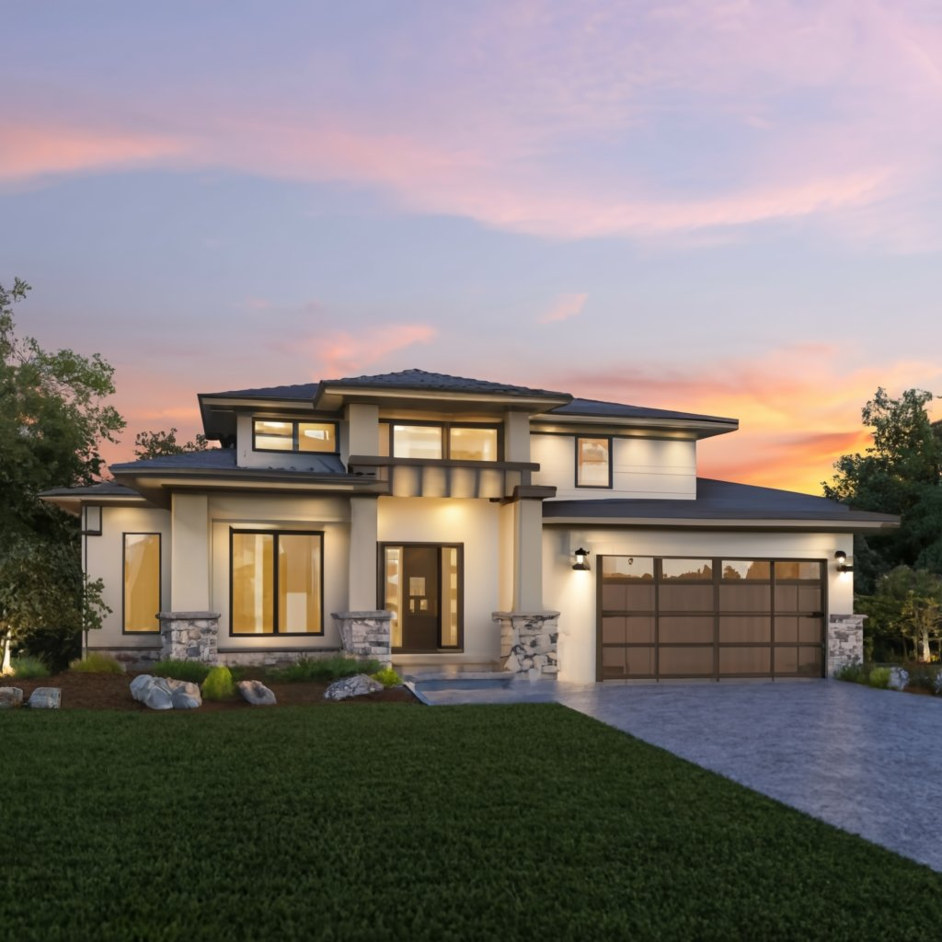

But I don’t want to lose my low rate!
2.875%
With NO Payments

Slide 46

Reverse Second Use Cases – Cash with no Payments
Advance Inheritance
Equity Buyout on other properties
Debt Consolidation
Second/Vacation home Investment
Income property Investment
ADU or home improvement
Increase IRA Value (other assets)
Long Term Care
Tax Free Income
Defer Social Security
This Photo by Unknown Author is licensed under CC BY-NC

Slide 47


The IRA Stretch™
Using a HECM to increase IRA withdrawal flexibility and reduce retirement cash flow risk while increasing Legacy
John Thompson
Certified Liability Advisor
John@smplmortgage.com
NMLS: 252514
© National Institute of Financial Education (All Rights Reserved)

Slide 48
The Home Equity IRA Stretch™
A Case Study
Client Scenario
Client Plan
70 and 71 - Retired Couple
$1,300,000 Home - No Mortgage
$862,000 in IRA Assets
Spending needs $25,000 over Pension/SS
Liquid Assets almost gone
Concerned about Tax on IRA withdrawals
RMD/Tax & Spending will run out in 13 years
HECM Standby Line of Credit Establish
$438,000 Access
$100,000 initial cash
$25,000 Tax Free draws for 10 years
Growing Line of Credit for Contingencies
Year to Year Evaluation on whether to draw from IRA or HECM based on market conditions with their advisor
Client Goals
Client Impact
Age in place
Freedom to travel
Remove stress around the budget
Maintain highest level of net worth without sacrificing lifestyle
Have plan in place for contingencies.
Client will be able to age in place with lower risk of cash flow depletion, reducing stress while increasing lifestyle. A funding source for contingency is now available as needed.
Key Results:
$350,000 Tax Free Cash Flow
$522,000 Line of Credit Available
$1,400,000 Home Equity (3% loan balance)
© National Institute of Financial Education (All Rights Reserved)
Notes:
What does it look like?: See our example where we’ll show a client at risk of running out of money in their 80’s becomes a more confident client with income through their 90’s, with greater peace of mind and flexibility to respond to changing market conditions.

Slide 49
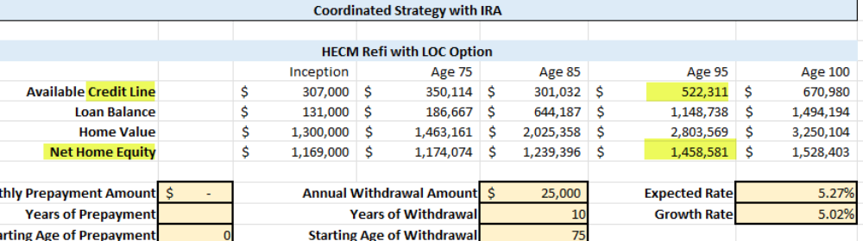
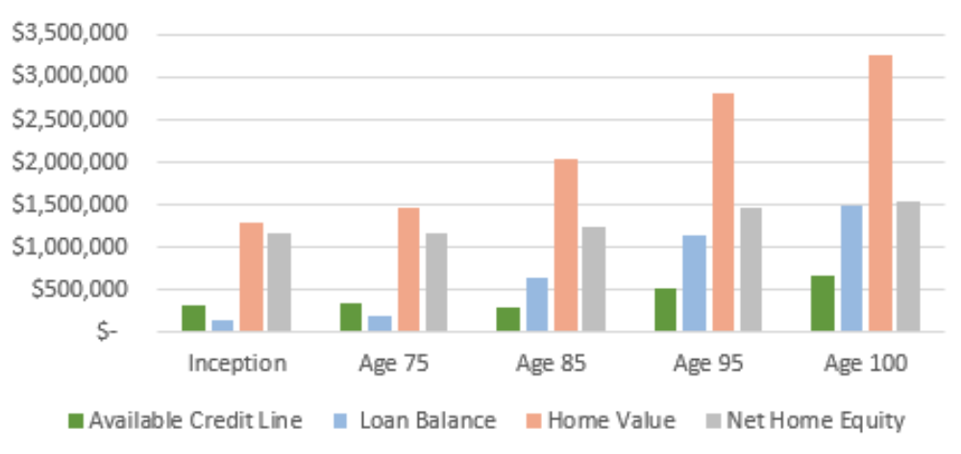
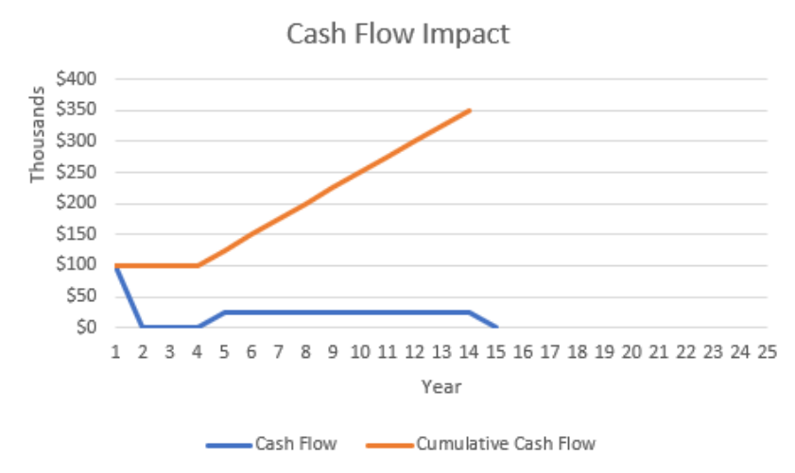
The Home Equity IRA Stretch™
A Case Study
© Borrow Smart University (All Rights Reserved)

Slide 50


Slide 51
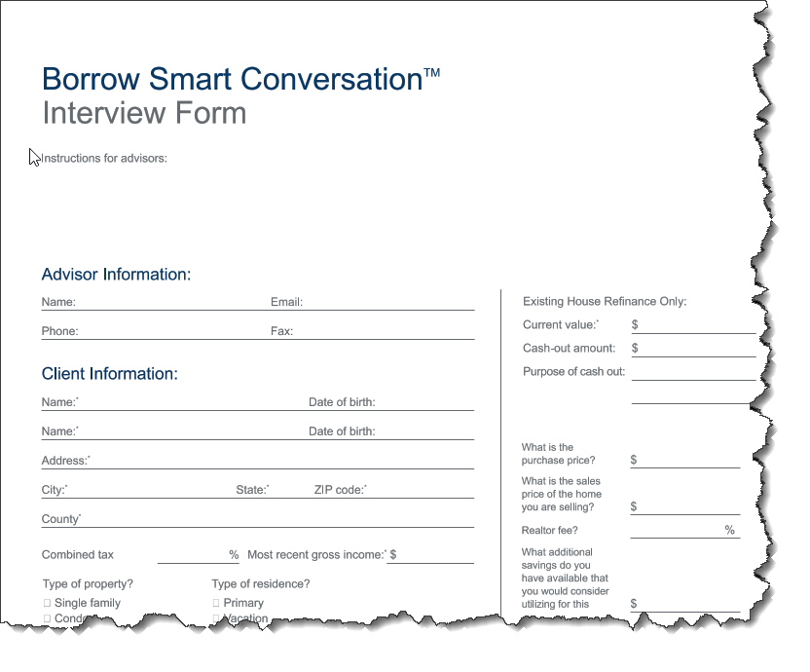
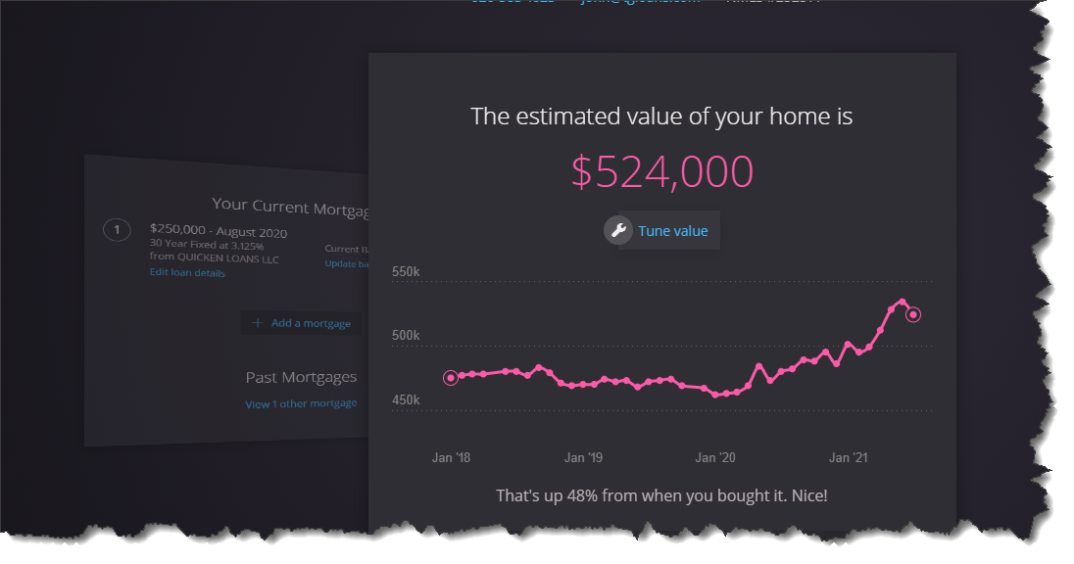
Tools
Home Bot…….
Real Estate Monthly Report
https://www.youtube.com/@SMPLMortgage
www.borrowsmartreverse.com
3 Buckets Scenario Form
Notes:
Links in Chat or FPA will send out! For Homebot for yourself drop me an email and you can check it out yourself - it is Free and you can share it with clients – we are implementing this with a few advisors and happy to share how that might work.
BSRS Book
NIFE Non profit – education around housing and finances www.niofe.org

Slide 52


A dba of C2 Financial
NMLS: 252514 DRE: 01104229
NMLS: 135622 DRE: 01821025
John Thompson
760-469-9279
www.SMPLmortgage.com
www.borrowsmartreverse.com

