Slide 1


HACA Live
Report from Baku: what happened at COP 29?
11 December 2024

Slide 2

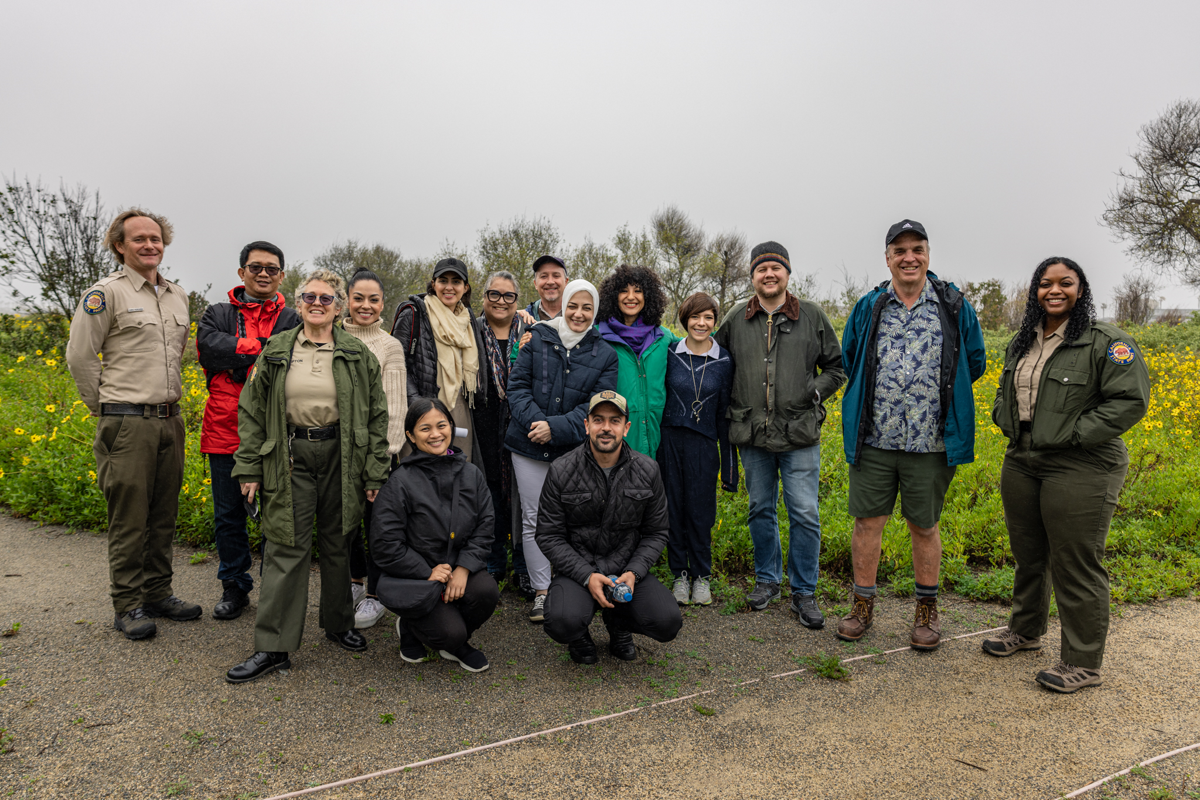

Heritage Adapts to Climate Alliance
Scaling effective, equitable, locally-led adaptation action for heritage sites and cultural practices by leveraging the power of the UN Global Goal on Adaptation.
Lead Partner:
With additional financial support from the National Geographic Society
Border Field State Park/Tijuana Estuary, California (USA)-Baja California (Mexico) border

Slide 3

UFGCR Thematic Targets
The final UFGCR adopted at COP28 includes the following seven thematic targets:
Water
Food and Agriculture
Health
Nature, Biodiversity
Infrastructure and Human Settlements
Poverty Eradication and Livelihoods
Cultural Heritage

Slide 4
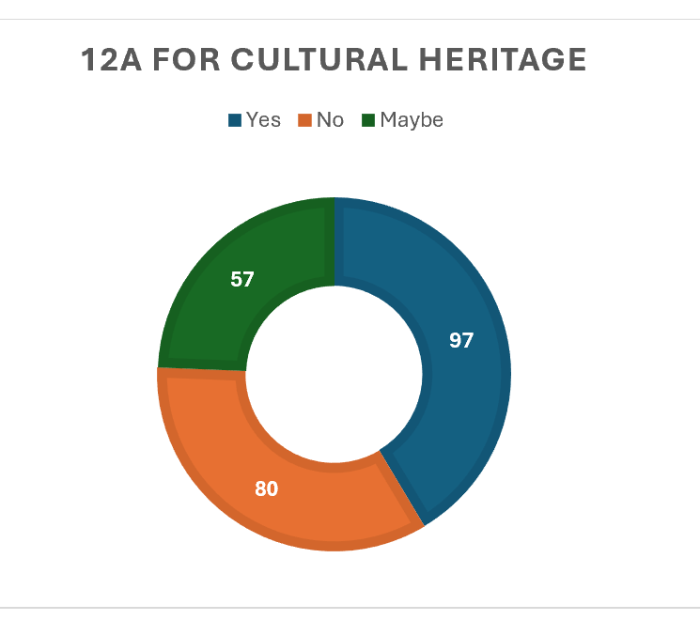
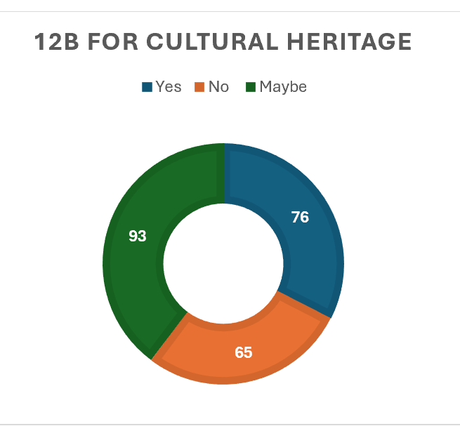
Pre-COP29: 2nd Expert Report
234 CH indicators identified after removing duplicates
12(a) Relevance to cultural heritage
12(b) Relevance to adaptation
11 December 2024

Slide 5
Pre-COP29: 2nd Expert Report
Direct Cultural Heritage indicators are very underrepresented (234 vs 5000)
New proposed indicators often lack the level of detail needed to estimate whether they could globally report on progress
Indicators proposed by States Parties are so specific as to not be useful.
Other indicators proposed seem to be specific to certain types of cultural heritage.
Other indicators proposed are only applicable at the local community level which raises questions about how the indicators will be eventually implemented.
Common reasons for ‘No’: scope not clearly defined e.g “Number of cultural practices” are unclear in what exactly would be included
11 December 2024

Slide 6
Pre-COP29: Secretariat Report
CH target broken down into three subcomponents to use as a basis for the indicator review
Relevant indicators categorized into five areas; community participation in knowledge systems, or resilience of built heritage,
Proposed using the availability of relevant data as a way of distinguishing between existing and proposed indicators, noting qualitative approach more appropriate on subcomponent re traditional, local and Indigenous Peoples’ knowledge.
Challenges arising from gaps in data, particularly on Indigenous knowledge, current indicators lack information on data readiness, especially in areas such as cultural heritage.

Slide 7
Pre-COP29: Secretariat Report
Some thematic areas that have significantly more links to some targets compared to others. For example, the food target would have more links to the water target than it would the cultural heritage target. Cross cutting issues least frequently mapped to target 9g (cultural heritage).
Experts working on cultural heritage (9g) highlighted instances where some proposed indicators were too broad and would be better suited to other thematic areas.
Highlighted the many overlaps between the target for cultural heritage and the target for ecosystems and biodiversity, and that consideration of cross-cutting indicators and issues therefore needs to be among the next steps.

Slide 8
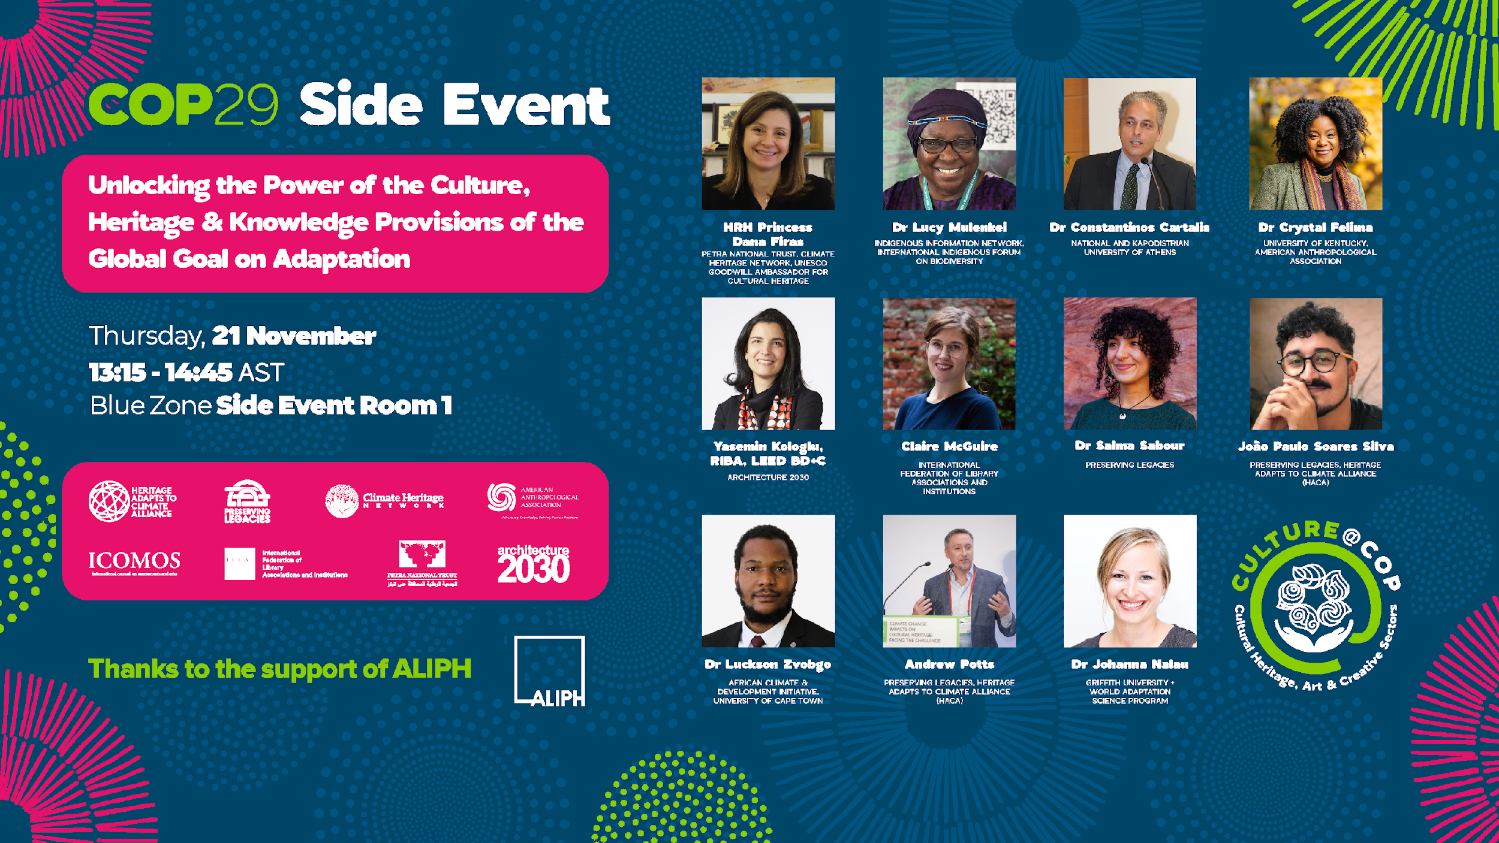
HACA UNFCCC (SEORS) Side Event
With financial support from the ALIPH Foundation, National Geographic Society, and the Mellon Foundation

Slide 9
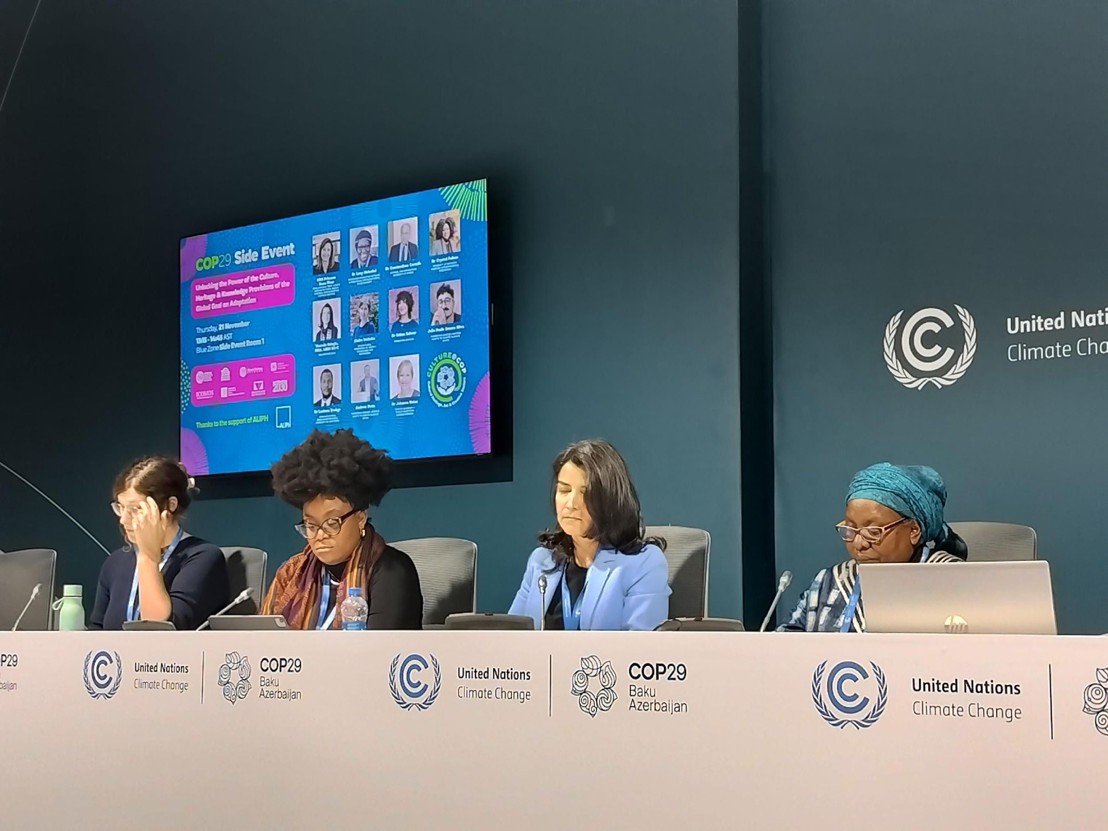
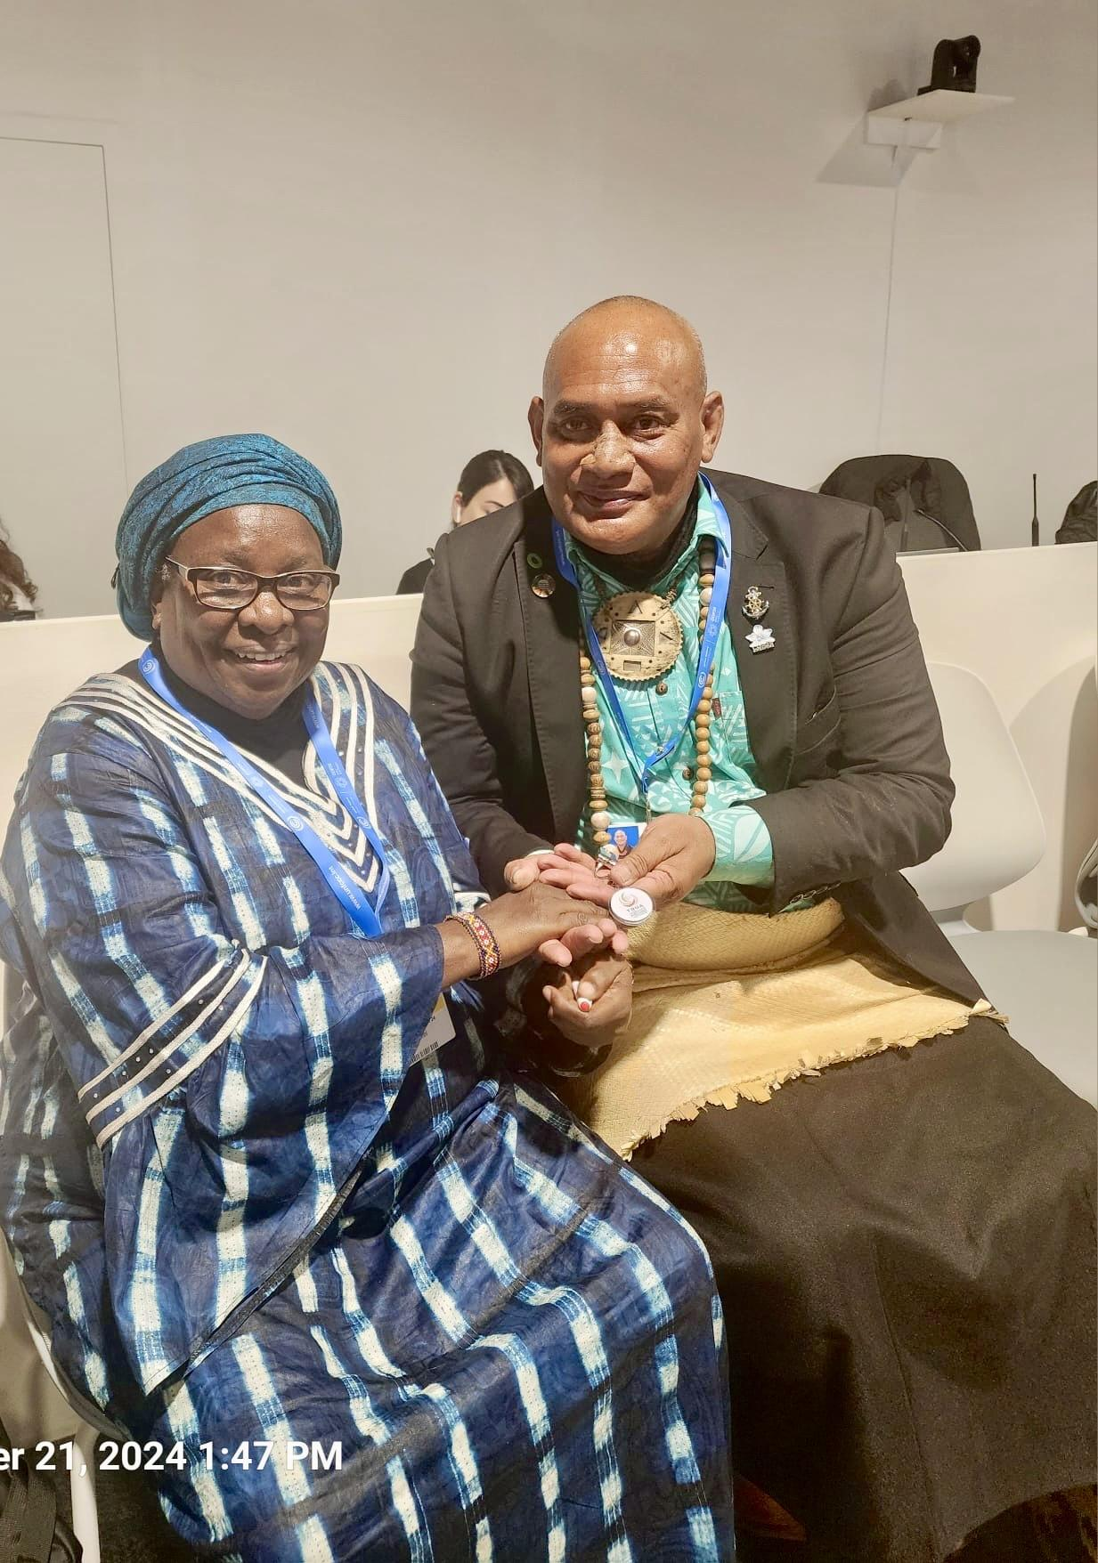
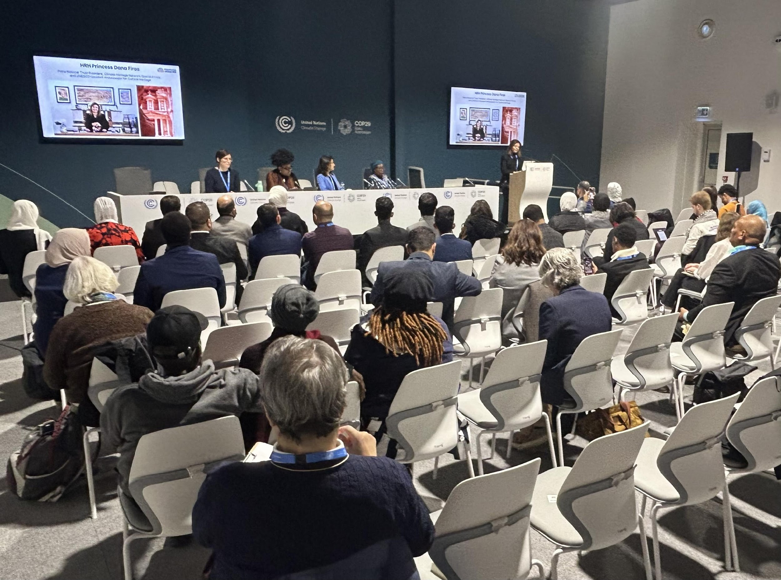
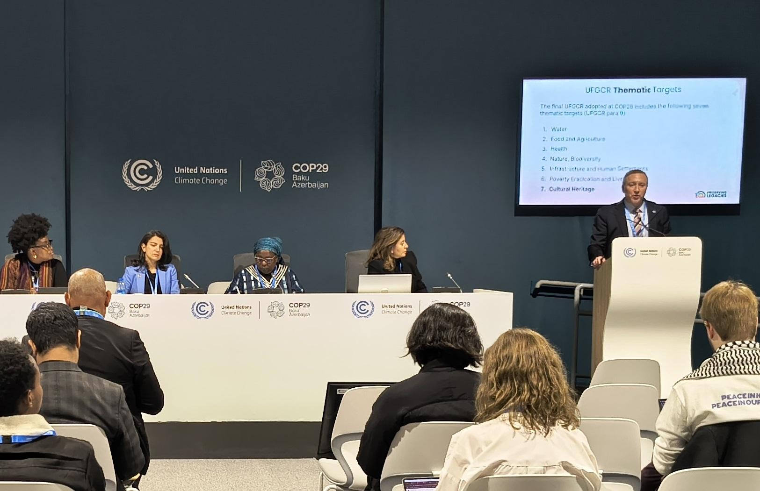
HACA UNFCCC Side Event
With financial support from the ALIPH Foundation, National Geographic Society, and the Mellon Foundation
Caption

Slide 10
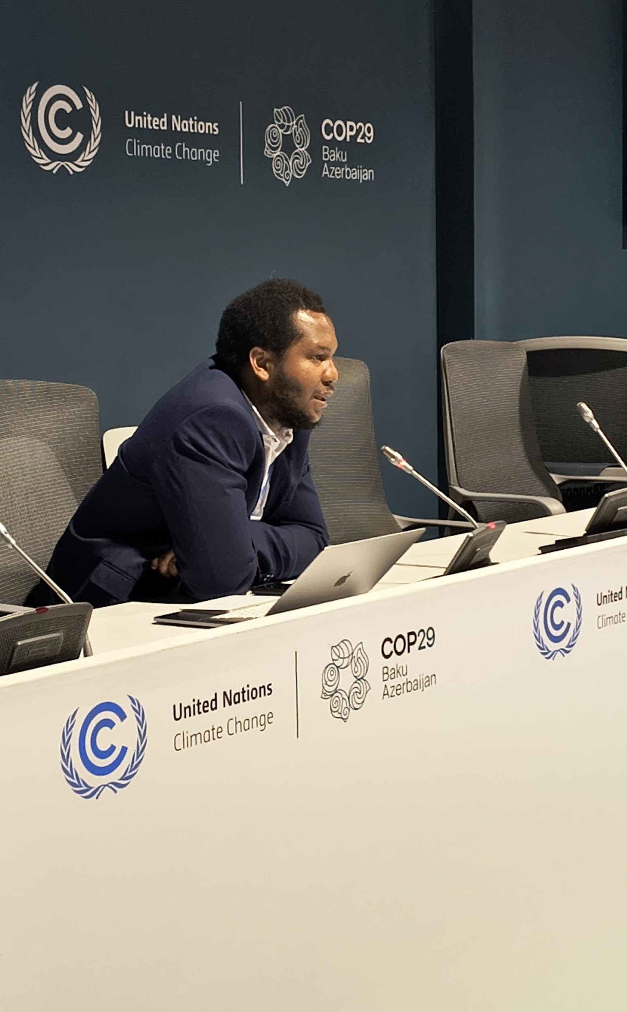
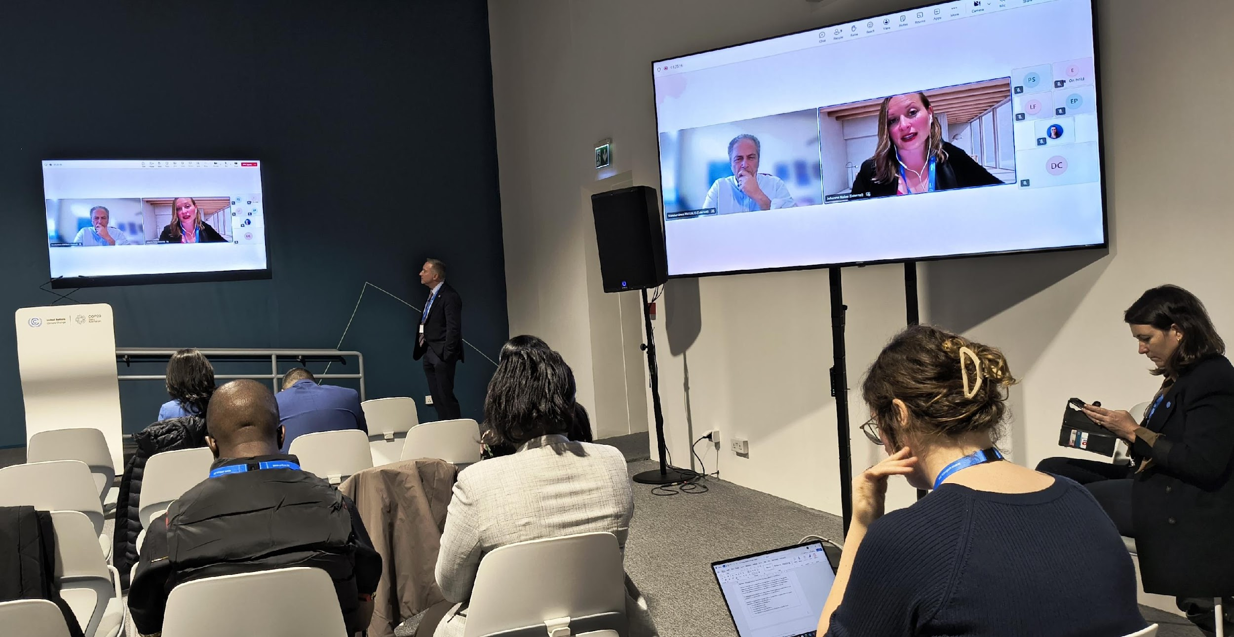
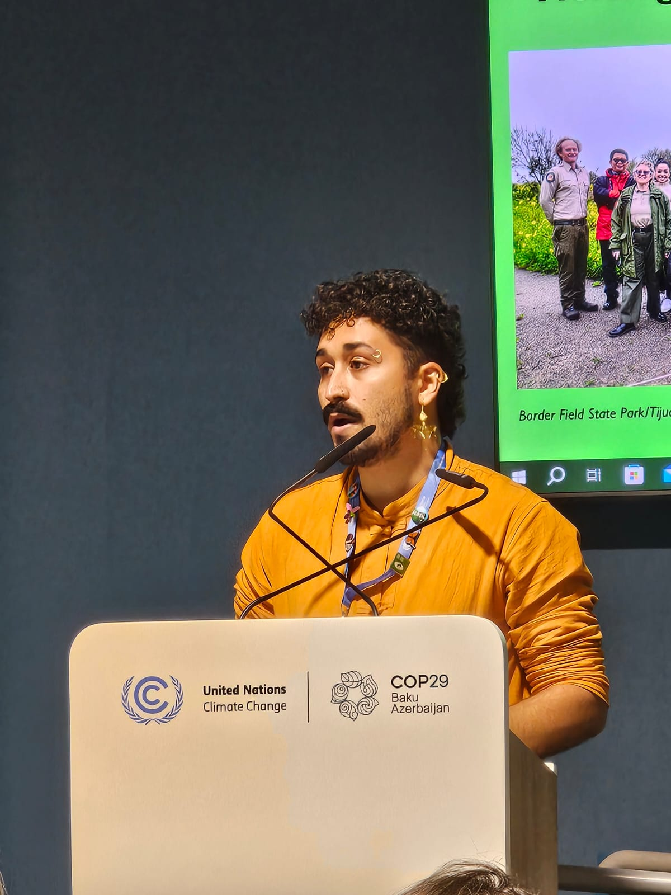
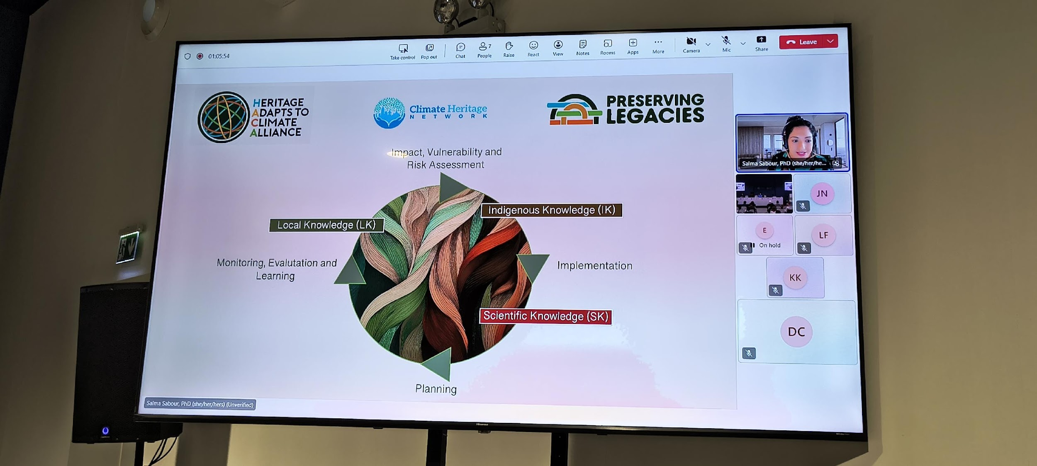
HACA SEORS Side Event
With financial support from the ALIPH Foundation, National Geographic Society, and the Mellon Foundation

Slide 11
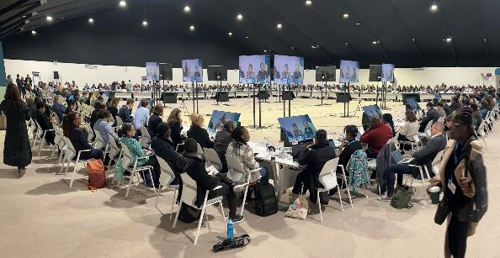
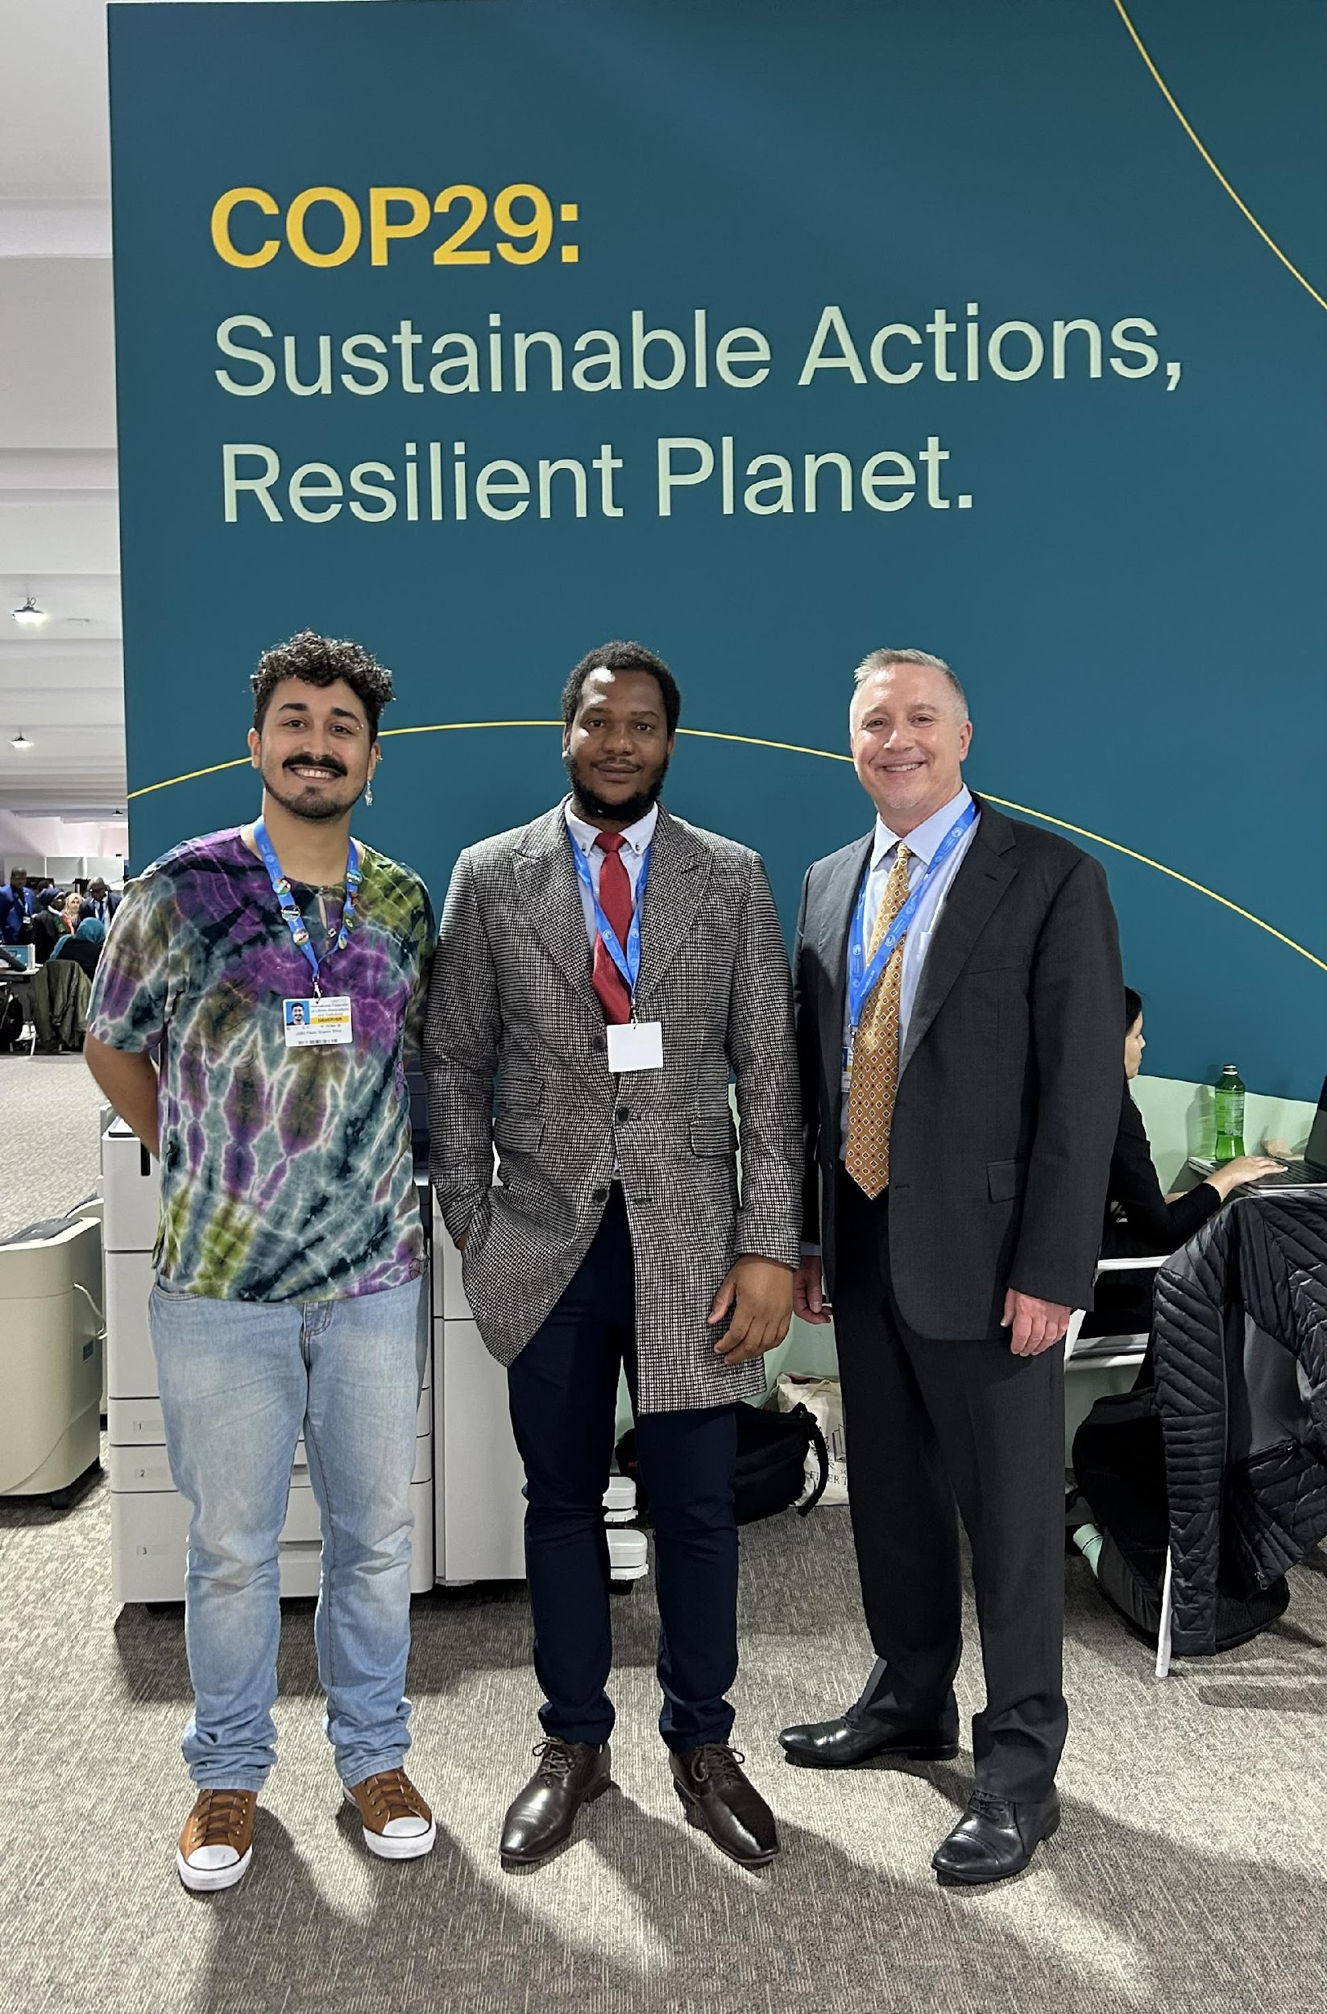
Adaptation Negotiations at COP 29
11 December 2024

Slide 12
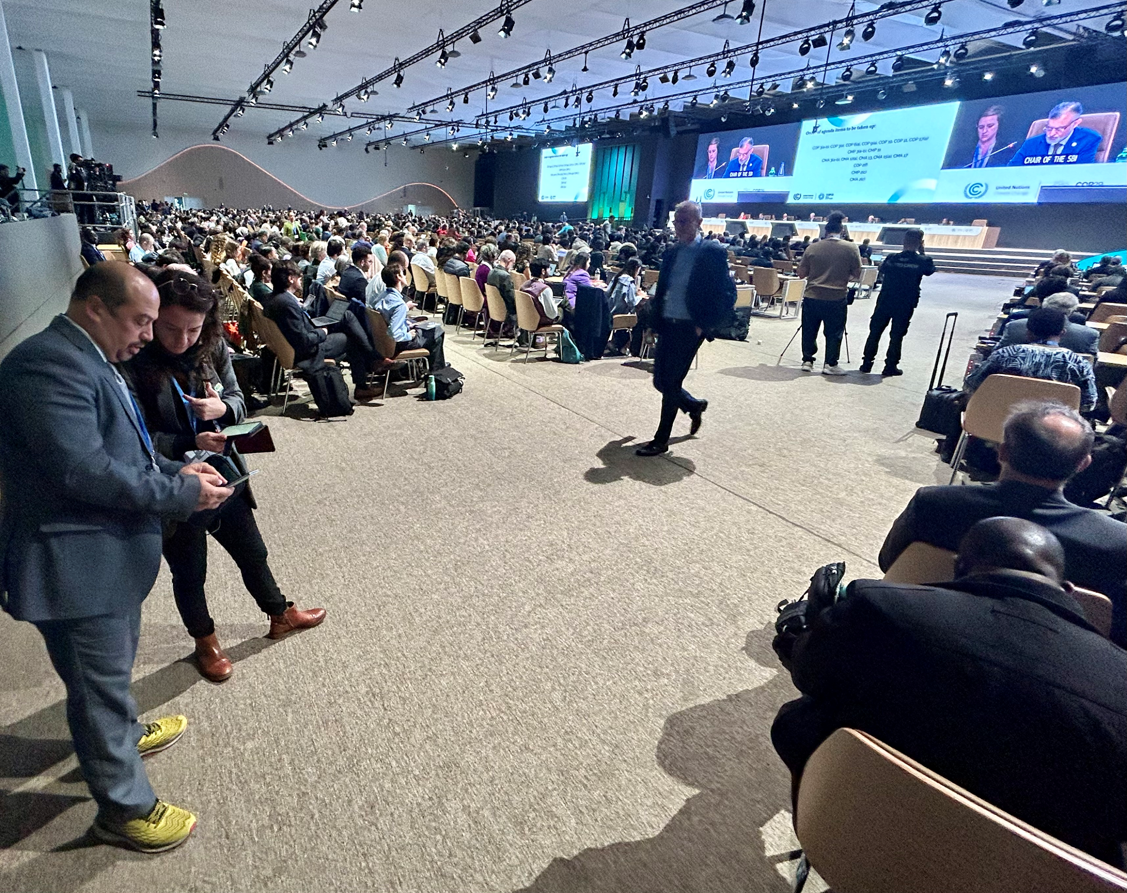
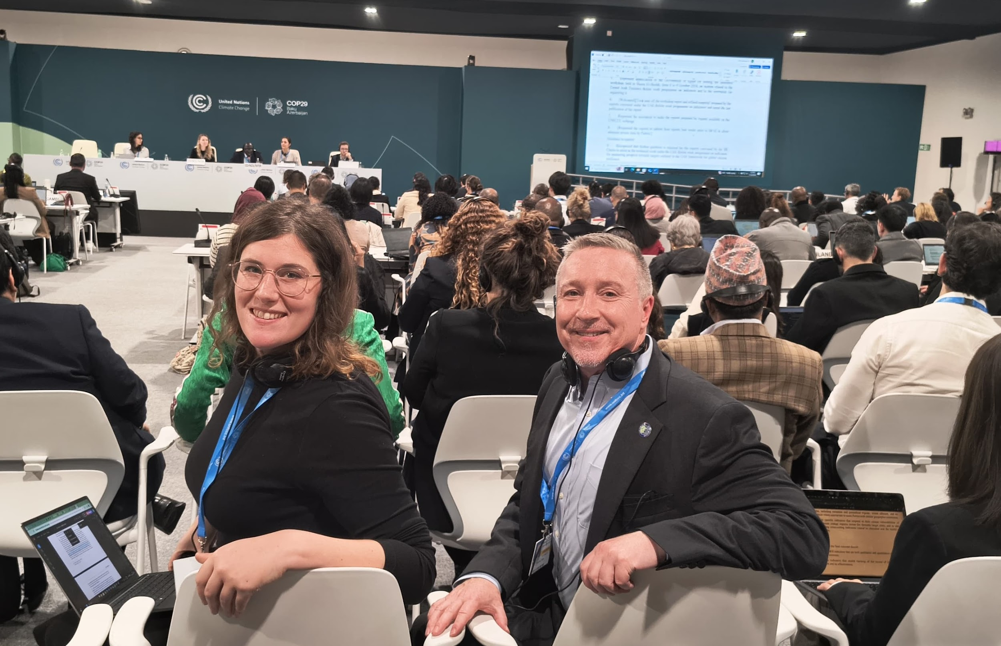
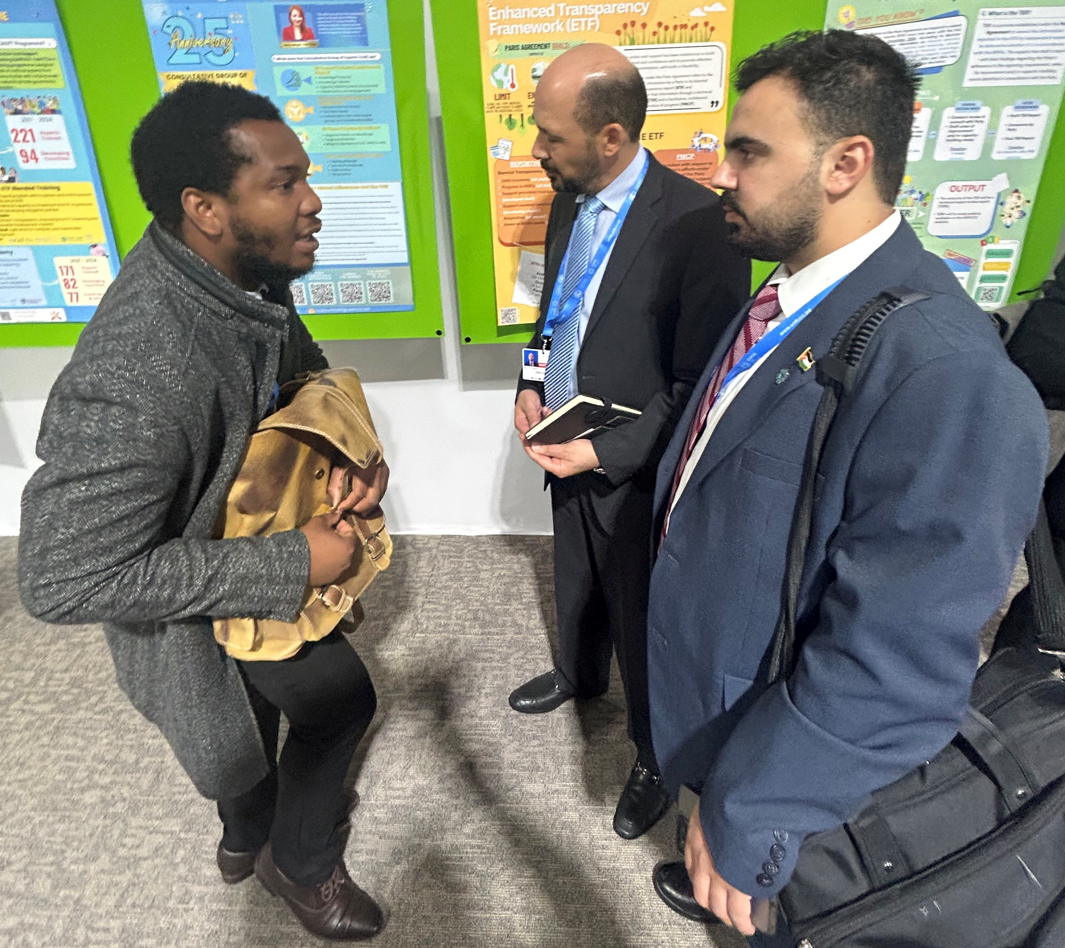
Adaptation Negotiations at COP 29
11 December 2024

Slide 13
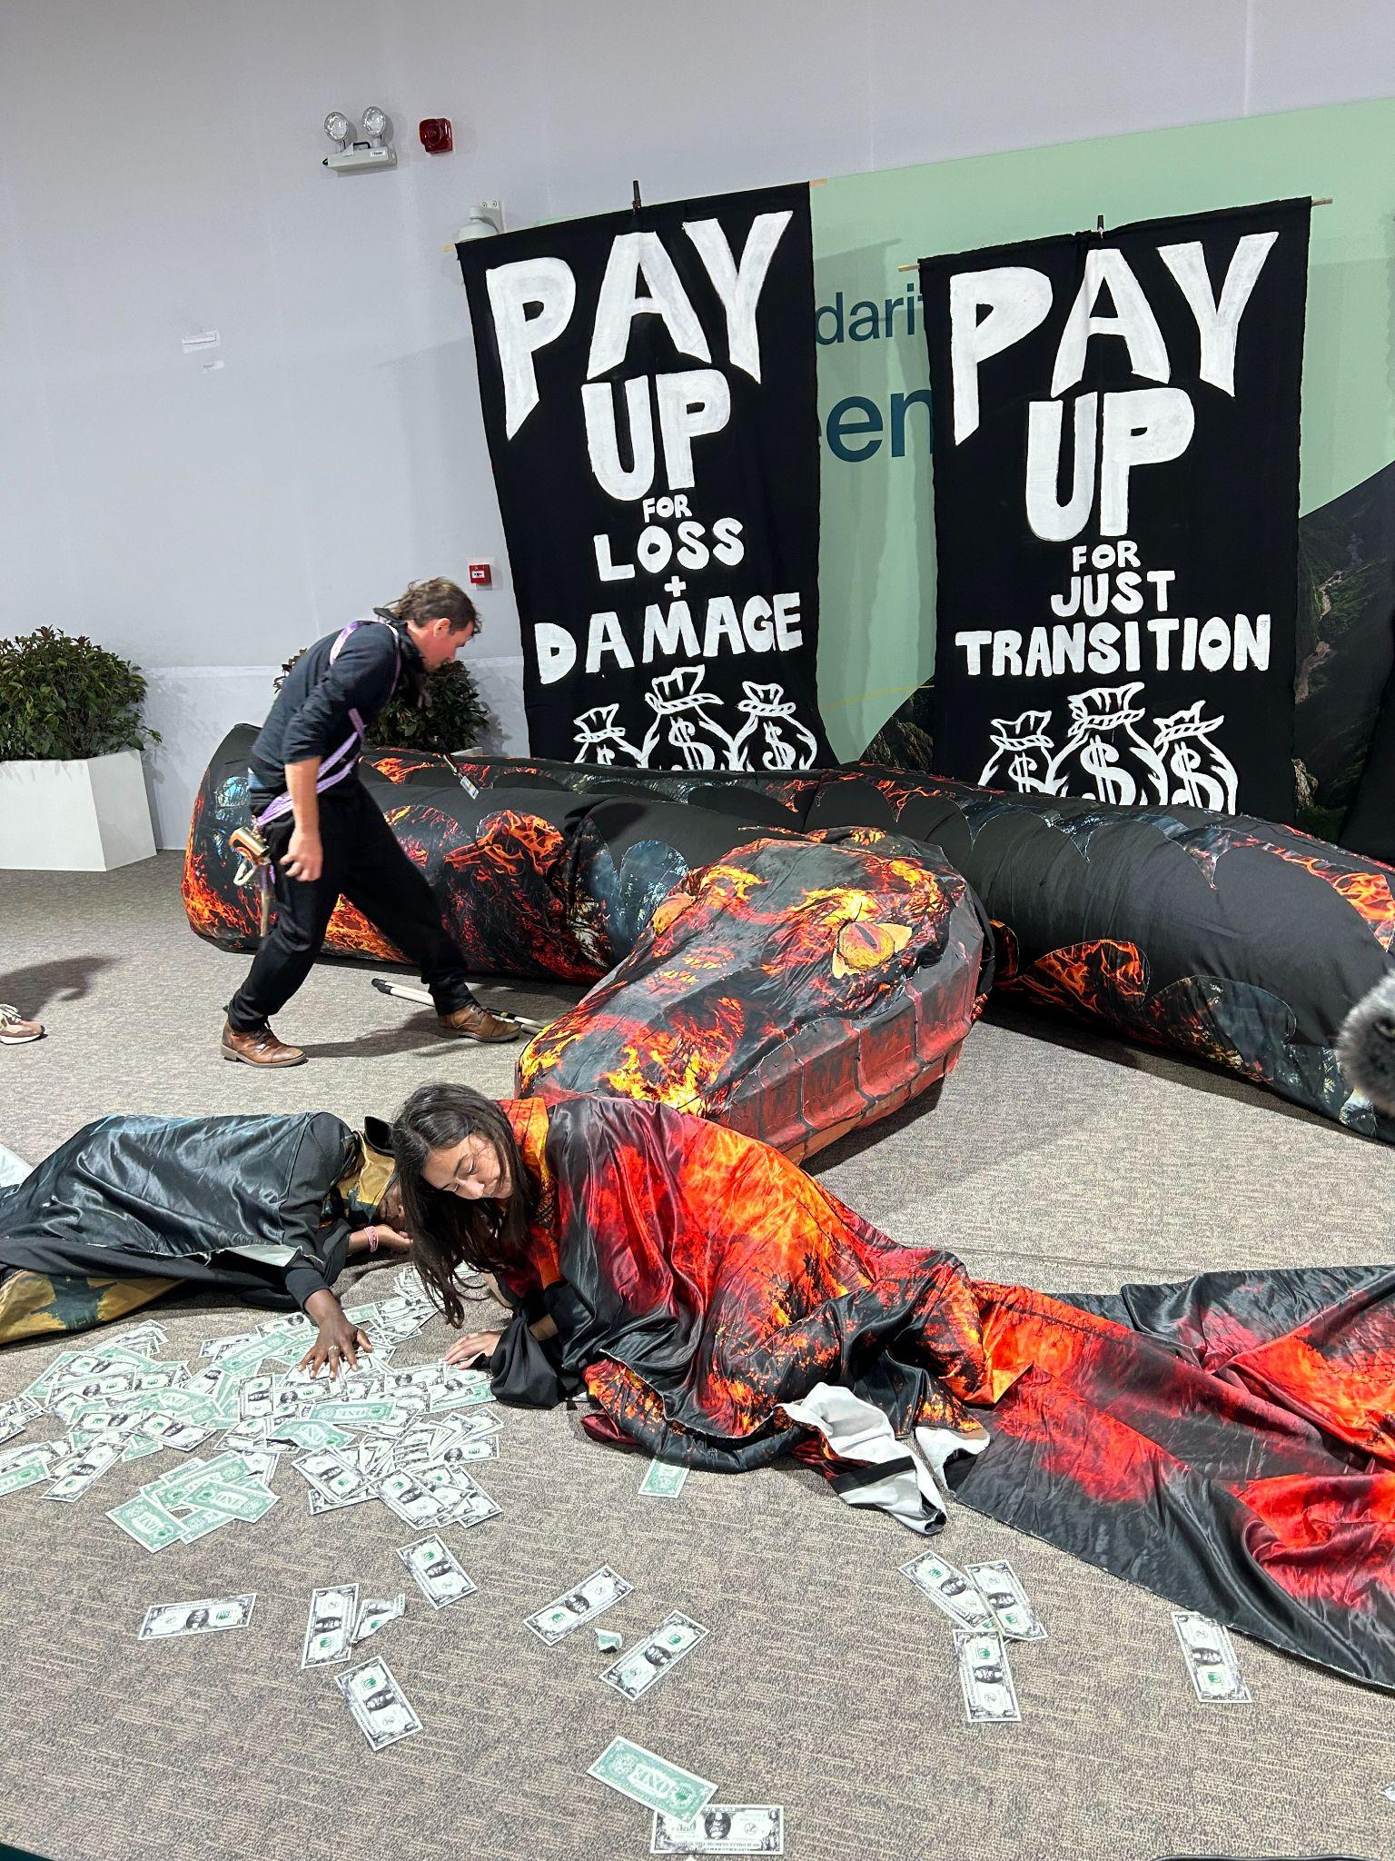
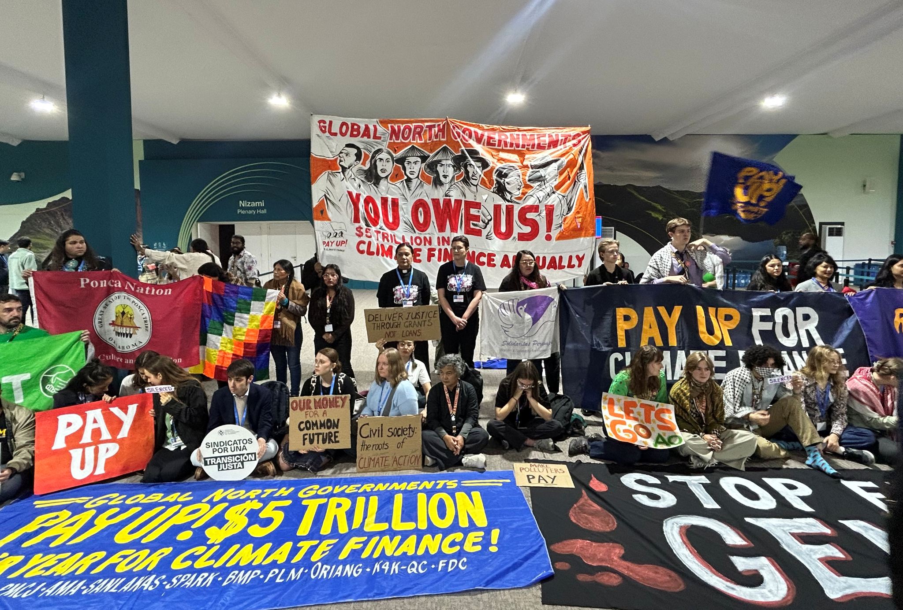
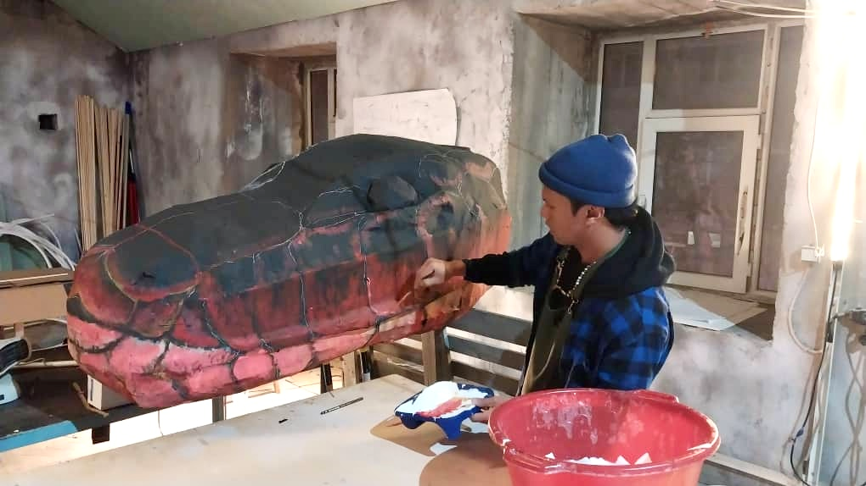

Culture in the “Streets” at COP29
Artivist Network Day of Action (L); Indigenous Temu artist Shaq Koyok at work (R)
Page ‹#›

Slide 14
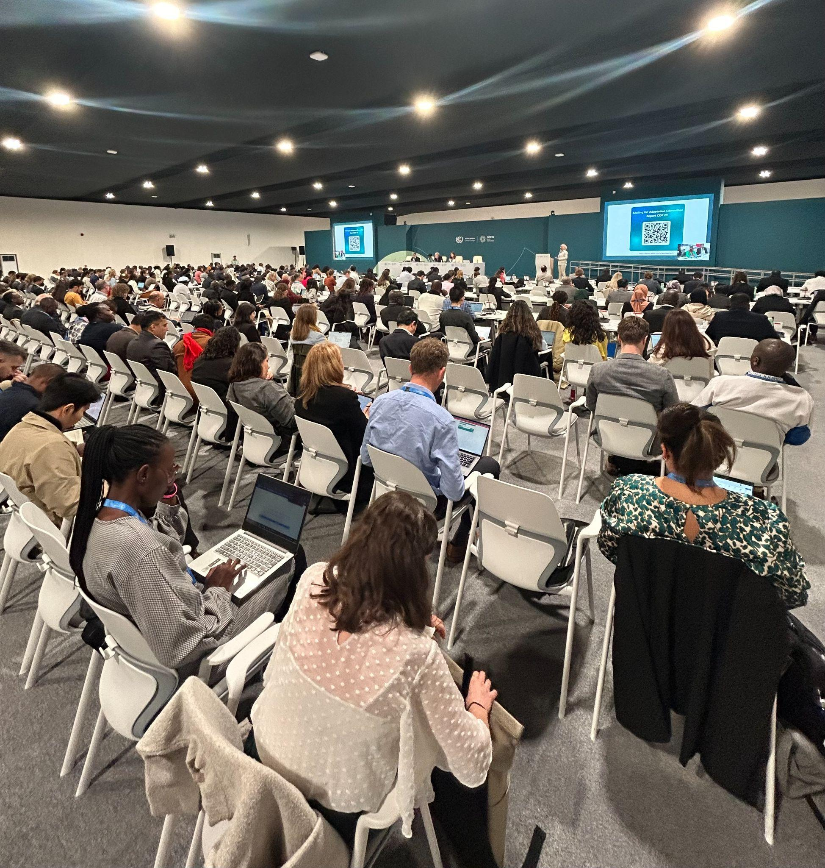
Final COP29 WP Decision
Emphasizes importance of ensuring geographical and gender balance among the experts.
Invites organization of regular dialogues and workshops, as needed, over the next year.
Emphasizes importance of including traditional knowledge, knowledge of Indigenous Peoples and local knowledge systems in work.
“Means of implementation” but in the context of “enablers of implementation”
Page ‹#›

Slide 15
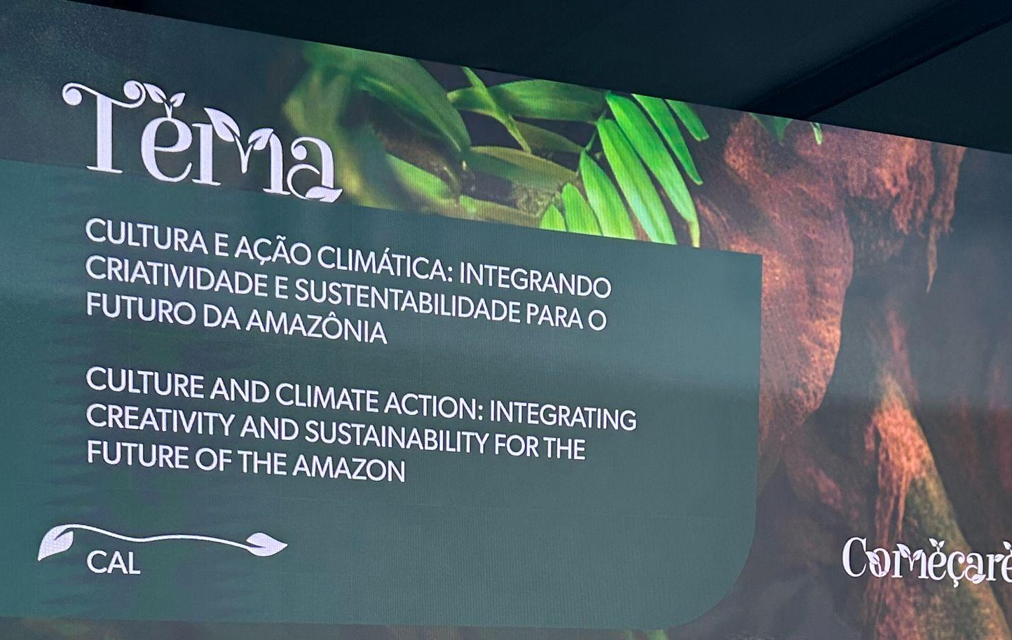
Final COP29 WP Decision - Time Line
Experts to commence work on further refining indicators, addressing gaps.
Requests SB Chairs to organize a hybrid workshop prior to SB62 (June 2025)
Experts to develop new indicators immediately and produce a consolidated list of indicator options for Parties no later than 4 weeks prior to SB62 (e.g. May 2025)
Secretariat to produce report prior to SB62.
SB62 (16-26 June - Bonn Germany)
Confirms COP30 will decide on a final list of indicators.
COP30 (11-22 November - Belem Brazil)
Page ‹#›

Slide 16
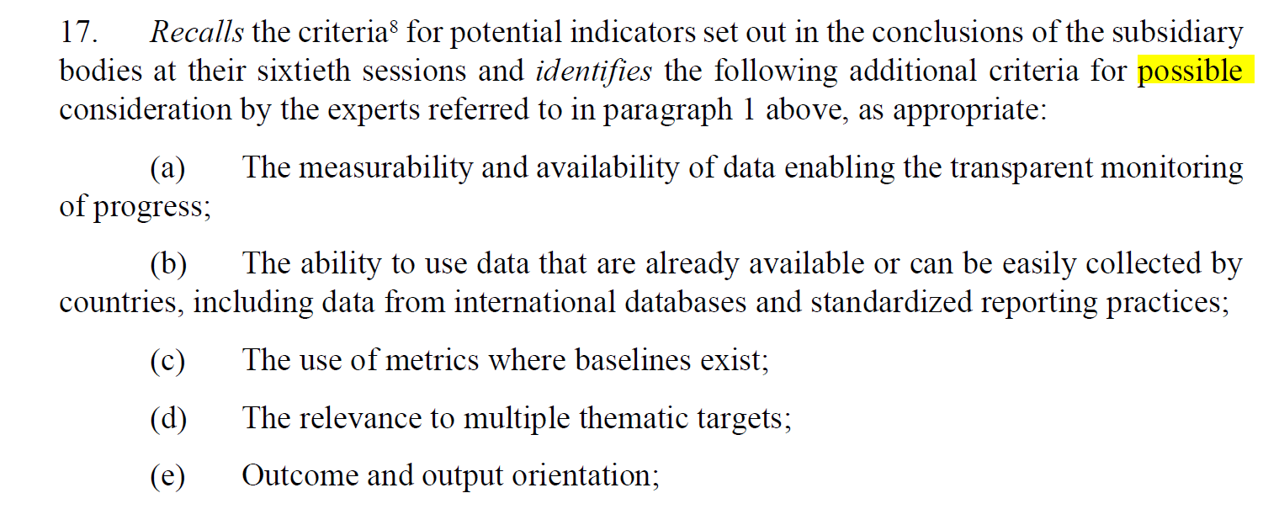
Final COP29 WP Decision
Page ‹#›

Slide 17
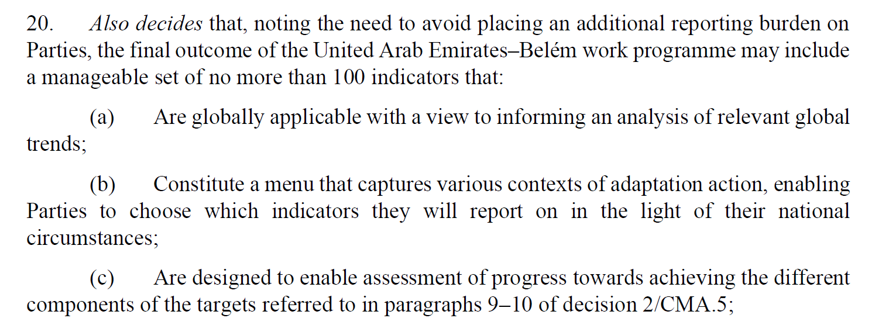
Final COP29 WP Decision
Page ‹#›

Slide 18
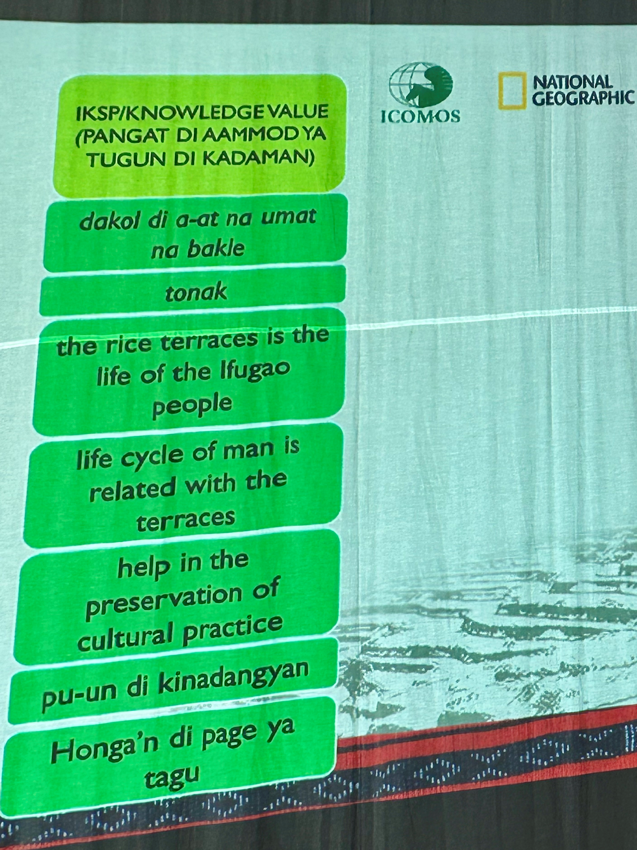
UFGCR Cross-Cutting Issues
UFGCR also includes several cross-cutting issues including:
Adaptation guided by traditional knowledge, Indigenous Peoples’ knowledge, local knowledge systems (UFGCR para 14)
Ethical and equitable engagement with Indigenous Peoples and local communities and application of traditional knowledge, the knowledge, wisdom and values of Indigenous Peoples, and local knowledge systems in UFGCR Implementation (para 22)
Empower people with the knowledge, skills, values and attitudes necessary for climate action. (para 23)
Page ‹#›

Slide 19
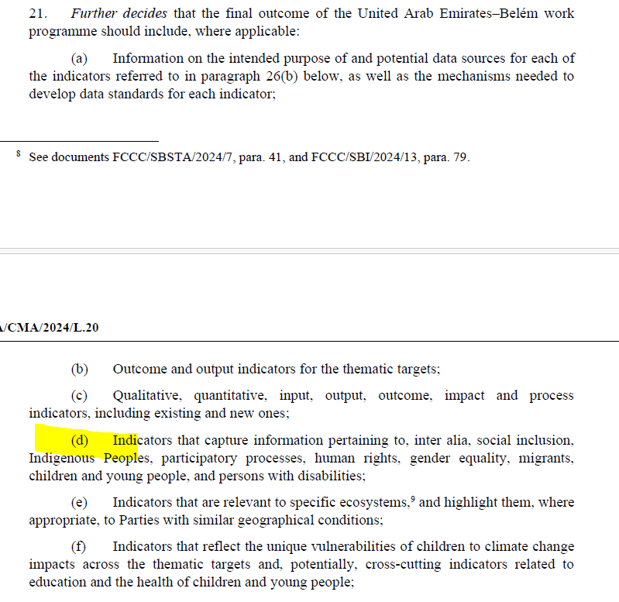
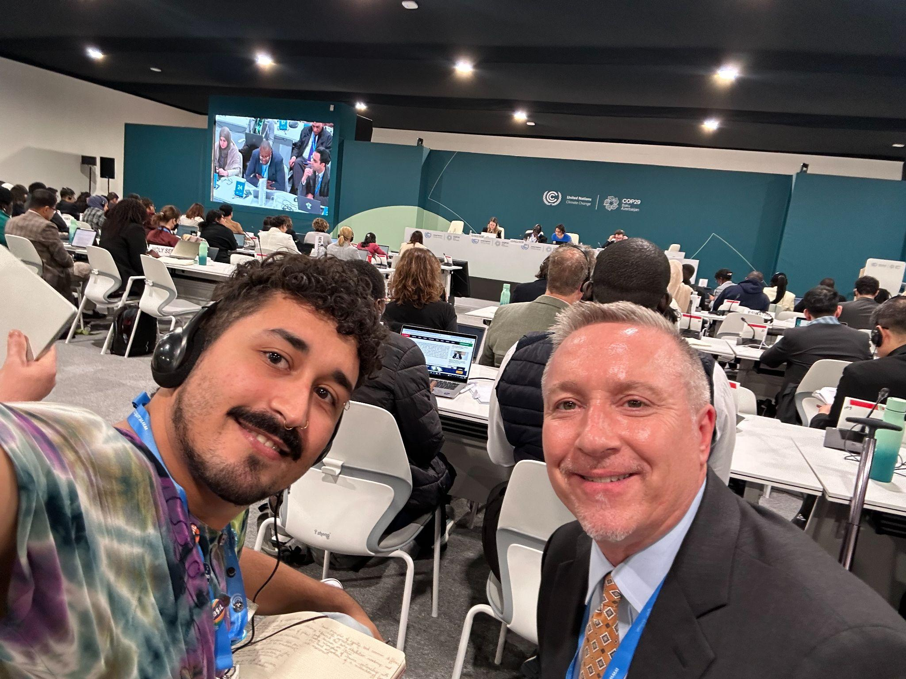
Final COP29 WP Decision
Page ‹#›

Slide 20
Other COP29 Adaptation Decision
Requests GGA be a standing agenda item at future SBs and COPs.
Launch the Baku Adaptation Road Map with the aim of advancing on the GGA.
Establishes the Baku high-level dialogue on adaptation, to be convened on the margins of each COP w aim of identifying ways of enhancing the implementation UFGCR.
Calls on Parties to update their adaptation communications ataking into account the UFGCR and requests secretariat review progress towards achieving the targets and report findings in the 2nd GST synthesis.
Welcomes IPCC decision to update 1994 IPCC Technical Guidelines for Assessing Climate Change Impacts and Adaptations, including adaptation indicators, metrics and methodologies to be scoped.

Slide 21
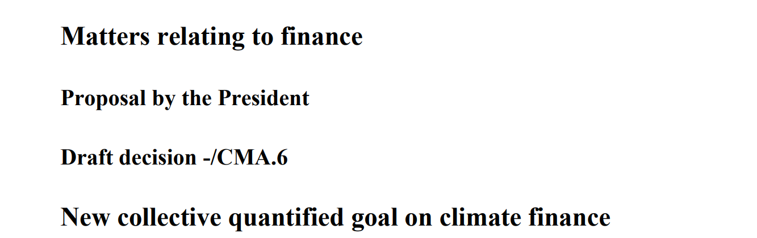
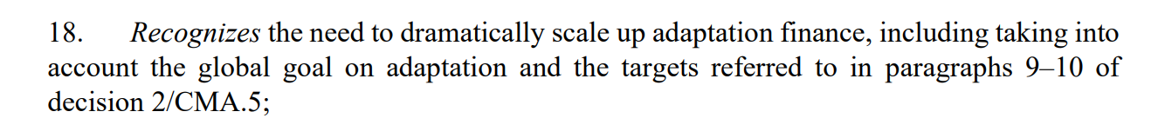
Finance Decision (NCQG)

Slide 22





