Slide 1

Is the Estate’s Largest Asset Actively Managed?
A Conversation for California Professional Fiduciaries

Slide 2
"How many of your files are house-rich and liquidity-constrained?"

Slide 3

The Home Is Often the Largest Asset in the Estate
But is rarely actively managed.
The Imbalance Is Structural
In most California estates, the primary residence accounts for over half of total asset value—yet it often sits unmanaged while liquid reserves dwindle.
This concentration creates risk that demands active fiduciary attention.
Real Estate
Liquid Assets
Retirement
Investments
Other

Slide 4



Real Estate Decision Face Three Pressures
Stability
Liquidity
Harmony
Financial sustainability of the property
Controlled access to capital when it's needed
Managing family dynamics and expectations

Slide 5

PRESSURE 1
Stability
Is the property financially sustainable?
Mortgage Structure
Rate Exposure
Fixed vs. adjustable, remaining term, amortization risk
ARM resets, refinance eligibility, rising costs, market changes
Payment Risk
Tax & Insurance
Can the estate sustain monthly obligations long-term?
Proposition 19 implications, rising premiums
"What creates the most financial instability in your files?"

Slide 6

PRESSURE 2
Liquidity
Is there controlled access to capital?
Care Costs vs. Reserves
Forced Sale Risk
Are liquid assets being consumed faster than expected?
Selling under pressure rarely achieves fair market value
Borrow vs. Sell
Timing
When does leveraging the asset outperform liquidating it?
Market conditions, tax calendar, beneficiary readiness
"How often does liquidity drive your property decisions?"

Slide 7

PRESSURE 3
Harmony
How will this affect the family?
Emotional Attachment
Legacy vs. Liquidity
The childhood home carries weight beyond market value
Preserving the property vs. distributing its value
Sibling Conflict
Documentation
Unequal needs, unequal attachment, unequal expectations
Transparent reasoning protects the fiduciary and the family
"What creates the most tension around real estate in your experience?"

Slide 8
Stability + Liquidity + Harmony
= Prudent Stewardship
When all three pressures are addressed together, the fiduciary's decision-making framework becomes clear, defensible, and aligned with the estate's best interests.

Slide 9

HECM Overview
Understanding the Home Equity Conversion Mortgage — at a high level — so you can evaluate when it belongs in the conversation.

Slide 10
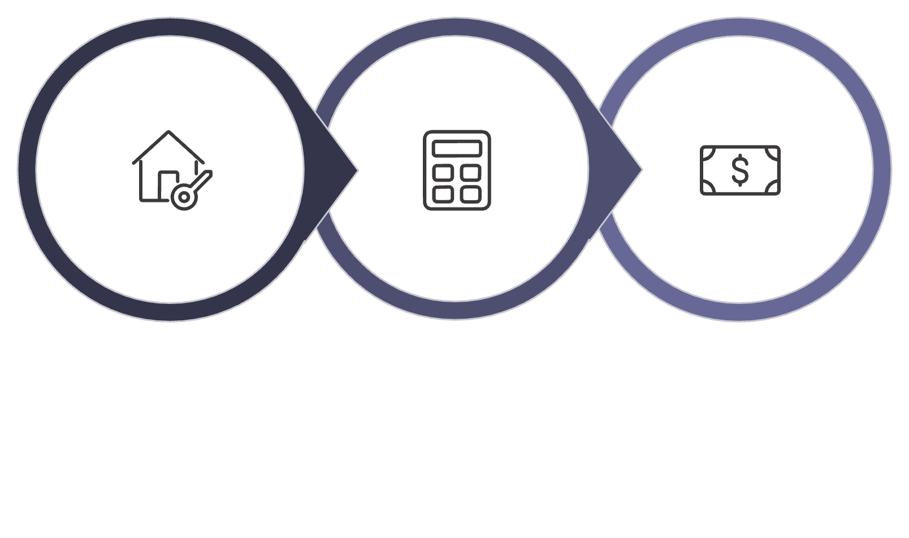



How the HECM Works at a High Level
Home Value
Youngest Age
Mortgage Balance
The Home Equity Conversion Mortgage converts a portion of home equity into accessible capital without requiring a monthly payment.
Non-Recourse
No Required Monthly Payment
Borrower or estate never owes more than the home's value
Loan balance repaid when the home is sold or borrower passes
HUD Counseling Required
Must Maintain Taxes & Insurance
Independent counseling ensures borrower understands obligations
Ongoing property obligations remain the borrower's responsibility

Slide 11
HECM Line of Credit (LOC) Growth*
Uses:
In-Home Care or The “If” in Life
Hedge Against HV Decline
Opportunities
Risk Management
62-year-old client with $1,209,800 Home Value
*Growth will vary. LOC Growth Rate: 5.875%
$2,249,396
$1,209,800 Home Value
at age 92
$31,600 Cost
NOTEWORTHY:
(1) The Line of credit grows regardless of what happens to the value of the home.
(2) The line cannot be cancelled or frozen*
(3) NO payments are required.
Notes:
The BIG Idea: Retirement researchers, such as Wade Pfau and Harold Evensky, have concluded that the HECM credit line is a powerful risk management tool that all advisors should evaluate for all their clients.
Talking Points:
Why? Let’s think of the Jones, a 62-YO couple with a home worth $636,150. They may be a couple with no LTCI or one that does not have a cash reserve that can help them through down markets. The HECM credit line provides a way for them to manage through these various risks. In their case, their credit line starts at $201,610., a modest amount. BUT let's say Mr. Jones passes away 3 months after they put the line in place. Let's now look at what Mrs. Jones, who at the age of 82 is worried about her declining savings, has available to her. Regardless of what happens to the value of the home, Mrs. Jones has $879,893 available to her. Or look at year 30, it’s over $1.8 million. Again, big plus of FHA fund. And by the way, the cost of this strategy can be as little as $4500.
Tips:
Add your stories of clients who have used line to manage health care risk etc.
Dr. Wade Pfau from the American College says at the very least this is a “PUT OPTION” on the value of the home.

Slide 12
3 Years of Draws Starting at Age 82 + Lump Sum
❶$200,000* for 3 Years + ❷ $802,404 \ Available in Credit Line at Age 86
$ 802,404
$ 600,000
$1,402,404 Tax Free Draws
*Assumption: $200,000 Annual LTC Cost
Notes:
BIG POINT: Mrs. Jones can draw over $1.5 million dollars with this deferred income strategy, all because she started early! How many of your clients could benefit from the “safety net” of having this strategy available to them.
Talking Points:
So how do we get to the $1.5+ million number? It assumes she draws $67,273 for 10 years for total of $672,730. At the end of 10 years or age 92 she draws every nickel from the available credit line, i.e. $879,893. Put the amounts together, she can access $1,552,623 in tax-free cash.
Do you have clients that could benefit from this income hedge for a cost of say $4,500? i.e. the initial cost of the credit line.

Slide 13
Credit Line Growth: How it Works
$420,987 Available Line:
X 6.59% * (Effective Growth Rate)
$27,743 Growth in Y1
$ 27,743 Growth
+ 420,987 Initial Line
$ 448,730 Available Line Y2 –
❶
2.00% Lender Margin
.50% MIP
4.09% CMT Index
6.59%*
❷
❸
Compounds …Guaranteed*
* Tax and insurance payments have to be made
Notes:
BIG POINT: This is the math behind the GROWTH in the credit line. KEY is the amount will grow by a GUARANTEED RATE, regardless of what happens the value of the client’s home
Talking Points:
1. So the available line, $201,610 in this example, is multiple by 7.39%.
2. The 7.39%. THE growth rate, is made up of 3 Factors: lender margin, FHA MIP and the 10-year Libor Swap Rate
3. KEY Point is the lender margin and the FHA MIP are FIXED, such the client’s line in this case is guaranteed to grow at 5%. (i.e. 4.5% LM + .5% MIP), regardless of whether the home appreciates or depreciates.

Slide 14


The IRA Stretch™
Using a HECM to increase IRA withdrawal flexibility and reduce retirement cash flow risk while increasing Legacy
John Thompson
Certified Liability Advisor
John@smplmortgage.com
NMLS: 252514
© National Institute of Financial Education (All Rights Reserved)

Slide 15
The Home Equity IRA Stretch™
A Case Study
Client Scenario
Client Plan
70 and 71 - Retired Couple
$1,300,000 Home - No Mortgage
$862,000 in IRA Assets
Spending needs $25,000 over Pension/SS
Liquid Assets almost gone
Concerned about Tax on IRA withdrawals
RMD/Tax & Spending will run out in 13 years
HECM Standby Line of Credit Establish
$438,000 Access
$100,000 initial cash
$25,000 Tax Free draws for 10 years
Growing Line of Credit for Contingencies
Year to Year Evaluation on whether to draw from IRA or HECM based on market conditions with their advisor
Client Goals
Client Impact
Age in place
Freedom to travel
Remove stress around the budget
Maintain highest level of net worth without
sacrificing lifestyle
Have plan in place for contingencies.
Client will be able to age in place with lower risk of cash flow depletion, reducing stress while increasing lifestyle. A funding source for contingency is now available as needed.
Key Results:
$350,000 Tax Free Cash Flow
$522,000 Line of Credit Available
$1,400,000 Home Equity (3% loan balance)
© National Institute of Financial Education (All Rights Reserved)
Notes:
What does it look like?: See our example where we’ll show a client at risk of running out of money in their 80’s becomes a more confident client with income through their 90’s, with greater peace of mind and flexibility to respond to changing market conditions.

Slide 16
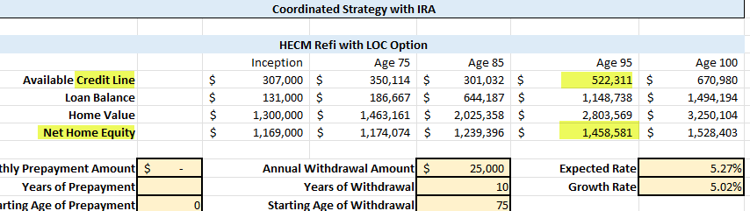
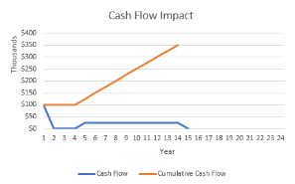
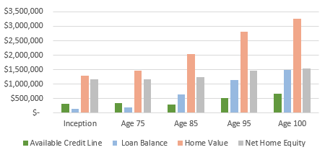
Notes:
The Growth rate on the Line of credit at 5% is 17,500 remember its compounding.

Slide 17
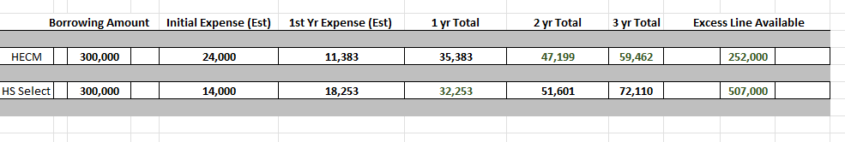

Slide 18
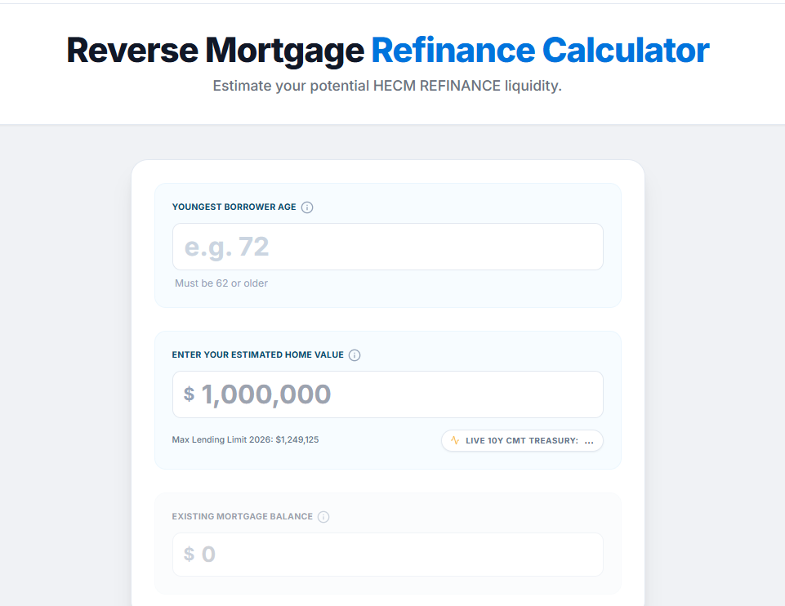
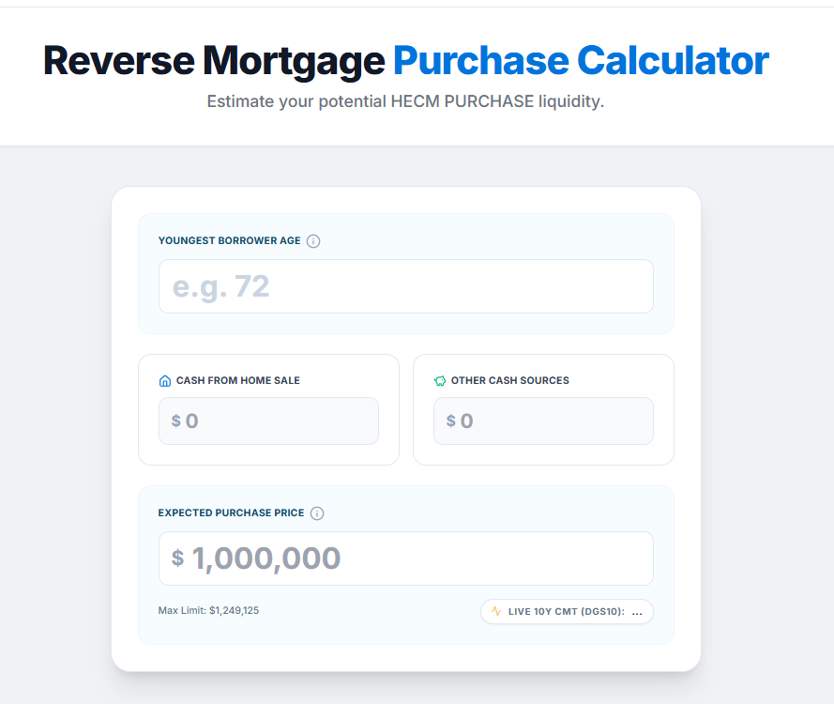

Slide 19

Why It Matters in Estate Administration
The HECM is not a product recommendation — it's a tool that fiduciaries should understand to evaluate options thoroughly.
Liquidity Without Forced Sale
Sequence Risk Buffer
Aging-in-Place Funding
Avoid liquidating investments in a down market
Finance modifications and care needs
Access capital while preserving the asset
Delayed Asset Liquidation
Buy time for better market conditions or family readiness
"In what situations would this create stability rather than risk?"

Slide 20

Private Money & Non-Traditional Financing
When conventional lending doesn't fit the estate's circumstances, alternative structures may offer a path forward.

Slide 21

When Conventional Financing Is Not an Option
Standard underwriting often fails to accommodate the realities of estate administration. Common obstacles include:
Trust Ownership Complexity
Income Qualification Issues
Bridge Financing Needs
Asset-Based Lending
Underwriting based on property value, not borrower income
Title held in irrevocable trusts or multi-party structures
Estates may lack qualifying income under traditional guidelines
Short-term capital required before probate resolution

Slide 22





Private / Asset-Based Lending
Private money serves a specific role in estate administration — not as a first choice, but as a flexible alternative when conventional options are unavailable.
Short-Term Bridge
Temporary capital to cover estate obligations during transitions
Renovation Funding
Prepare a property for sale to maximize estate value
Probate Transitions
Fund obligations while title and administration are resolved
Flexibility Over Rate
Higher cost, but speed and structure are the real value

Slide 23

Deferred-Payment Structures
Used Carefully and Strategically
In specific circumstances, deferred-payment products can preserve short-term cash flow — but they require rigorous analysis and fiduciary judgment.
1%-5% Minimum Payment
Negative Amortization
Reduces monthly obligation to preserve estate liquidity
Unpaid interest accrues — the loan balance grows over time
Payment Flexibility
Cash Flow Preservation
Adjustable payment tiers allow cash flow management
Frees capital for higher-priority estate needs
Not appropriate in all cases. Requires structured analysis, documented rationale, and alignment with the estate's overall financial plan.

Slide 24

Integration
How we work together — supporting your fiduciary judgment.

Slide 25
Common Triggers for a Liability Review
Certain situations should prompt a structured review of how the property fits within the estate's overall financial picture.
1
2
3
4
Clients Over 55
Mortgage Structures Exposure
Rising Care Costs
Low Liquid Reserves
Opens additional financing options including reverse mortgage eligibility
In-home care or facility costs eroding liquid reserves
Estate approaching a cash-poor, asset-rich threshold
Align the liability with sustainable cash flow
5
6
Beneficiary Conflict
Aging-in-Place Renovation
Disagreements over retain vs. sell creating administration friction
Capital needed for accessibility modifications to the home

Slide 26
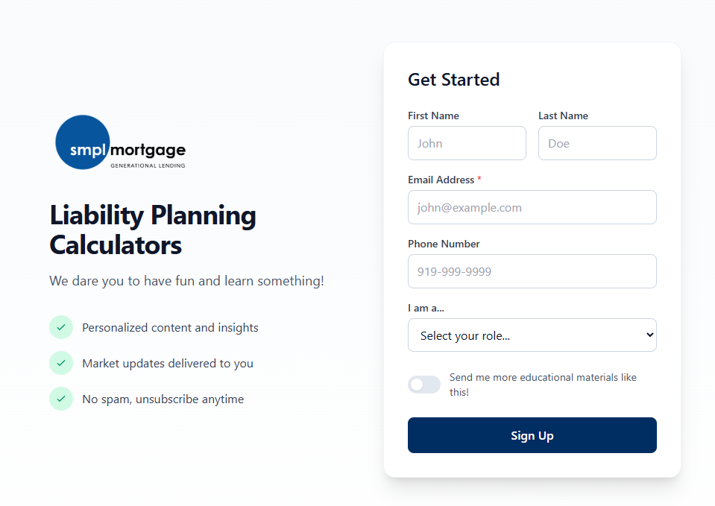


Slide 27

“We provide Strategic Mortgage Advice and Education to help families build Generational Wealth at every Stage of Life”

