Slide 1
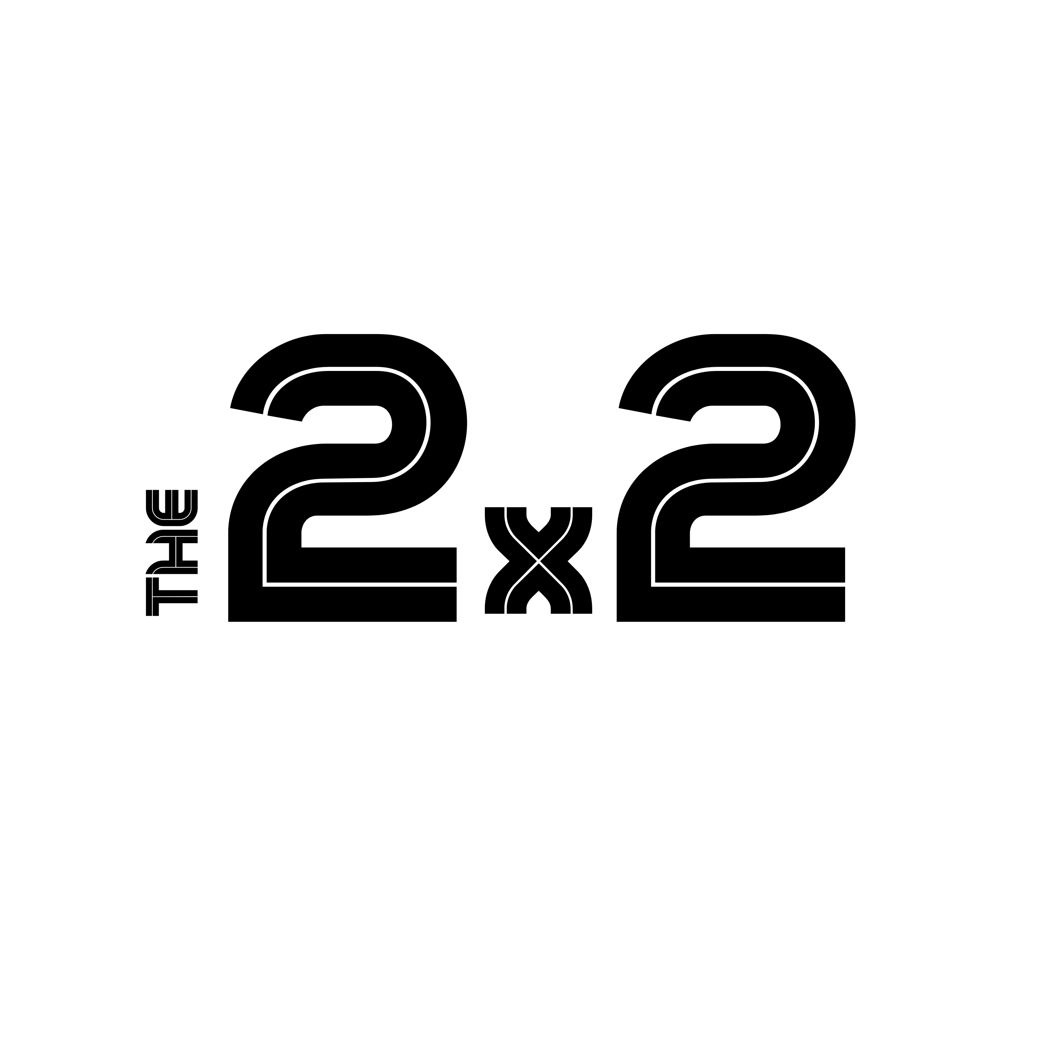
Frame the Problem:
Bucketing

Slide 2




Strategic Problem Solving
OUR PROVEN FRAMEWORK
1
2
3
4
Frame the Problem
Visualize Insights
Enable Decisions
Mobilize Action

Slide 3
Bucketing
Frame
USE IT
Move from an unorganized set of causes to logical, MECE components of a problem that can be assessed.
BUCKETING
Causes: Start by listing the potential causes of the problem. This does not need to be organized, but it should be complete.
Drivers: Organize the causes into a logical list, eliminating repetition.
Buckets: Group logically based on shared characteristics to show the MECE components of the problem.
Problem Statement: Create (or revise) a simple but complete problem statement.
Cause F
Driver A
Cause D
Driver B
Bucket 1
Cause G
Cause H
Driver C
Cause E
PROBLEM
STATEMENT
Cause A
Driver D
Cause K
Bucket 2
Driver E
Cause I
Cause B
Driver F
Bucket 3
Cause C
*MECE: Mututally Exclusive, Collectively Exhaustive. In ‘normal’ terms – no overlaps and everything is covered.

Slide 4
Kinetix is challenged on two fronts
EXAMPLE
Frame
Cannot address channel competitive entry nor about to adapt product, pricing, and sales motion to new market realities.
Competitor Investing in Channel
Kinetix is losing an increasing percentage of new client acquisition deals
Lack of Channel Program / Response
Lack of vertical value propositions
Kinetix is facing revenue loss and share erosion in it’s core customer verticals.
Product & Positioning are generalized and not targeted to core customer needs
Product complexity
Pricing & TCO
Inefficient Demand Generation
Sales and marketing costs are increasingly inefficient
High Cost of Sales

Slide 5

Subscribe to The 2x2 for more content like this.
the2x2.com
This document provided by our company is for general informational purposes only and does not constitute legal advice. We do not guarantee its accuracy or suitability for your specific needs. You are responsible for reviewing, customizing, and otherwise ensuring compliance with applicable laws. The Template does not create an attorney-client relationship, and we are not liable for any errors or damages resulting from its use. Any links to third-party content are at your own risk, and we do not endorse or assume responsibility for them. The Template is protected by intellectual property laws, and you may not distribute or modify it without our consent. We are not liable for any direct or indirect damages arising from the use of the Template. By using the Template, you agree to these terms. The2x2, 500 W 2nd St. Suite 1900, Austin, TX 78701.

