Slide 1

Notes:
In 2005 CMG decided to re-invent the mortgage. Why did they do that you ask? They recognized that the standard 30 year mortgage has been the same for the last 70 years. It helped a lot of americans get into houses but is also helped fuel the rise in home prices and therefore the cost of the debt to finance them, something needed to change.

Slide 2
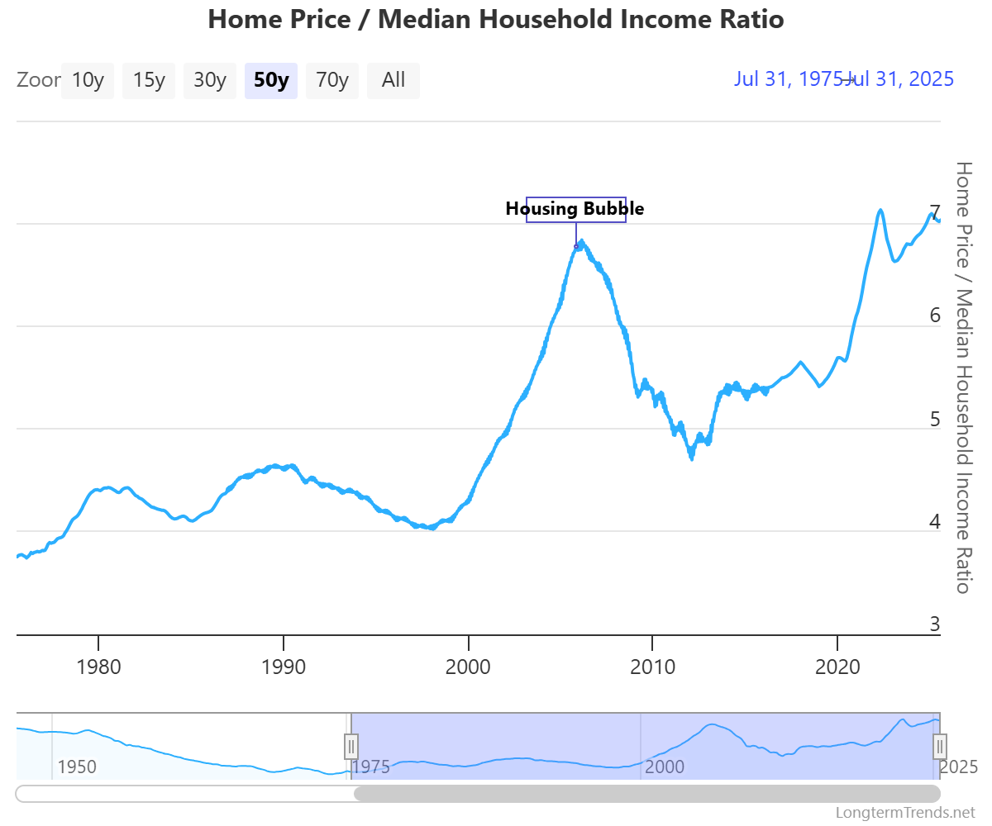
1980
Income:
$23,620
House Price:
$83,200
2025
Income:
$83,730
House Price:
$588,829
Source: The Kobeissi Letter
Notes:
When I was a kid in the ‘80s, my oldest sister bought a house which she ended up able to pay off in 15 years. Back then the median cost of a home was 3.5 X median income. Today that home is 7 X income

Slide 3
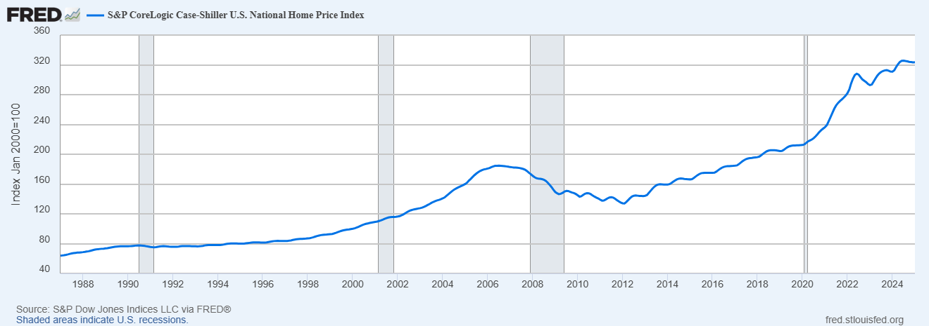
Notes:
In 1954 Congress officially authorized the 30 year mortgage and it became the gold standard for most people. It made homes feel more affordable but ultimately ended up much more expensive. 2000 mortgage rates fell, subprime mortgage – corrected in ‘08 but obviously not nearly to original prices. 2020 we also saw an explosion

Slide 4
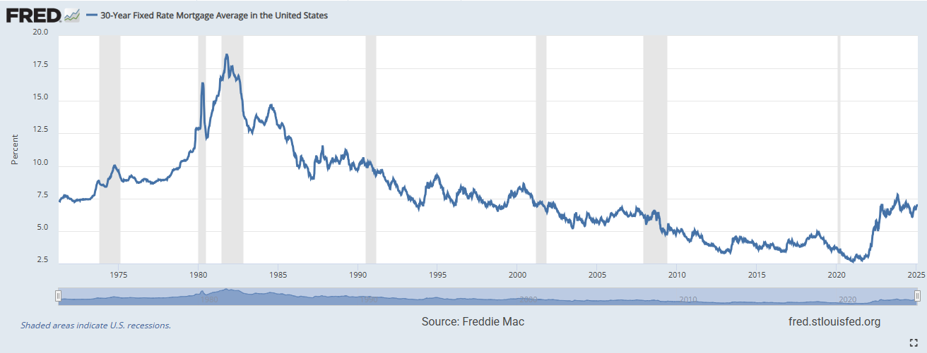
Notes:
Yes, mortgage rates are higher than in 2021 but I do want to put it into a little bit of perspective. Historically speaking, they aren’t all that bad. I’m glad I wasn’t trying to buy a house in the ‘80s!

Slide 5
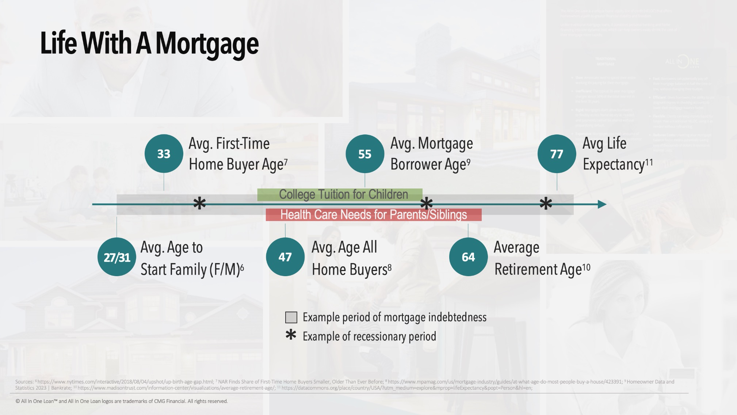
Notes:
Life with a mortgage is pretty expensive. Most of our accumulation phase is spent with close to half of our cash flows going to a mortgage and for a growing number of Americans they are carrying that debt into their distribution phase. The house is where 82% of Americans have the majority of their wealth. For 60% of homeowners it's also their largest liability.

Slide 6
The Big ?
Real Estate
Assets
Liabilities
Financial
Advisor
Liability
Advisor
Notes:
the house is the intersection of assets and liabilities which is why I believe your clients' balance sheets should be looked at as 3 sided
I get a lot of questions when helping people manage their liabilities and I’m guessing you get asked these as well. Should I get a 15 yr mortgage or a 30? Should I put down all of the money from the sale of my house towards the new house? I just got an inheritance. Should I pay off my house? These questions boil down to “should I put the money in my house and lower my mortgage balance or invest in savings?” It’s a variation of location….

Slide 7
Location Location Location
Real Estate
Assets
Liabilities
Prepay or invest??
Financial
Advisor
Liability
Advisor
Notes:
When people talk about real estate the words location… come up. Why? The better the location the higher the chance of appreciation. And of course, another term for appreciation is return.
We live lives of cash and cash flow and deciding what to do with that money, i.e. prepay or invest, is a version of Location, location, location. The heart of the question is really What is the highest and best use of my money? I can show you a lot of different ways that we can work together with strategies to help clients reduce the cost of ownership dramatically over their lifetime. When your client is buying a first house, a new house or an investment property. When they want a large sum of money and need to look at if it should come from their investments or from a loan against the real estate, when they are trying to decide if a refinance makes sense, when they have a big house they don’t need any more but they are concerned about trading down and what their options are.

Slide 8
Location Location Location
Safety Liquidity Return
Real Estate
Assets
Liabilities
Prepay or invest??
Financial
Advisor
Liability
Advisor
Notes:
When helping clients decide the best location for cash and cash flow you understand the importance of Safety, liquidity and return and the challenge of balancing these 3 things appropriately. Your clients should care about these 3 things as well, but I would guess that most of them only focus on 1 of these. Depending on the client you are most often getting asked about either return or safety. From people I talk to liquidity seems to be the least talked about until of course they are up against a need and can’t access the money.

Slide 9
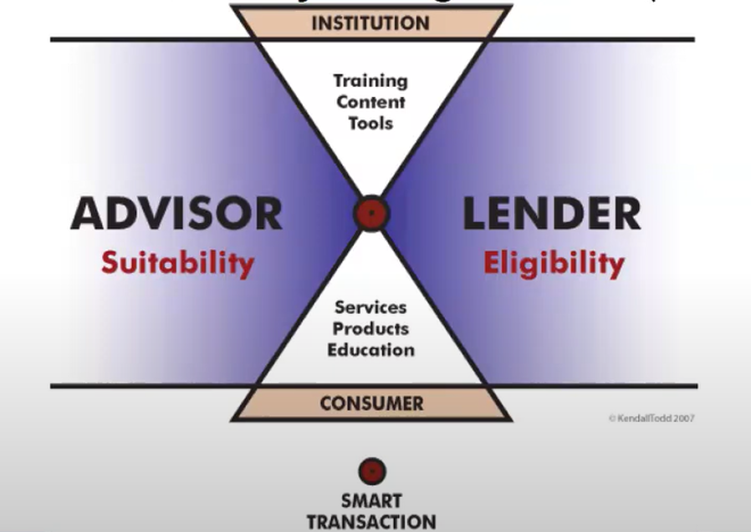
Product vs Strategy
Notes:
As a volunteer faculty member of NIFE we want to combat the missing and mis information around how we manage our money. The problem with the mortgage industry is that it looks at eligibility without considering suitability. Companies like Rocket & quicken sell mortgages like they are a TV and there is some best price without considering the overall impact on your wealth. I want to empower you with some of key concepts so you are better equipped for all decisions that are made around how to own, finance, and pay off real estate. Tiger Woods club or swing?

Slide 10
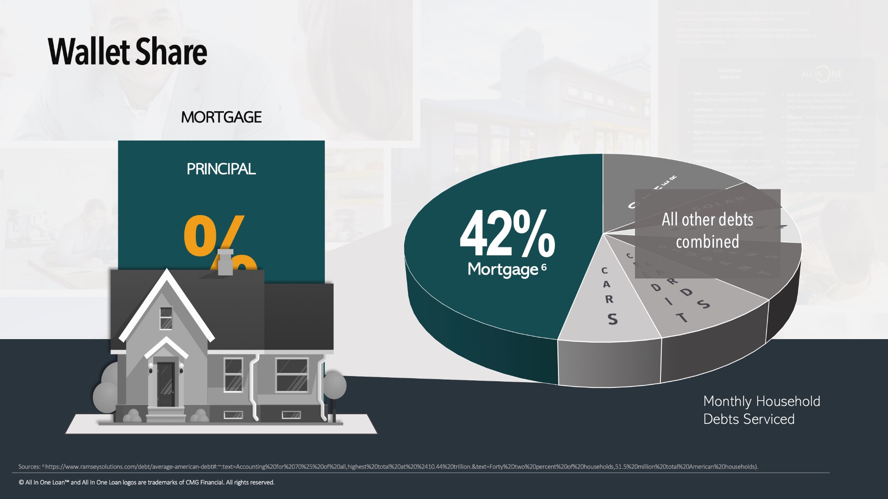

Slide 11
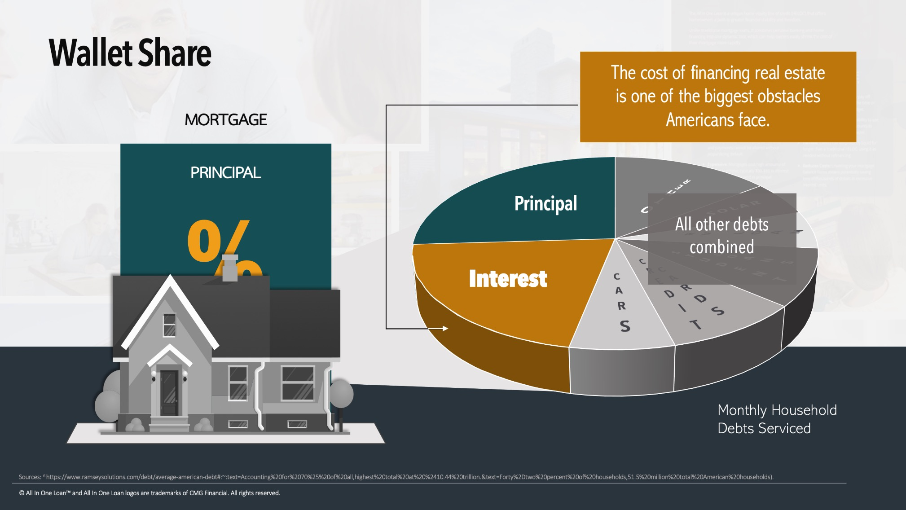

Slide 12
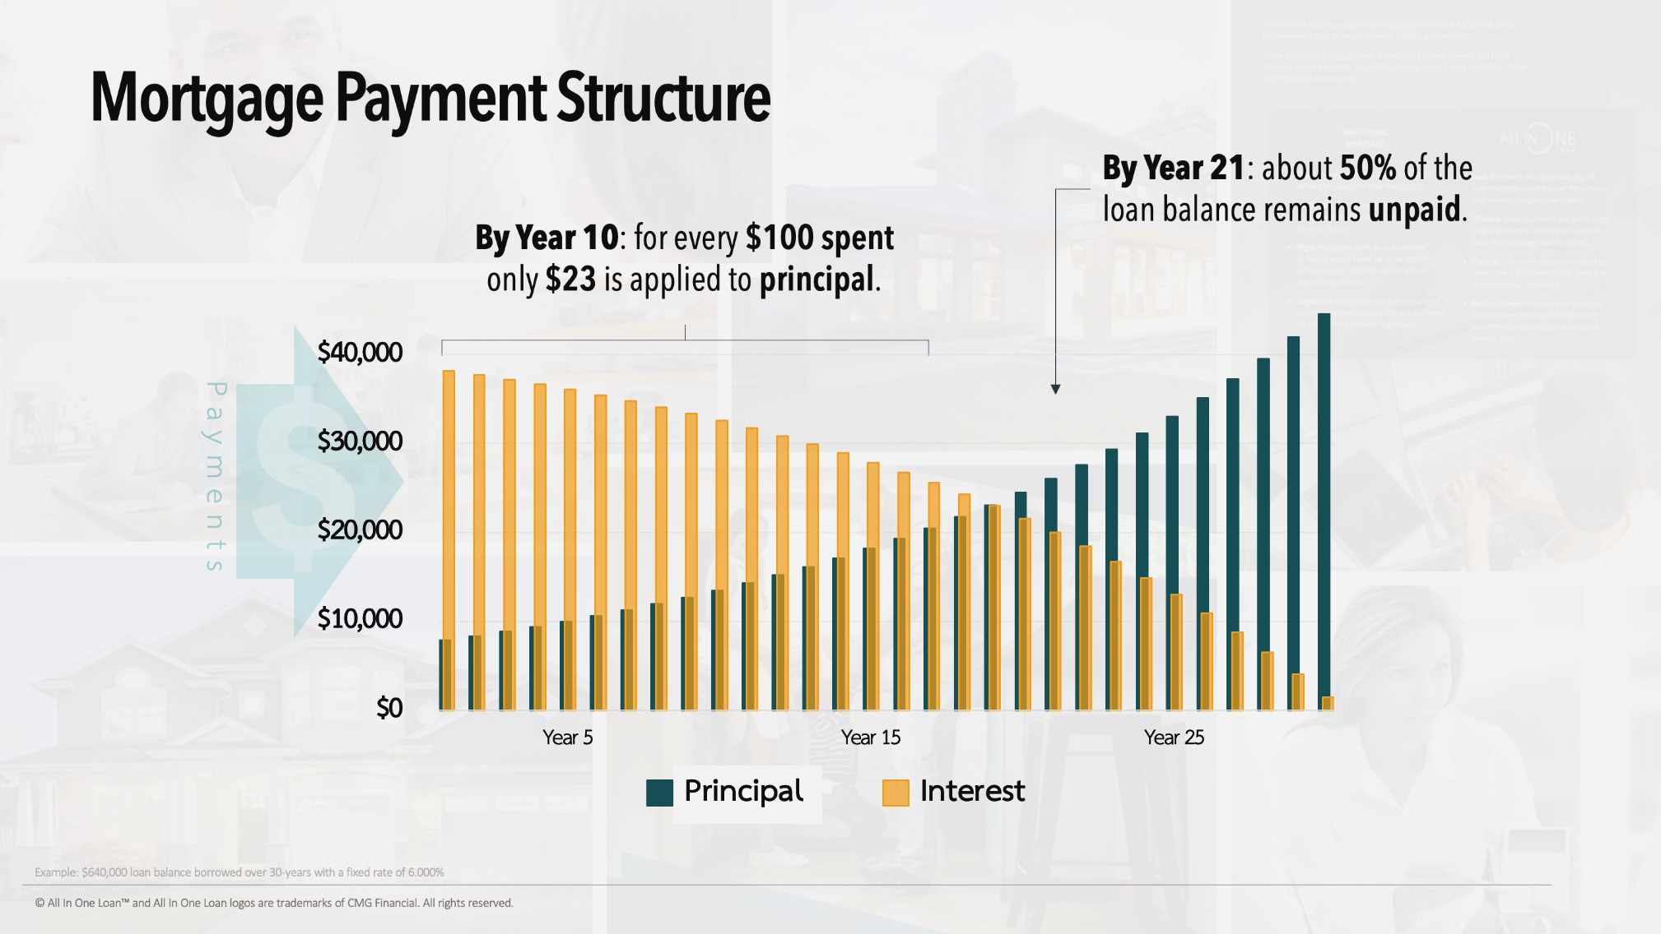
Notes:
When we look at how the interest is front end loaded in that mortgage though, we’ll have to say thank goodness for appreciation or it would feel like renting for those first few years. Factor in the fact that most people refinance or sell within the first 5-7 years and the numbers can be a bit depressing. At some point along the way, a buyer or homeowner qualifies for the all in one mortgage and then they are able to break free from the ball and chain mortgage and create a financial battle ax that will hammer down the cost of that loan. We took this archaic payment structure and modernized it.

Slide 13

“If I had asked people what they wanted, they would have said faster horses” -Henry Ford
Visionaries don’t just meet expectations.
They redefine them.
The All In One Loan™ - Mortgage reimagined
from a fixed expense...to a dynamic financial tool.

Slide 14
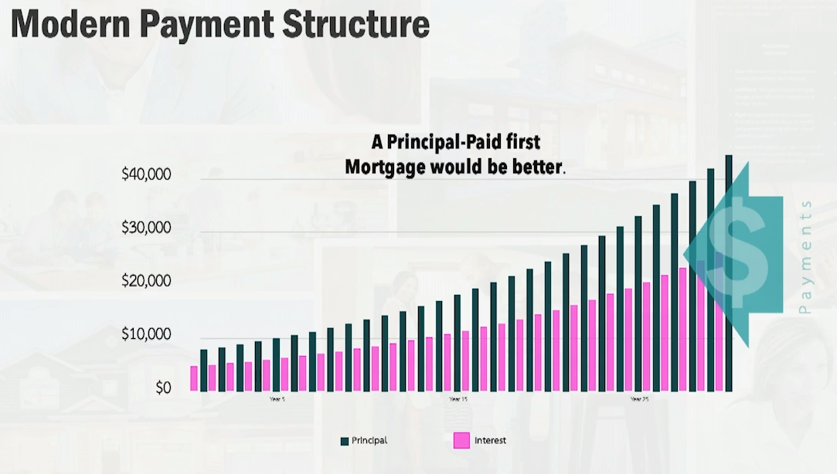
Notes:
We created the only principal paid first mortgage in America.

Slide 15
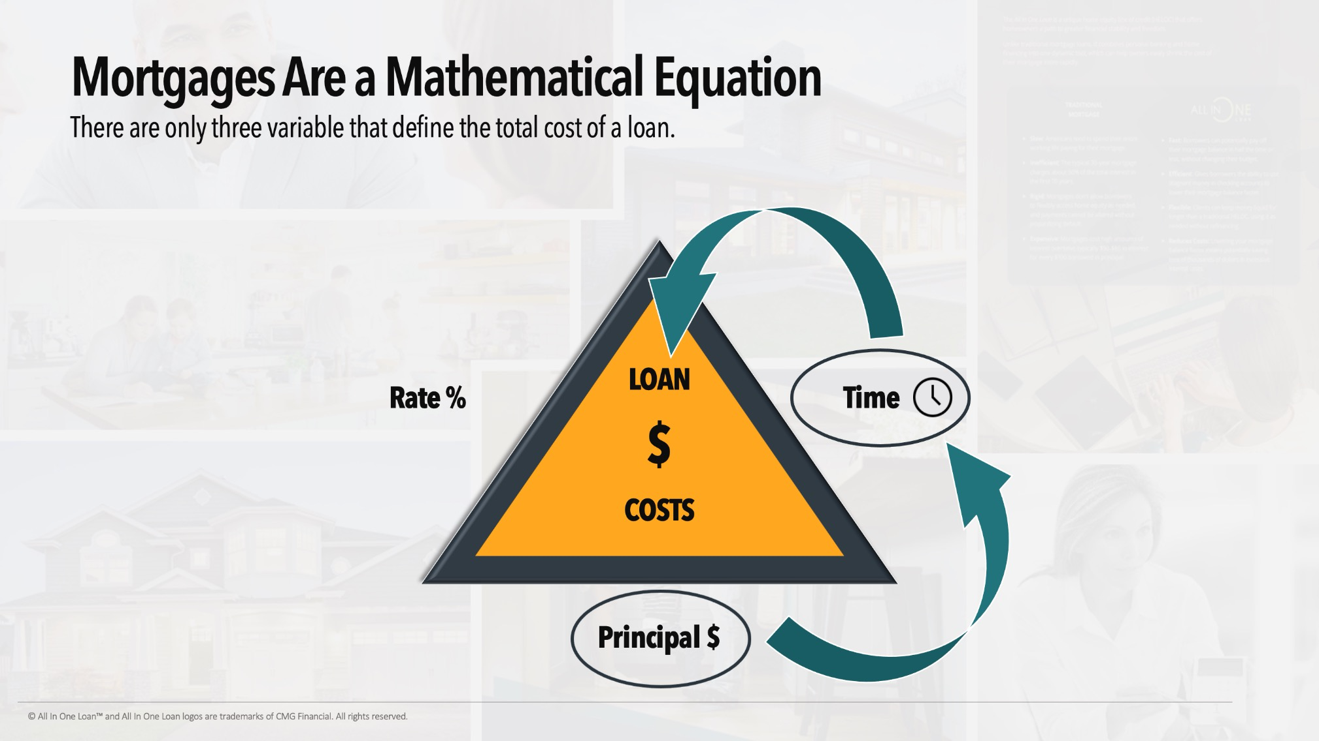
Notes:
Mortgages are just a math equation and fortunately, there is no law that says the lender can’t change it. Instead of focusing on the rate focus on what you owe and how long you are going to owe it. By doing that we automatically reduce how much you are going to be charged.

Slide 16
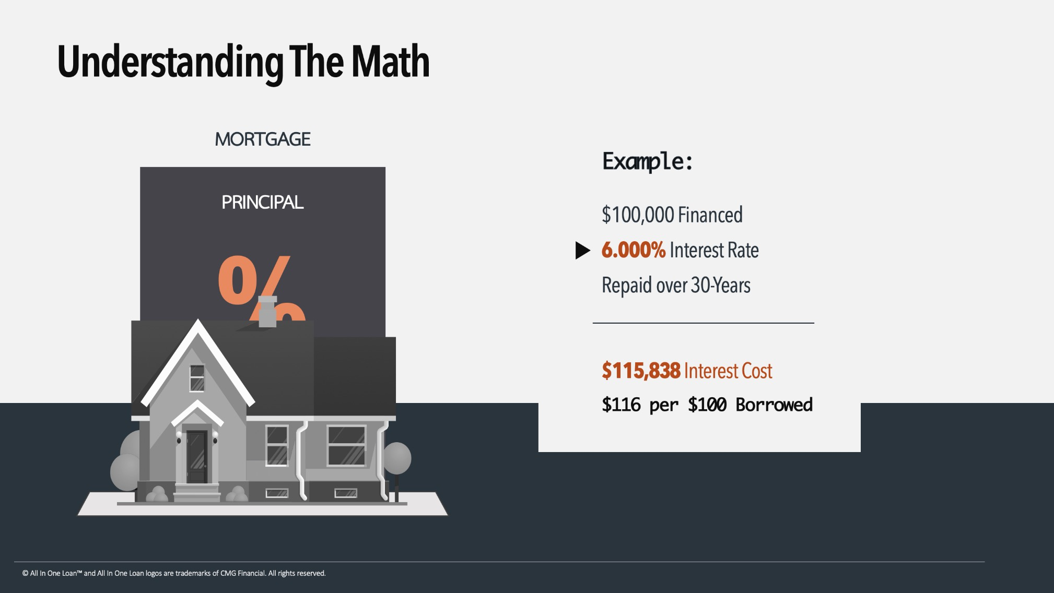


Slide 17
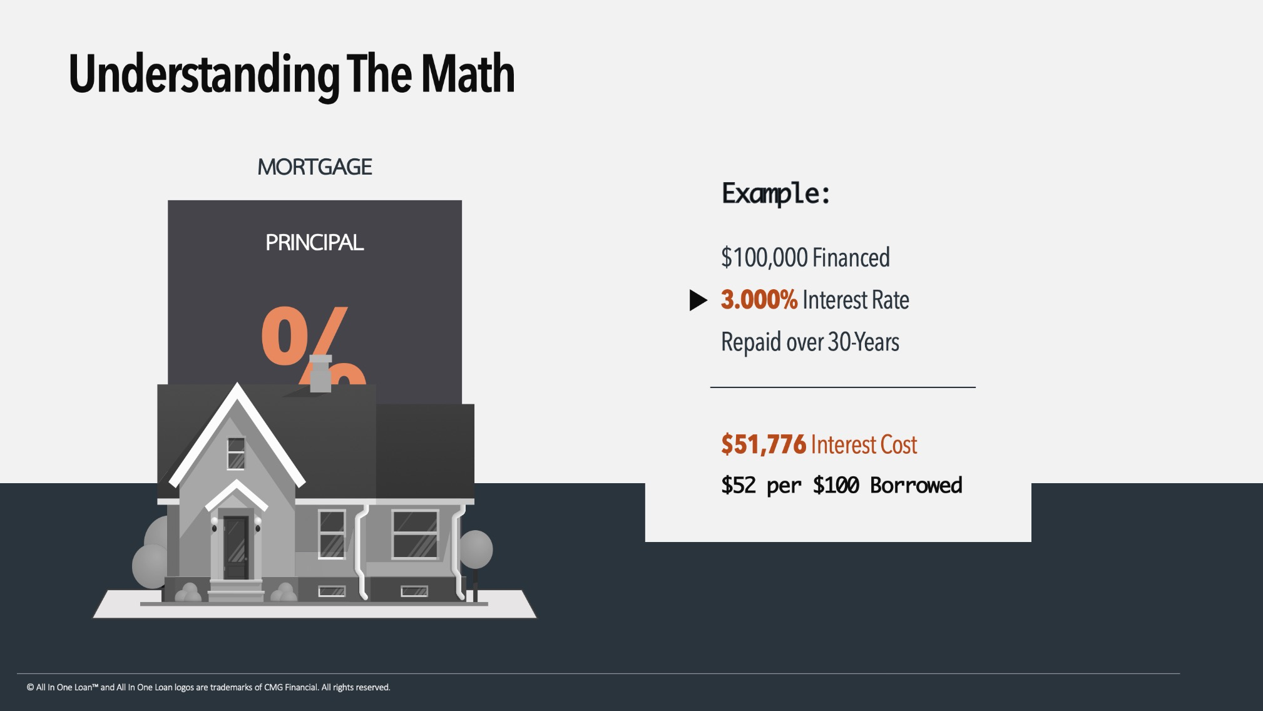

Slide 18
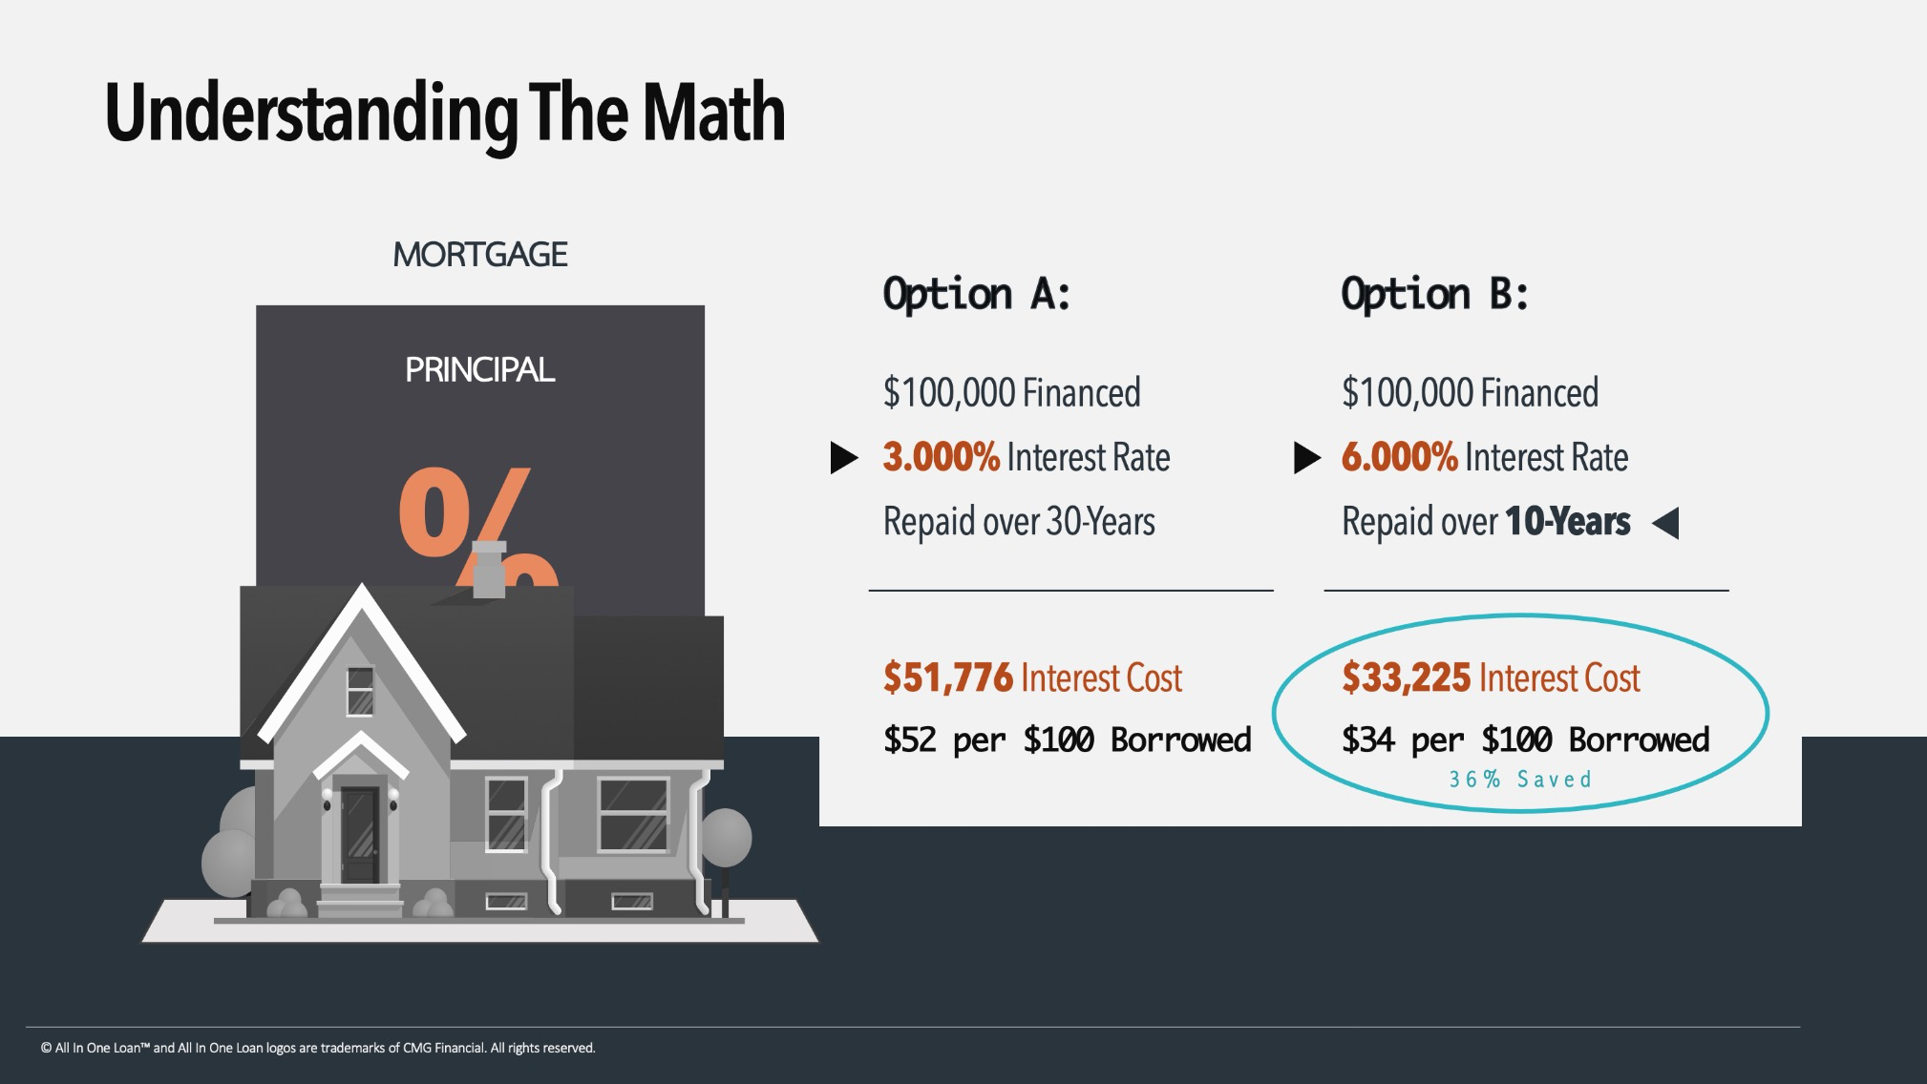
Rate vs Cost

Slide 19
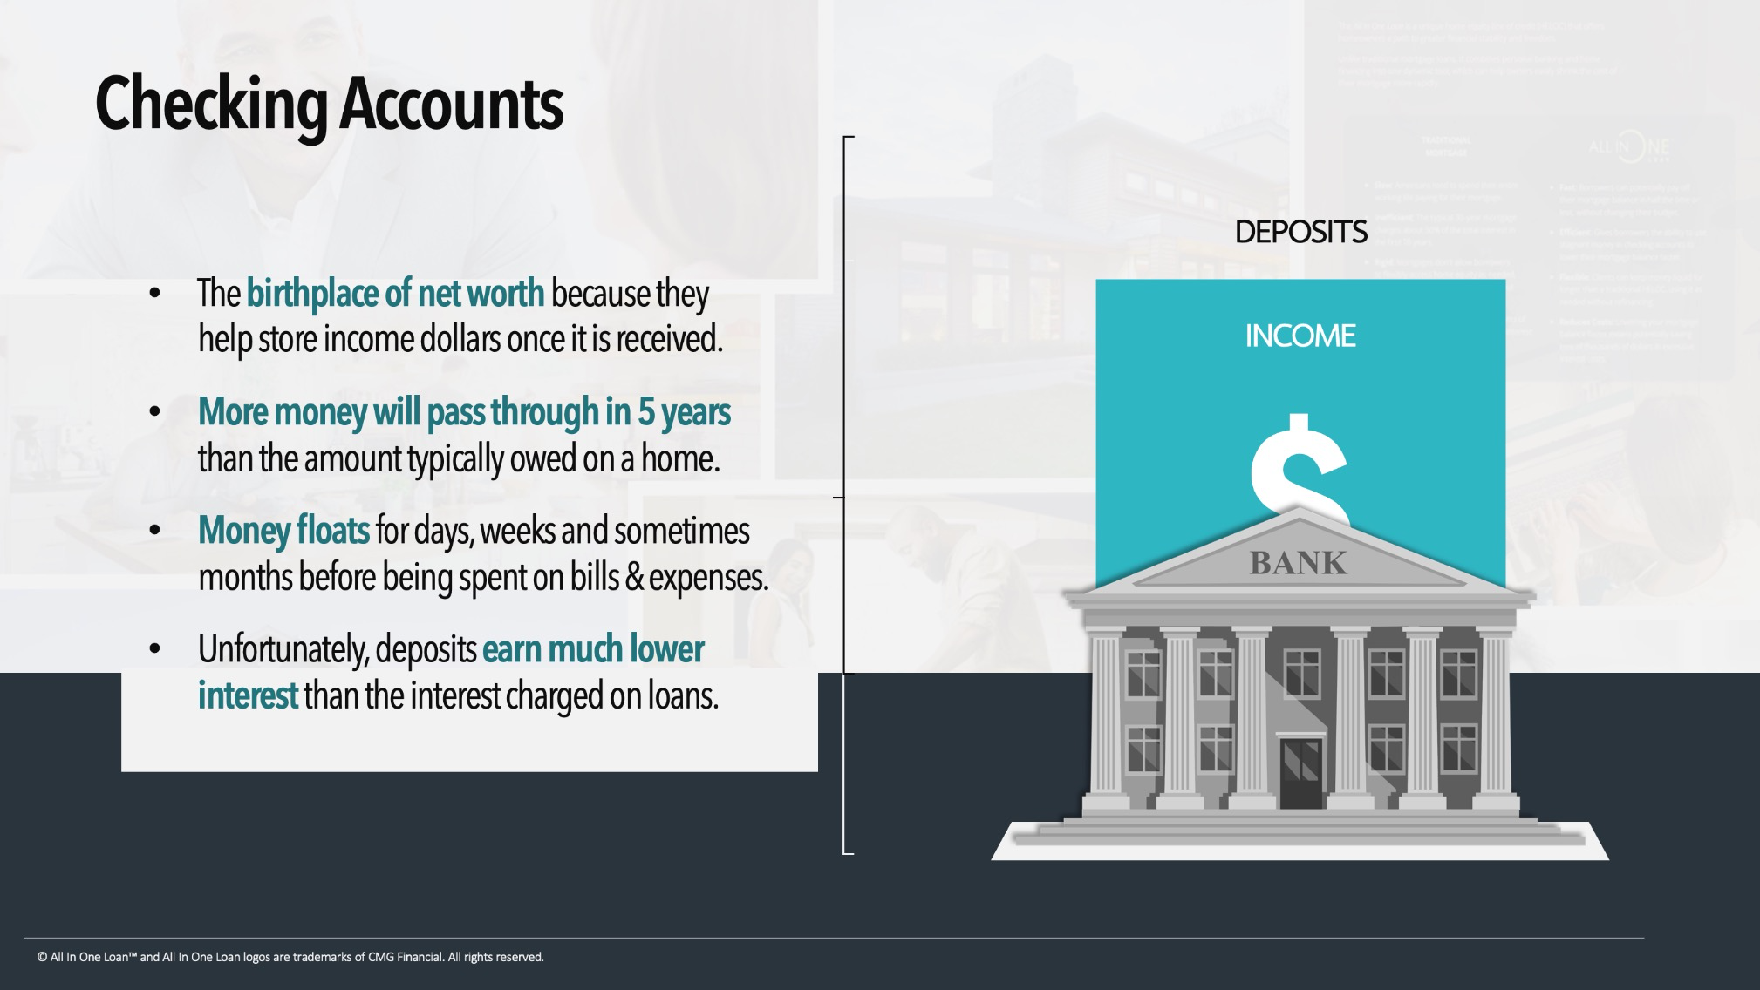

Slide 20
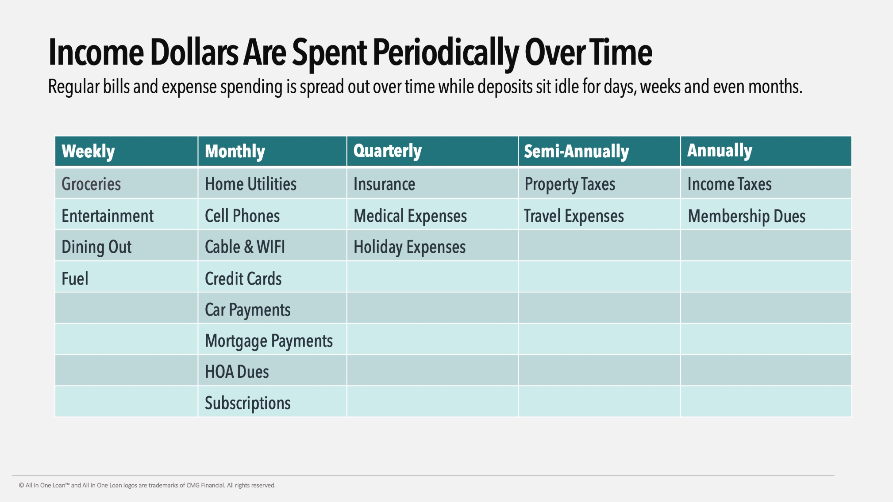

Slide 21
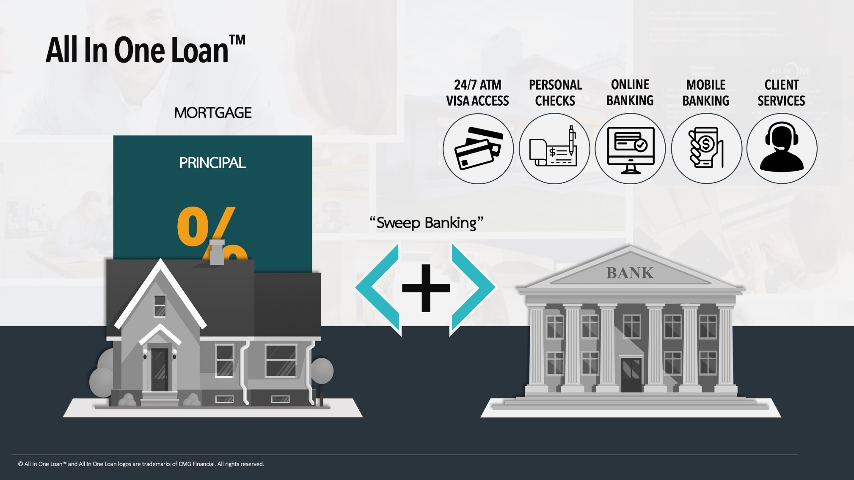
Notes:
The all in one loan is an offset mortgage combining your home loan and your deposit account.

Slide 22

Notes:
When someone gets an all in one loan mortgage they get a checking account and when they deposit money into that checking account it doesn’t just sit there

Slide 23
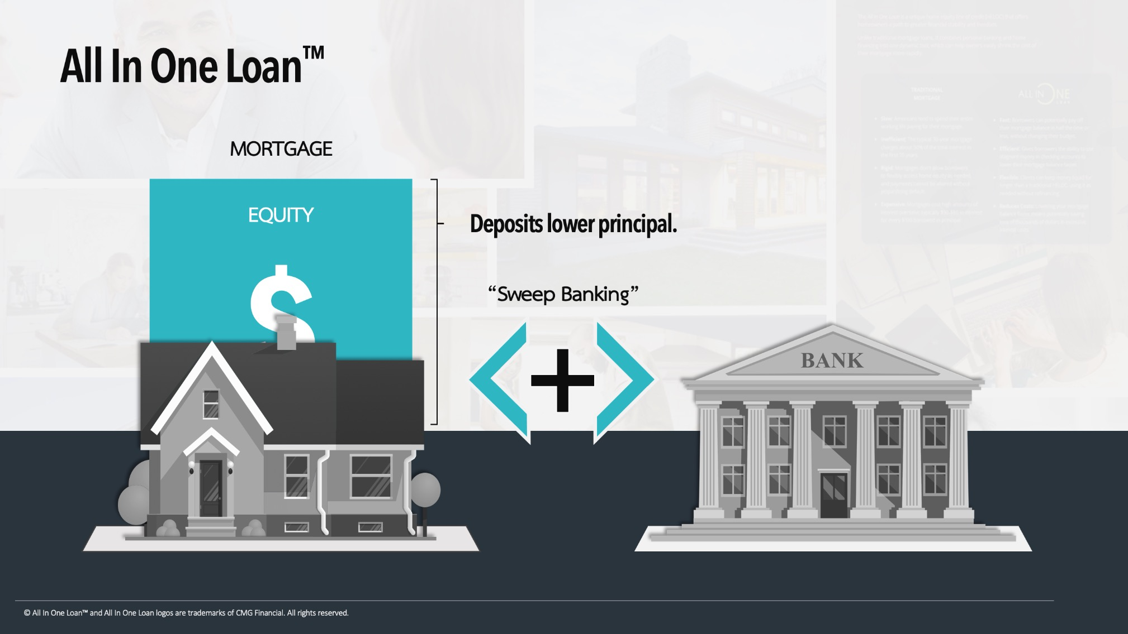
Notes:
it pays down the mortgage that day so you checking account balance works towards your principal, reducing your principal balance and interest balance.

Slide 24
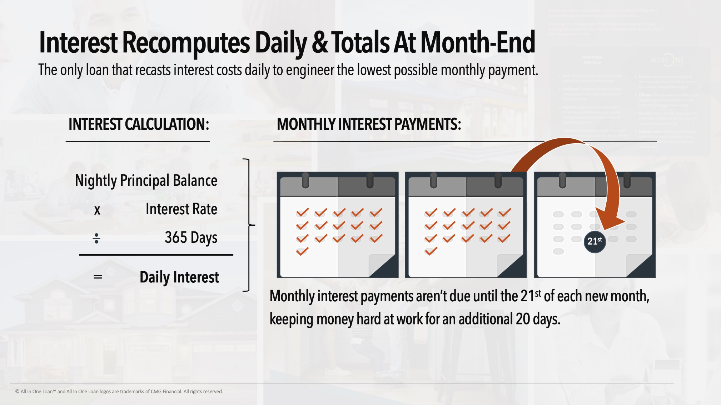
Notes:
That is a benefit because interest on this loan is not predetermined. It recasts every single day. That way we are engineering the lowest possible interest payment every month. Meanwhile all of that money stays liquid

Slide 25
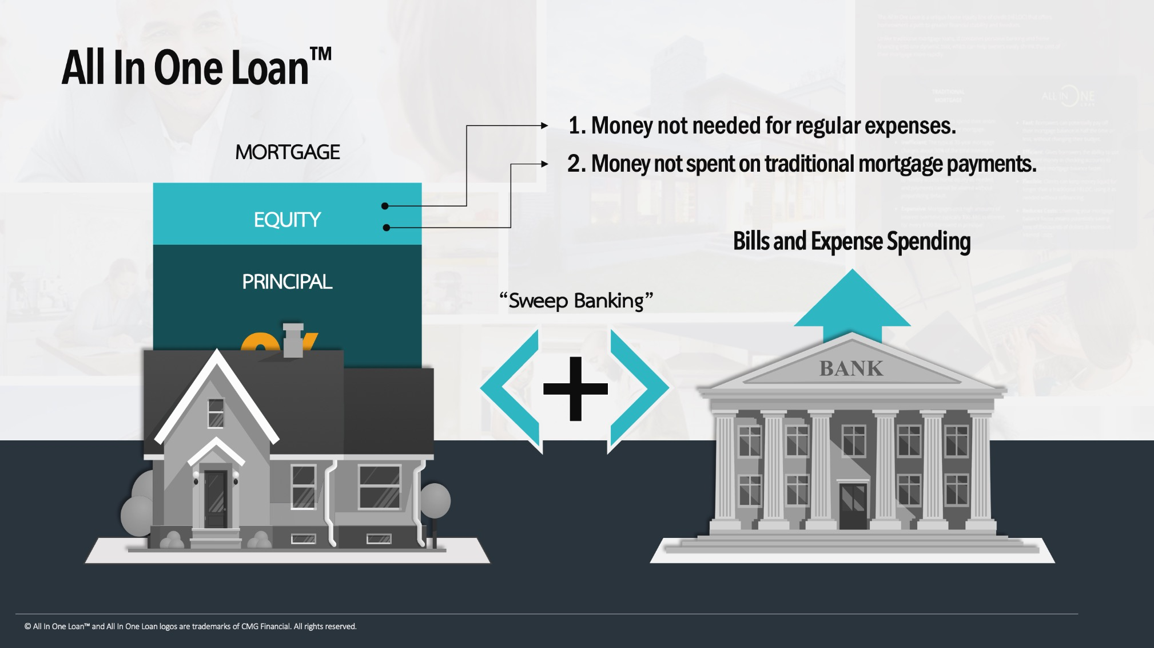
Notes:
Your principal is paid first meaning a faster principal paydown which allows you to save significantly over the course of your home loan. The beauty is any of the funds used to pay down the balance can still be accessed whenever you need them. They are all liquid, all the time. Spend your money as you normally would.

Slide 26
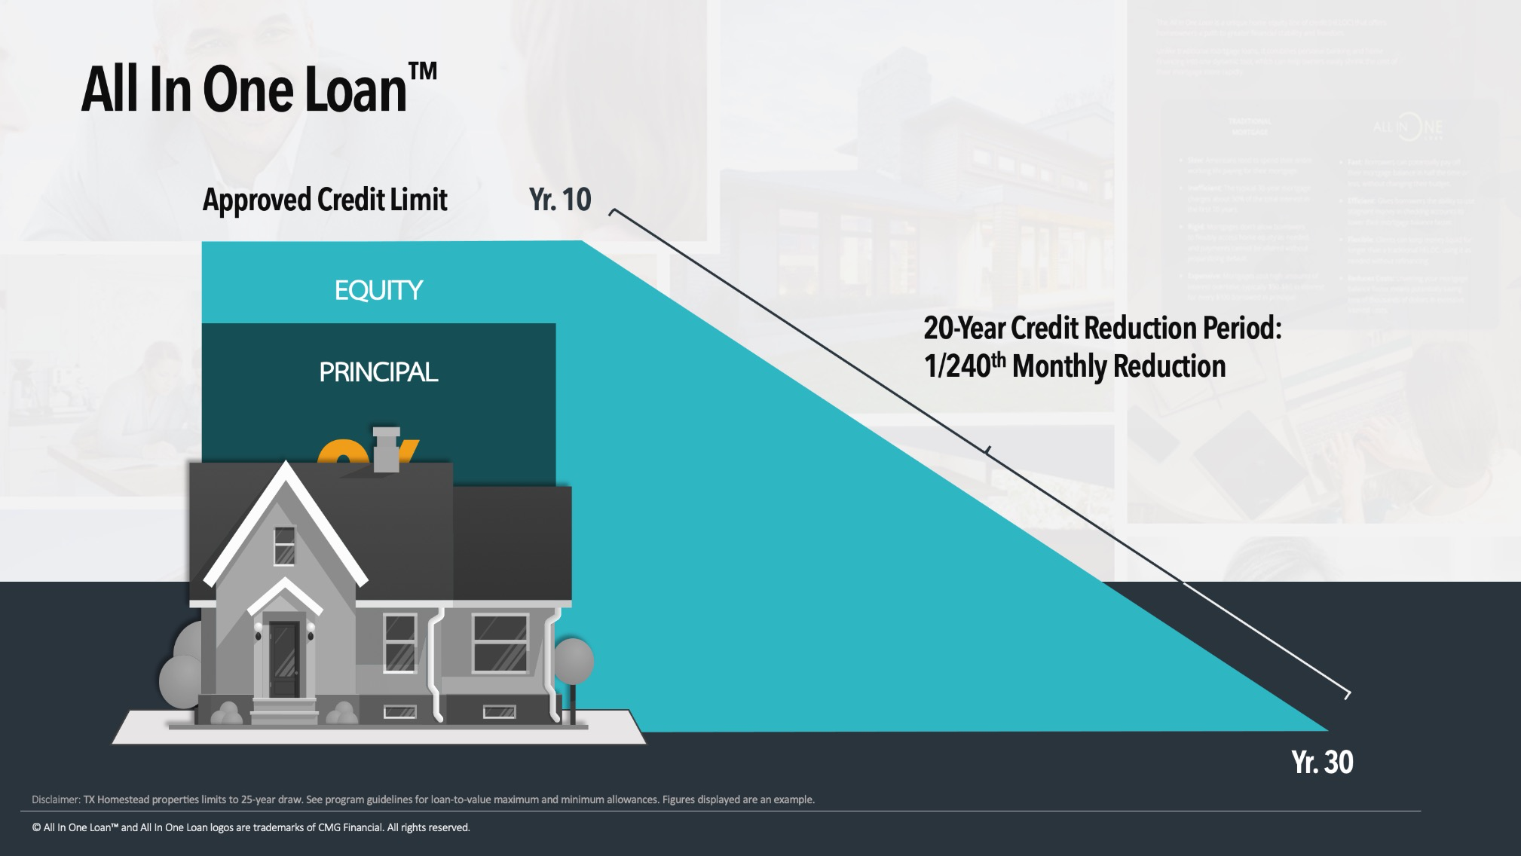

Slide 27
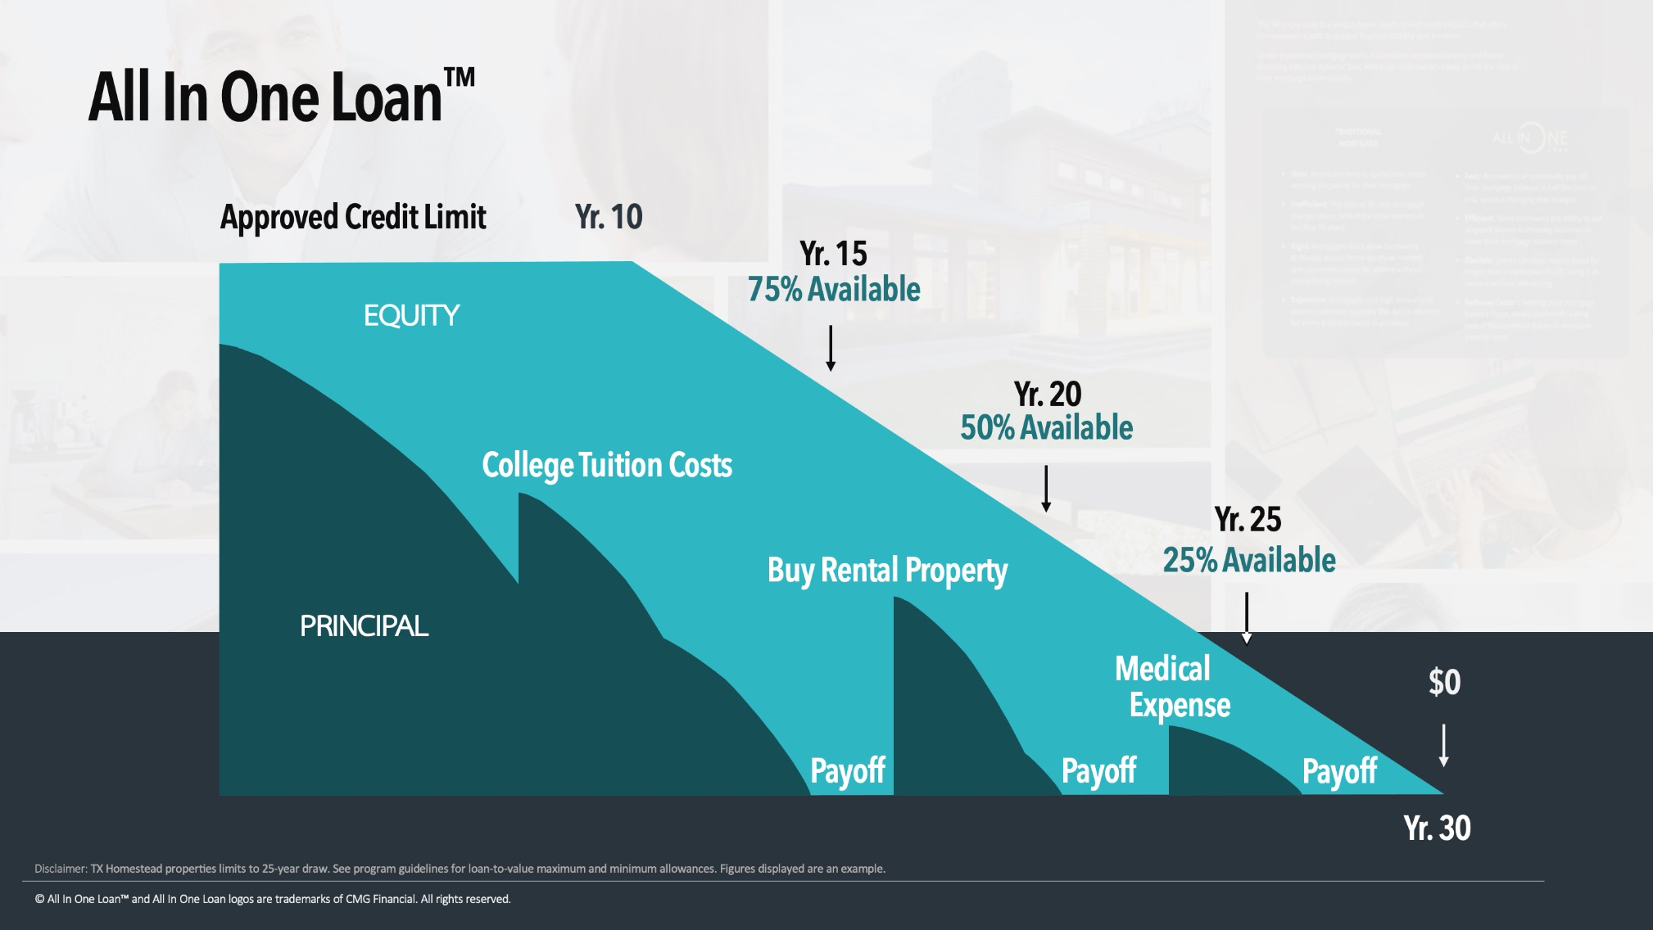

Slide 28
Decreasing Payments: Instead of monthly payments being locked-in at the same amount each month for decades, All In One Loan™ monthly payments lower with principal as the loan is paid-off.
Accelerated Payoff: All In One Loan™ applies more money towards principal first before interest is calculated so customers can paydown their principal 2-4 times faster compared to a traditional mortgage.
Total Interest Savings: All In One Loan™ customers can save tens and even hundreds of thousands of dollars in finance charges (interest) resulting in a significant reduction in a home's total price.
Increased Monthly Cash Flow: Because the All In one Loan™ payments decrease with principal, it also improves household monthly cash-flow.
Access to Equity Money: The All In One Loan™ keeps equity money available for use 24/7 without refinancing, which provides an incentive to apply as much money towards principal as possible with peace of mind and greater capability to capitalize on opportunities.

Slide 29
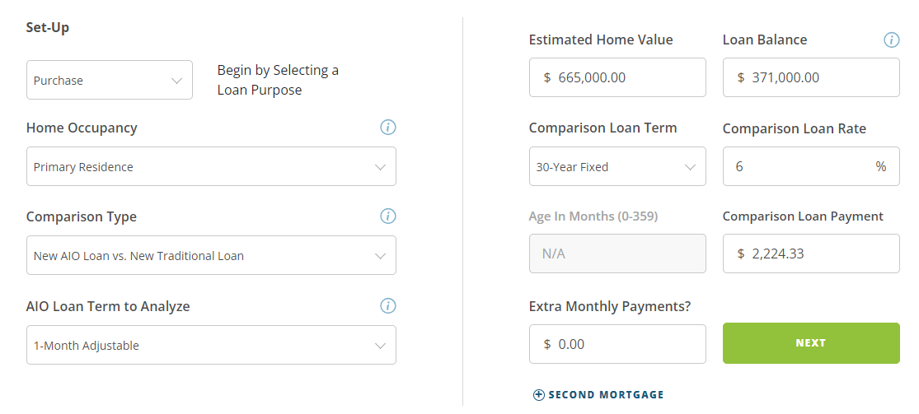

Slide 30
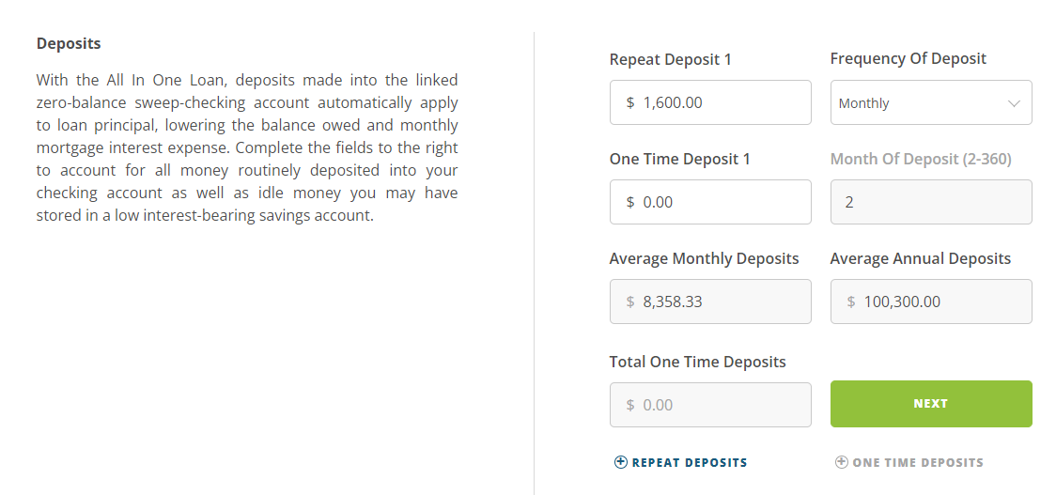

Slide 31
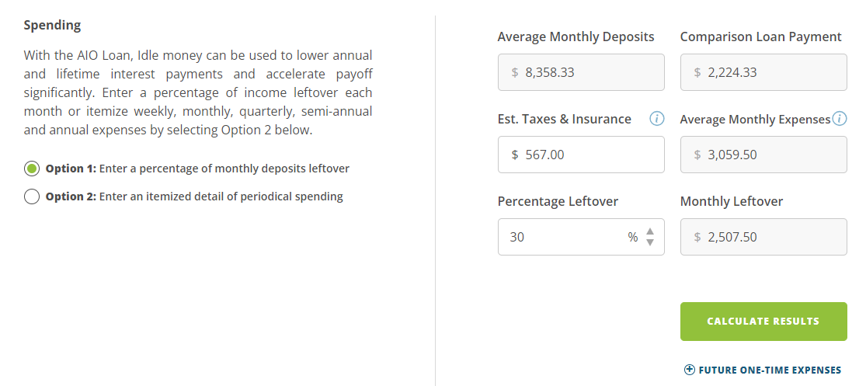

Slide 32
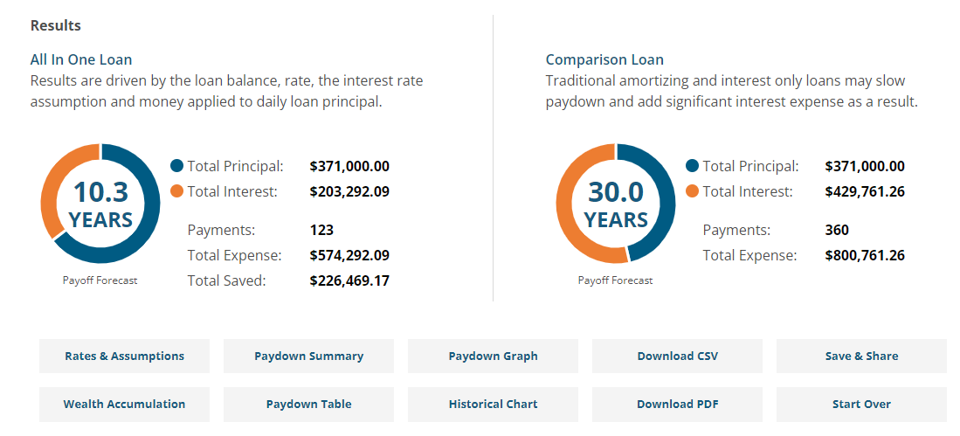

Slide 33
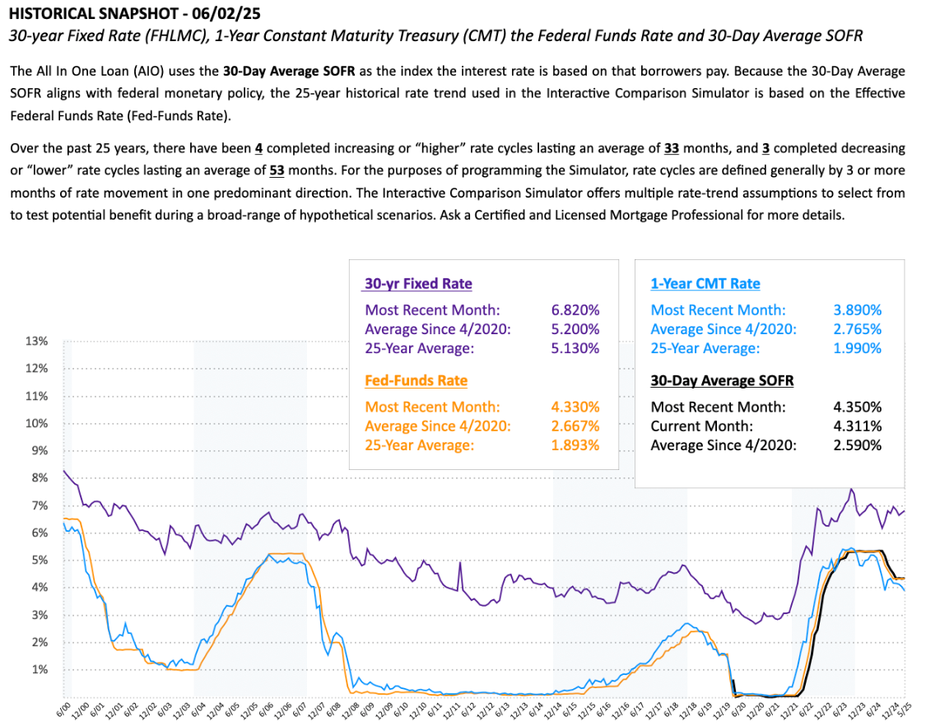

Slide 34
The All in One helps people get what they really want!
Access to Money When Needed
People don’t want another loan to fund big expenses.
The AIO provides 24/7 access to payment and equity dollars without needing to refinance
Less Housing Debt & Interest Expense
Nobody wants to pay more than necessary.
The AIO lowers monthly and annual interest cost with less dependency on interest rates.
Easier Time Developing Wealth
Americans aren’t investing enough for their future.
The AIO grows equity in real estate 200%-400% faster helping borrowers increase their wealth.
Notes:
The all in one is great for borrowers who have positive monthly cash flow, low debt to income ratio, and excellent repayment history.

Slide 35
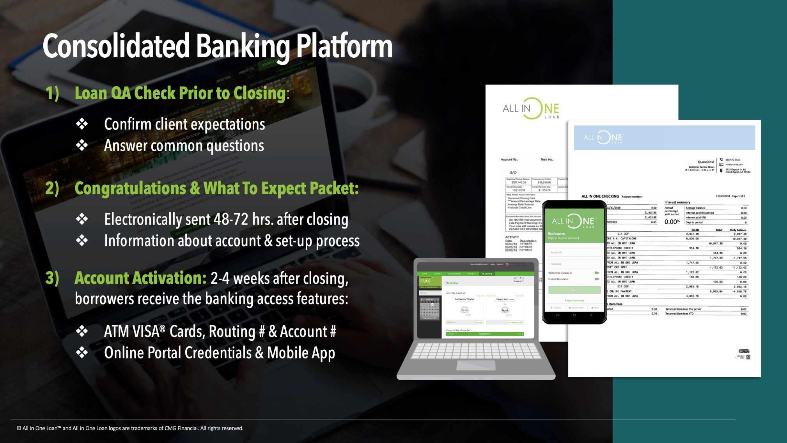
Notes:
It isn’t just a mortgage – it is a financial platform. This is the most dynamic product every offered in the united states.

Slide 36
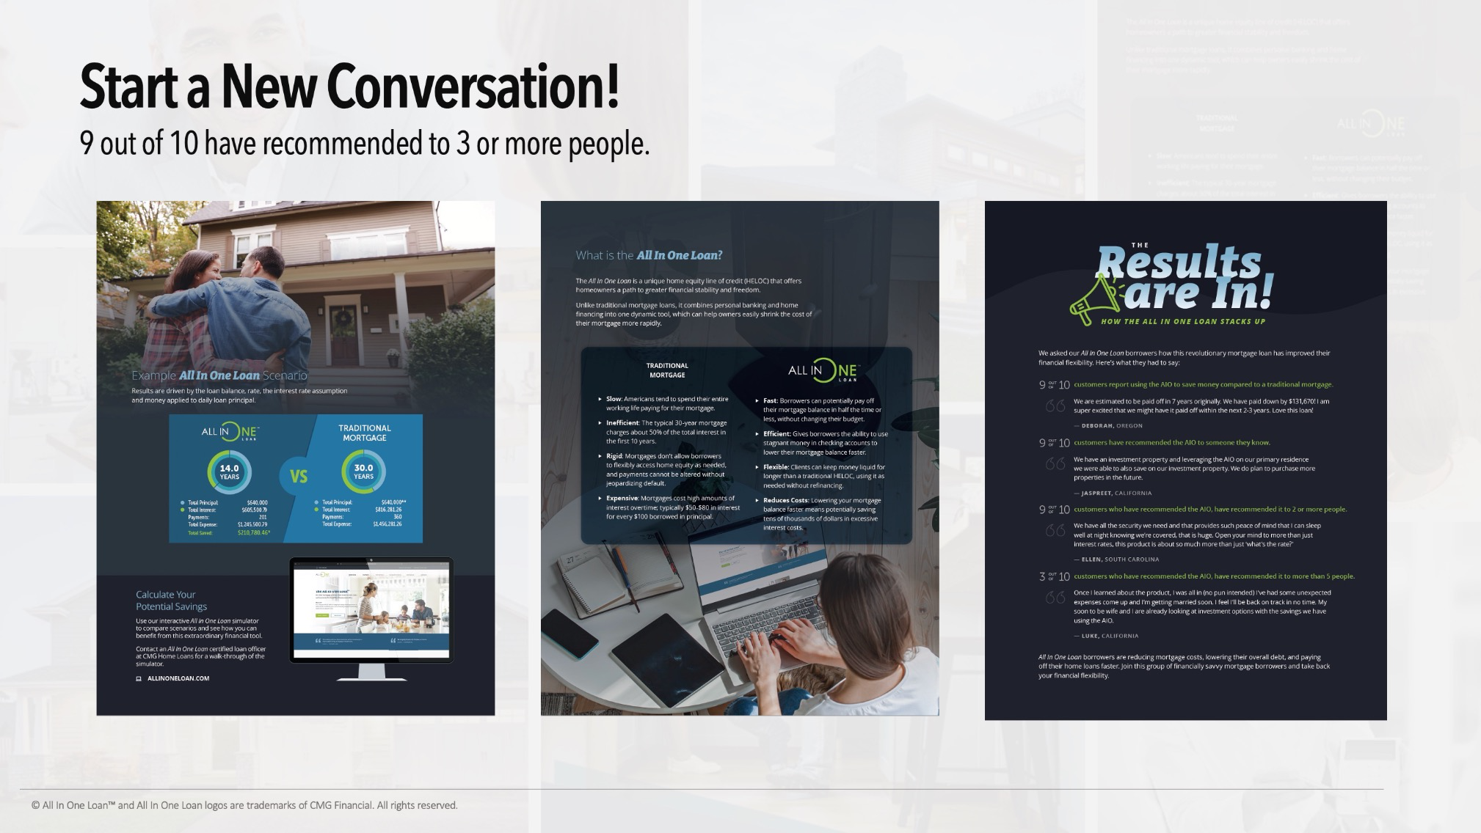

Slide 37


Slide 38


