Slide 1


7 Steps 7 Concepts
Your LOGO
For Advisors
Your Name

Slide 2
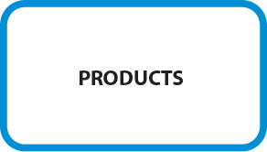
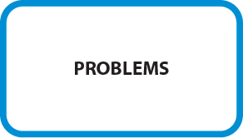
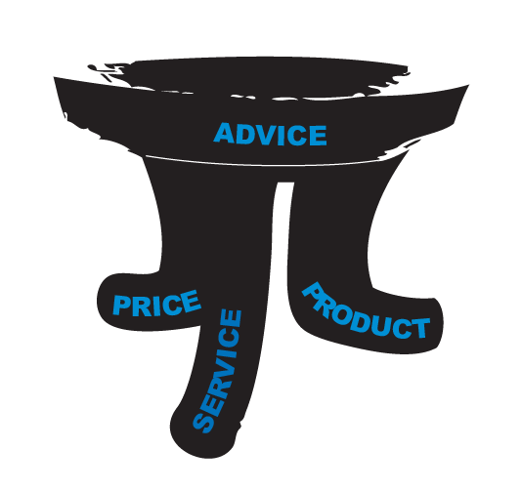
Products – vs – Problems…

Slide 3
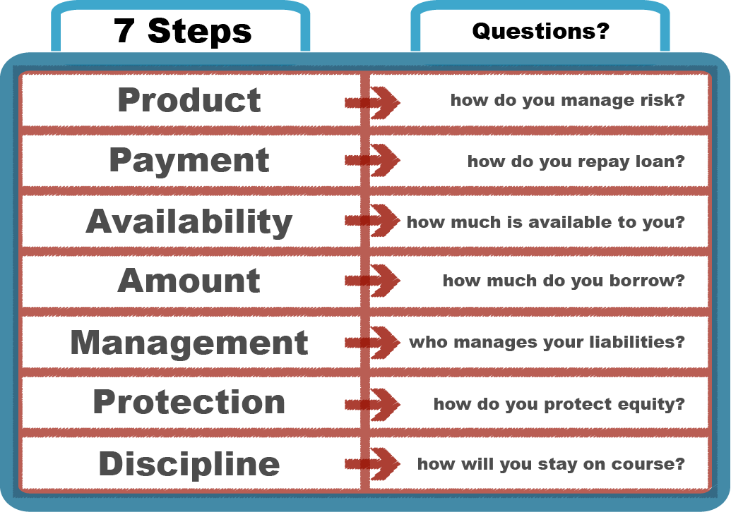
The 7 Steps

Slide 4
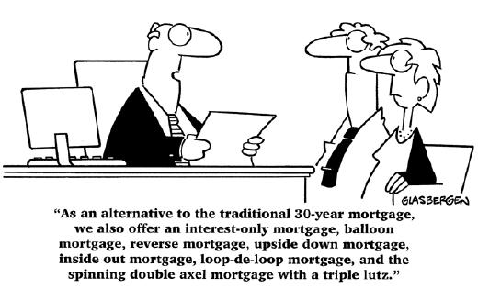
Product

Slide 5
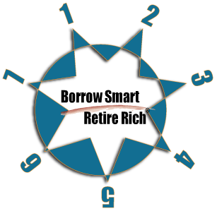
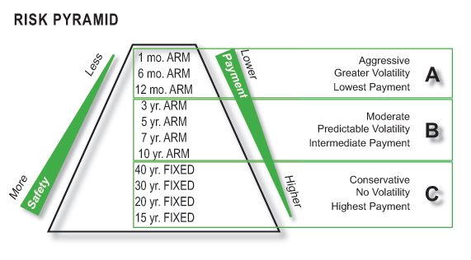
Step 1 - Product
Consider the loan product that best
manages acceptable risk for your client.
Average age of the mortgage
at refinance – <3 years*
Average age of mortgage
at purchase - 7 years**
Percentage of closings
w/ 30 year FRM – 63%***
how will we manage risk?

Slide 6
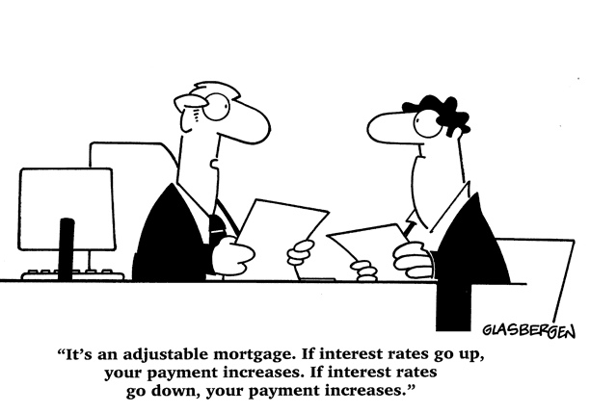
Payment

Slide 7

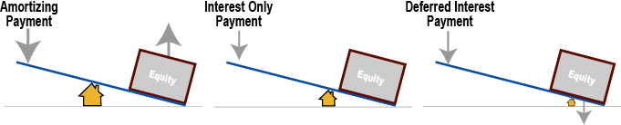
Step 2 – Payment
Consider the best strategy for
your client to ultimately repay the loan.
how will we repay this loan?

Slide 8

Availability

Slide 9
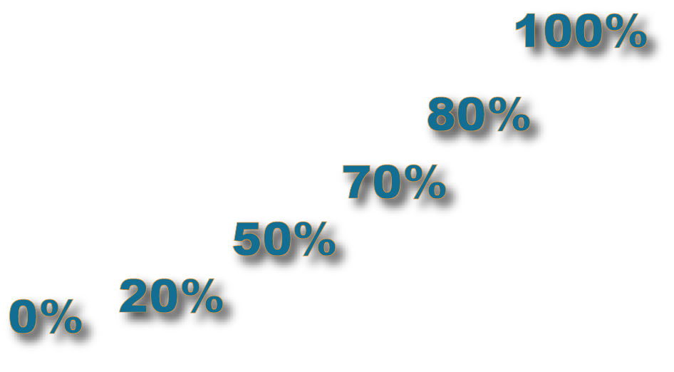
Step 3 - Availability
Consider what portion of the
wealth is currently available to your client.
liquidity – liquidity – liquidity
location – location – location
how much is available to you?

Slide 10
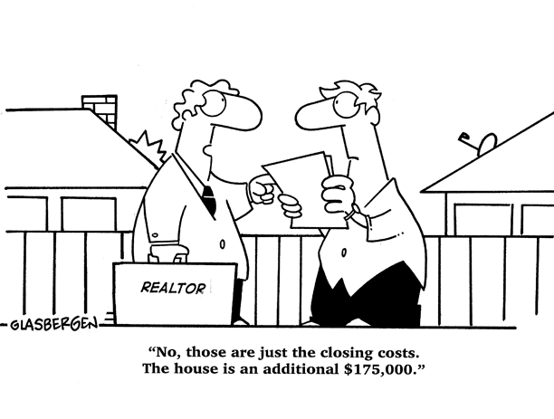
Amount

Slide 11
Step 4 - Amount
Consider how much the client
should borrow based on their situation.
Conservative | Moderate | Aggressive
minimum | + all debts | + cash out
how much do you borrow?

Slide 12
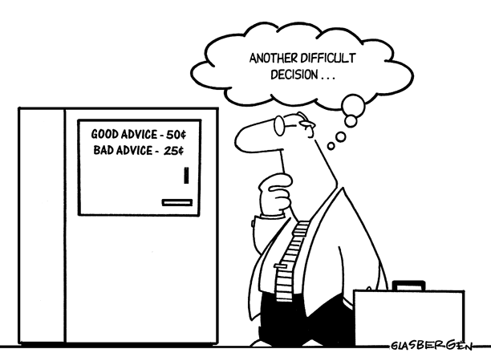
Management

Slide 13

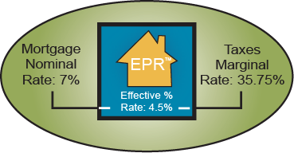
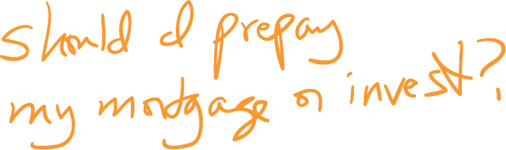

Step 5 - Management
Consider how you will support the
clients over time with their decisions.
who manages your liabilities?

Slide 14

Protection

Slide 15

Step 6 - Protection
Consider that wealth in the house is collateral
to your client only if they have access.
lawsuit
divorce
home
equity
line
foreclosure
disability
job loss
depreciation
how do you protect equity?

Slide 16
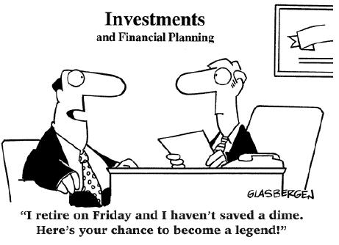
Discipline

Slide 17
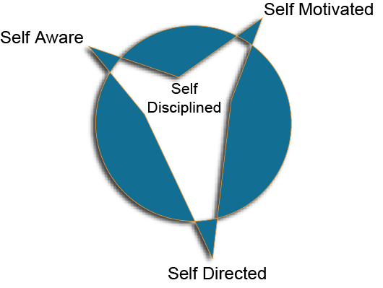
Step 7 - Discipline
Consider your ongoing role.
News – What’s Happening the Market? (newsletters)
Weather – What’s Happening Locally? (emails)
Traffic – What’s Happening with You? (annual review)
how will you stay on course?

Slide 18

7-Steps
Another layer down
The 7 Steps – sub-layers

Slide 19
7 Steps Sub-layers - PRODUCT
Conservative | Moderate | Aggressive
30 yr fixed | 5 - 10 yr fixed | 1-36 mo fixed
Amortizing | Interest Only | Deferred
Character / Capacity / Collateral | Credit
minimum | + all debts | + cash out
self aware > self motivated > self directed
HELOC to maximum available
discipline | < RISK > | market

Slide 20

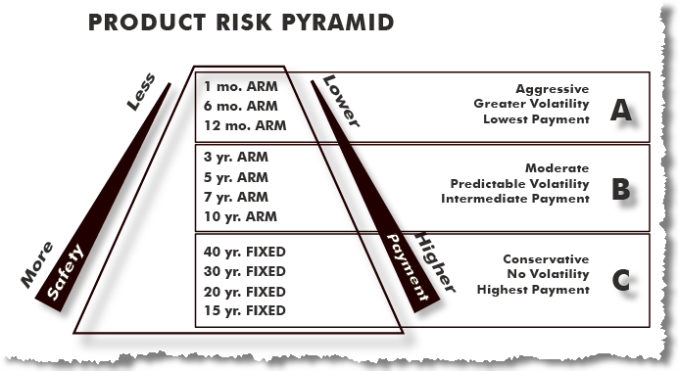
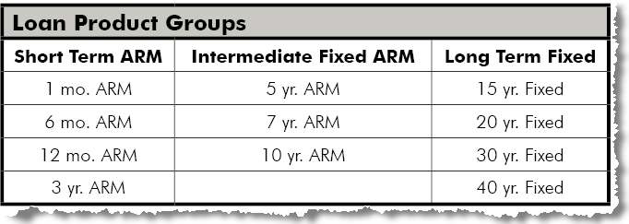
7 Steps Sub-layers - PRODUCT

Slide 21
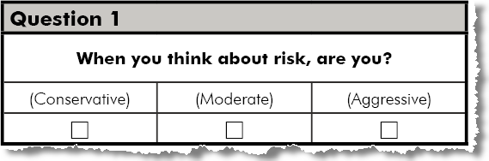
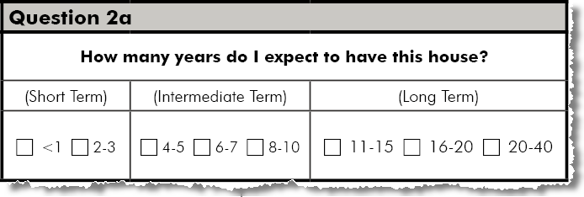
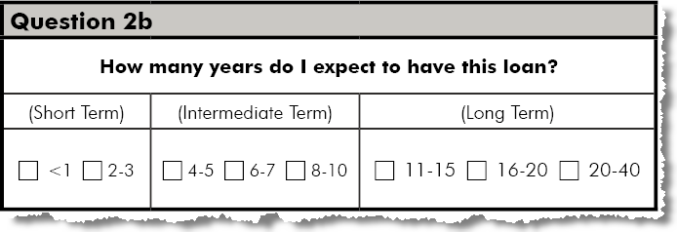
7 Steps Sub-layers - PRODUCT

Slide 22
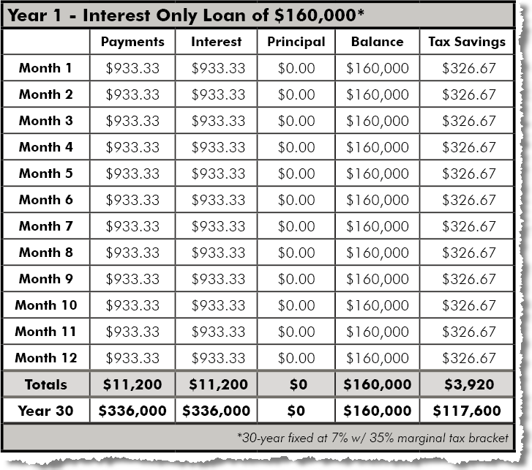
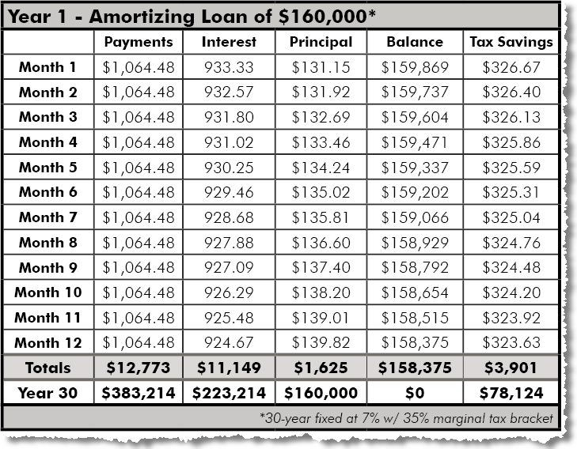
7 Steps Sub-layers - PAYMENT

Slide 23
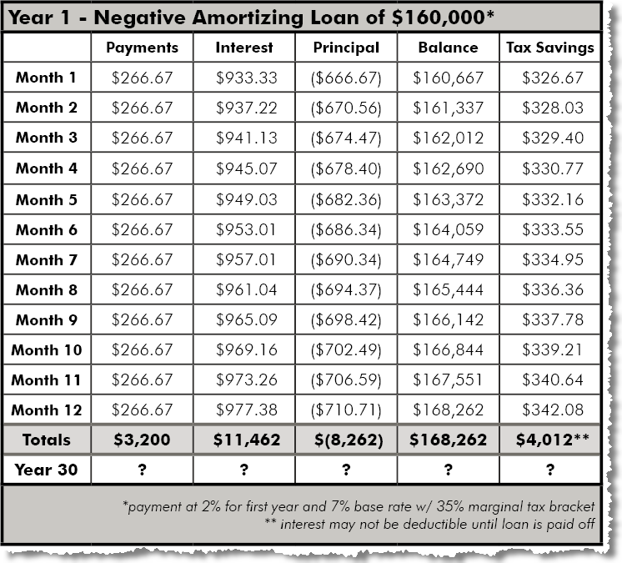
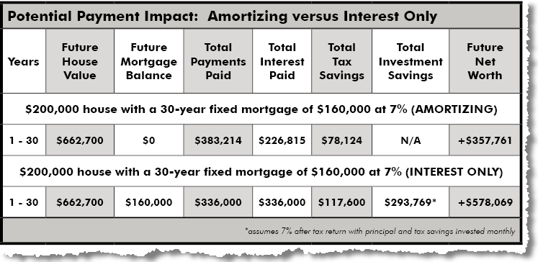
7 Steps Sub-layers - PAYMENT

Slide 24
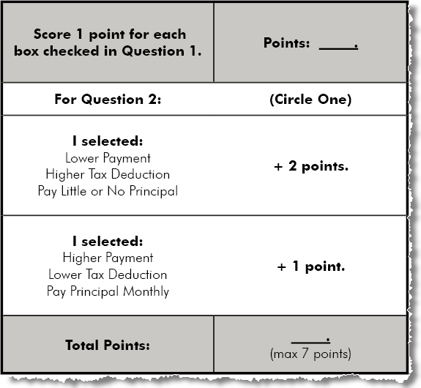
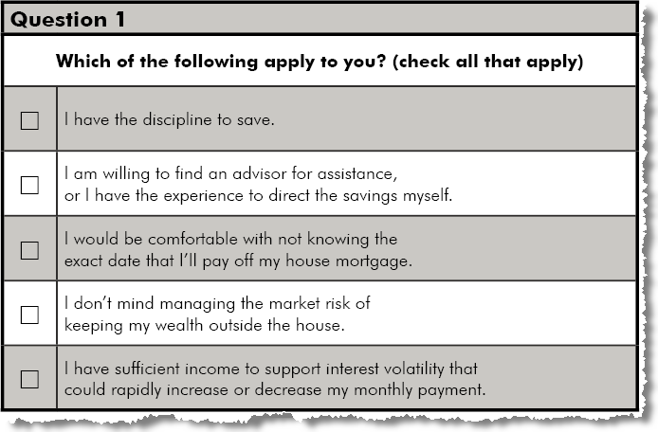
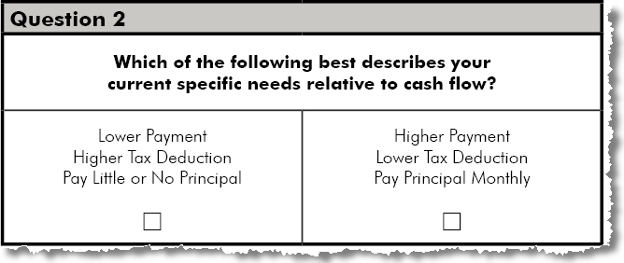
7 Steps Sub-layers - PAYMENT

Slide 25
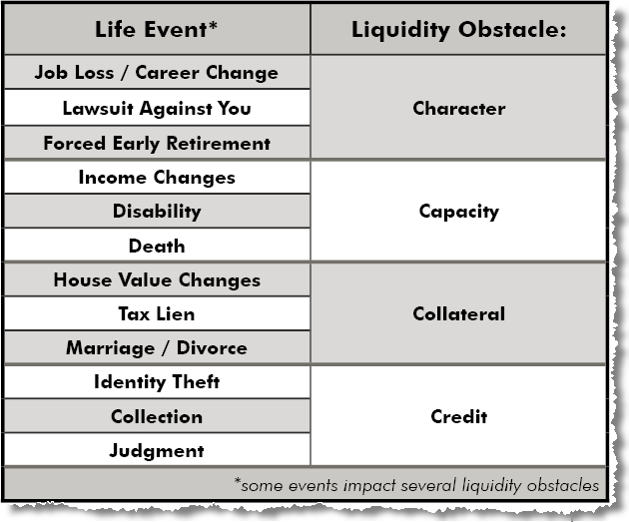
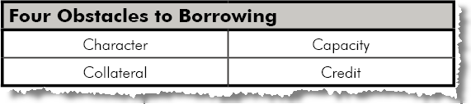
7 Steps Sub-layers - AVAILABILITY

Slide 26
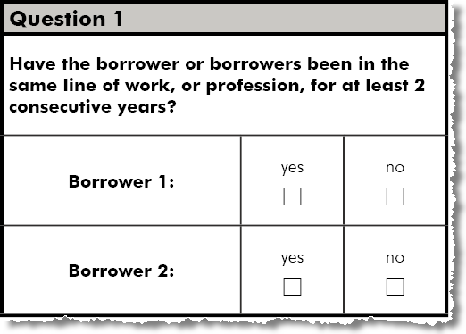
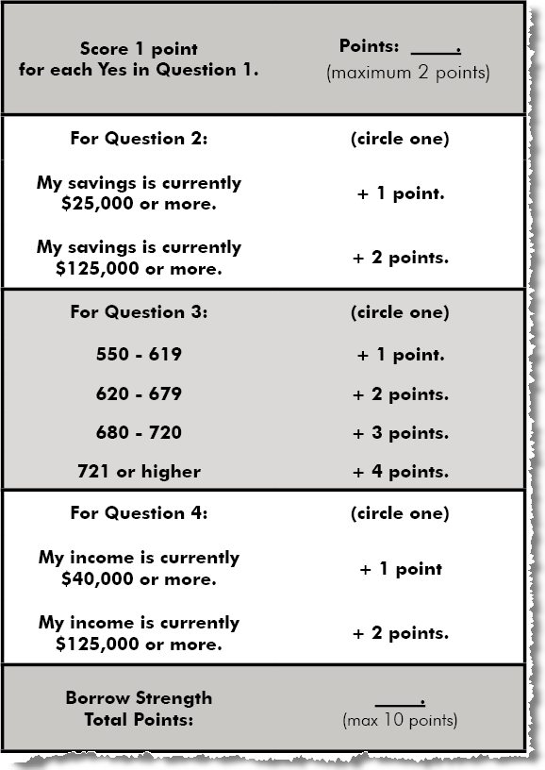
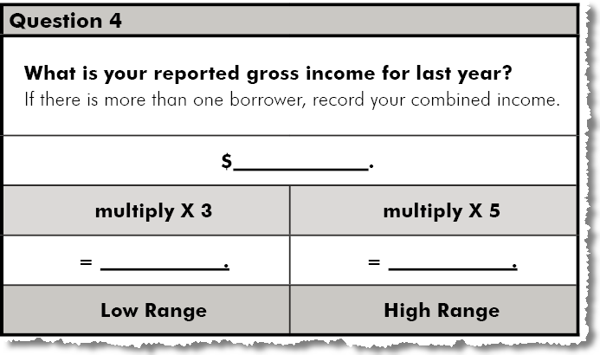
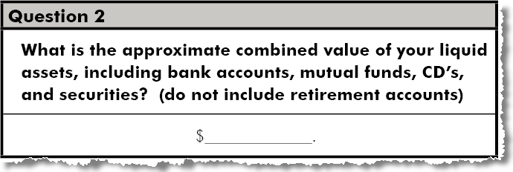
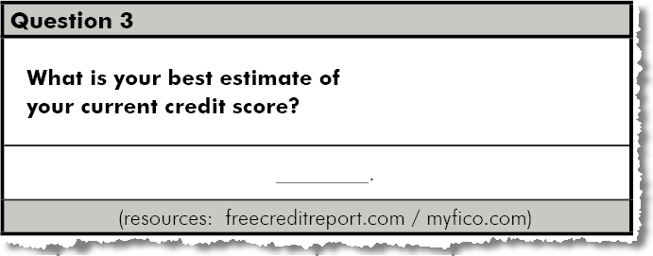
7 Steps Sub-layers - AVAILABILITY

Slide 27
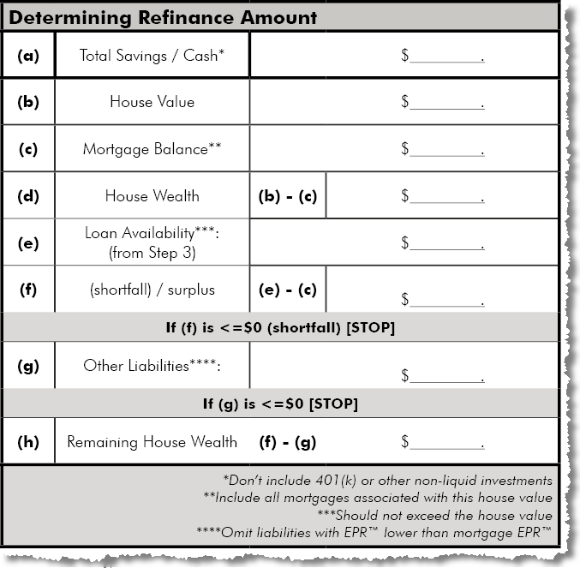
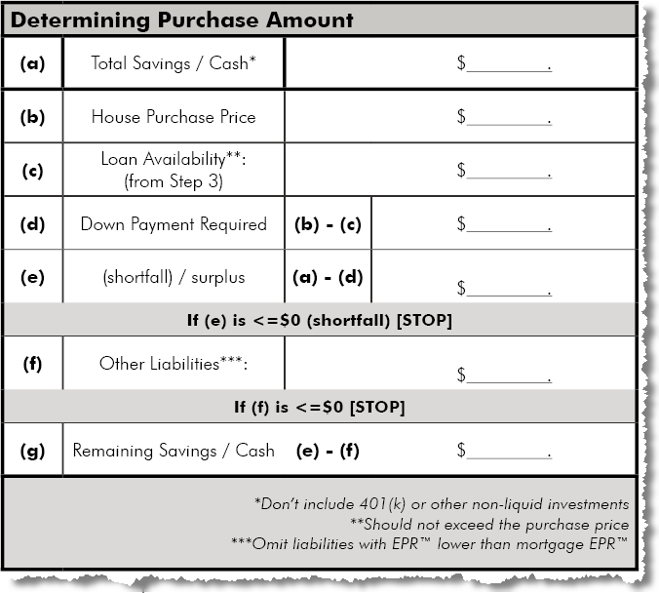
7 Steps Sub-layers - AMOUNT

Slide 28
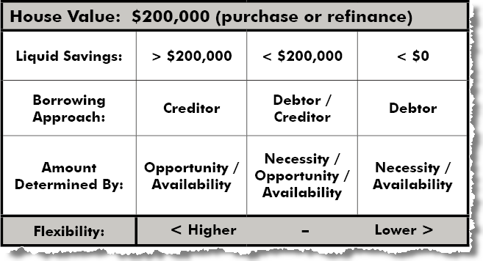
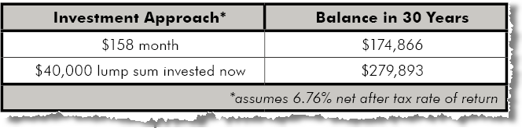
7 Steps Sub-layers - AMOUNT

Slide 29
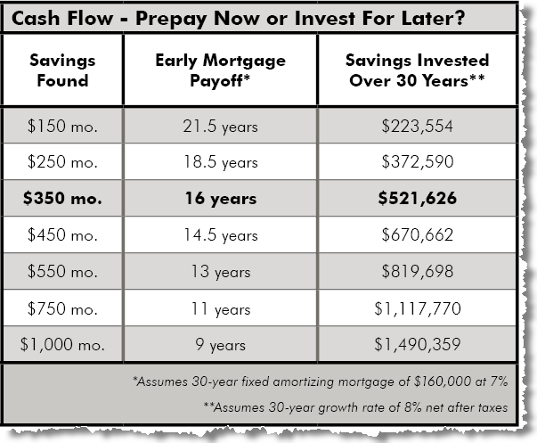
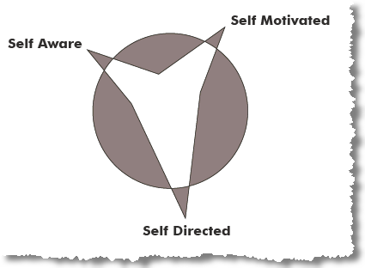
7 Steps Sub-layers - MANAGEMENT

Slide 30
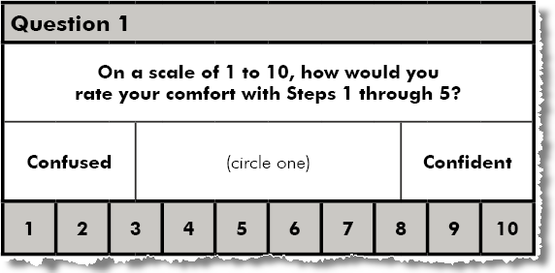
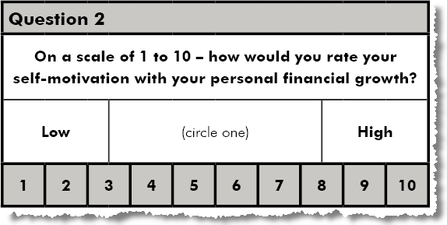
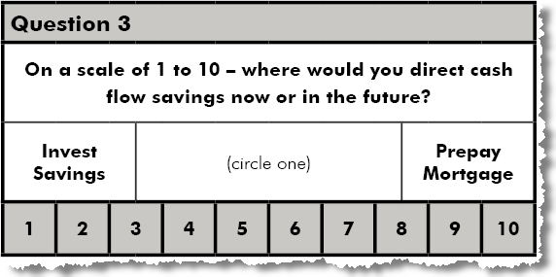
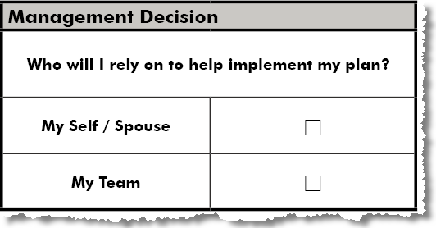
7 Steps Sub-layers - MANAGEMENT

Slide 31
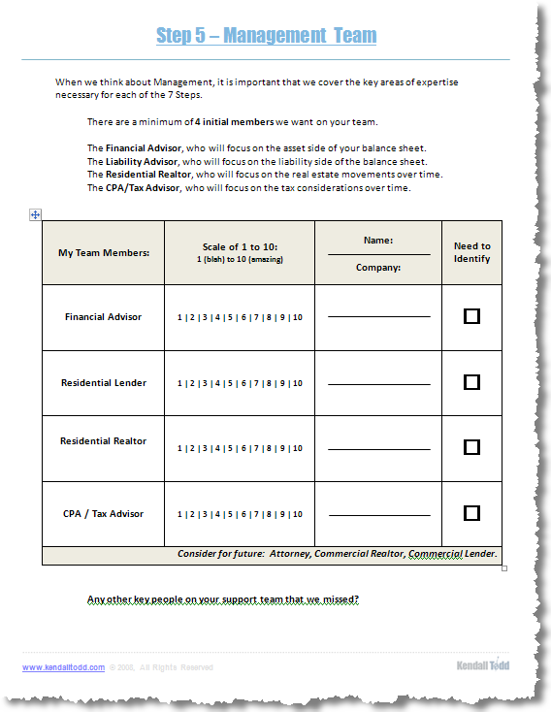
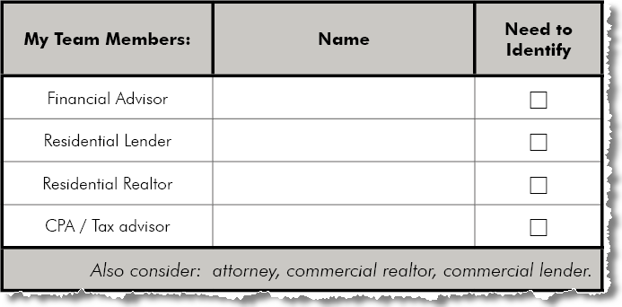
7 Steps Sub-layers - MANAGEMENT

Slide 32
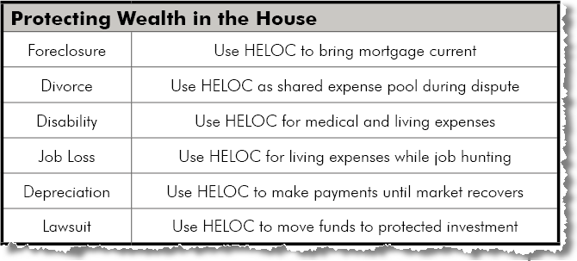
7 Steps Sub-layers - PROTECTION

Slide 33
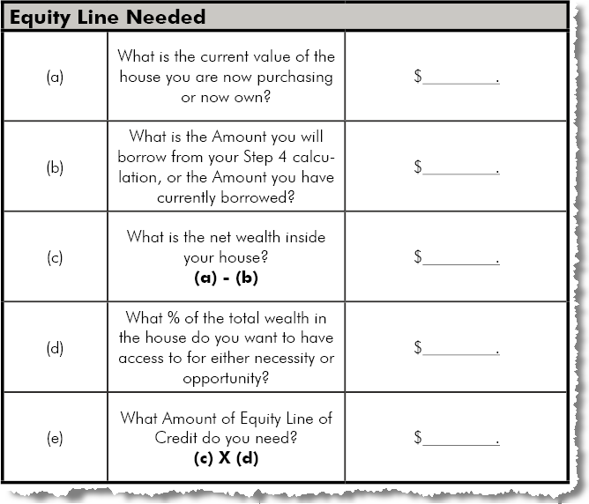
7 Steps Sub-layers - PROTECTION

Slide 34
7 Steps Sub-layers - DISCIPLINE
Discipline
Market Risk
Discipline Risk

Slide 35
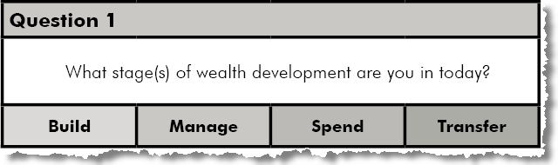


7 Steps Sub-layers - DISCIPLINE

Slide 36
7 Steps Sub-layers - PRODUCT
Conservative | Moderate | Aggressive
30 yr fixed | 5 - 10 yr fixed | 1-36 mo fixed
Amortizing | Interest Only | Deferred
Character / Capacity / Collateral | Credit
minimum | + all debts | + cash out
self aware > self motivated > self directed
HELOC to maximum available
discipline | < RISK > | market

Slide 37
The 7 Steps

Slide 38
Jack and Jackie
Earn $80,000 a year and have company 401(k) matching of 10%, they have 700 credit scores, and have $60,000 from savings to buy their first house, a $200,000 purchase in NC. They have $20,000 in credit card and auto debt that they were paying interest of $166 per month. They expect to fix up this first house and move to a larger one in 5 years when they start a family. They consider themselves moderate risk takers.
7 Steps | Before | After
Product | 30 year fixed | 5 year ARM
Payment | Amortizing | Interest Only
Availability | $200,000 | $200,000
Amount | $140,000 | $160,000
Management | N/A | Yes
Protection | N/A | $40,000 HELOC
Discipline | N/A | Annual Review

Slide 39
Jack and Jackie
7 Steps | After | Impact
Product | 5 year ARM | Reduced Rate .25%
Payment | Interest Only | Reduced Pmt $31 mo
Availability | $200,000 | -
Amount | $160,000 | Reduced Interest $166 mo
Management | Yes | Financial Advisor Engaged
Protection | $40,000 HELOC | Full protection wealth
Discipline | Annual Review | Stay on course
$197 per month for 30 years at 4% growth rate
= $1,082,115 in 401(k).
$2,780,376 at 8%

Slide 40

The 7 Concepts

Slide 41
7 Steps 7 Concepts
Your LOGO
For Advisors
Your Name

